Slide 1
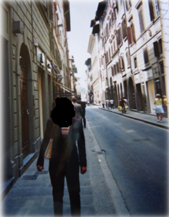
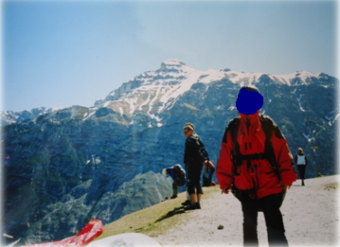
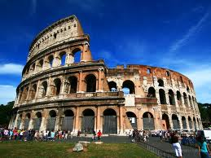
From:
To:
Sent: Mon, June 4th, 2004 11:46:23 PM
Subject: Greetings from Europe
Hi Mom and Dad,
Miss you guys. Studying abroad so far has been amazing! First stop was Rome, and I laid eyes on the Coliseum for the very first time. Wow! The sheer size and age of the monument alone stopped me right in my tracks and I was overcome with emotion. I didn't realize how much of the world I was missing by never having traveled until this point. I feel like a new person, I even got up the courage to hang glide in Austria!
Don’t worry, I’m learning a lot too. International business really excites me! From visiting companies in different countries, such as Gucci in Italy and Audi in Germany, I have gained a sense of how culture influences business decisions. As someone interested in marketing, I think Nestle was probably my favorite company presentation of all. The brand is so strong in the U.S. and so familiar to my childhood that I never suspected it is actually a Swiss company until I visited today. I am certain I want a career that allows me to travel on a regular basis and connect with people all over the world. Next stop Paris, will write again soon!
Love,
My Outlook - A Collection of Past and Future Emails
By:

Slide 2
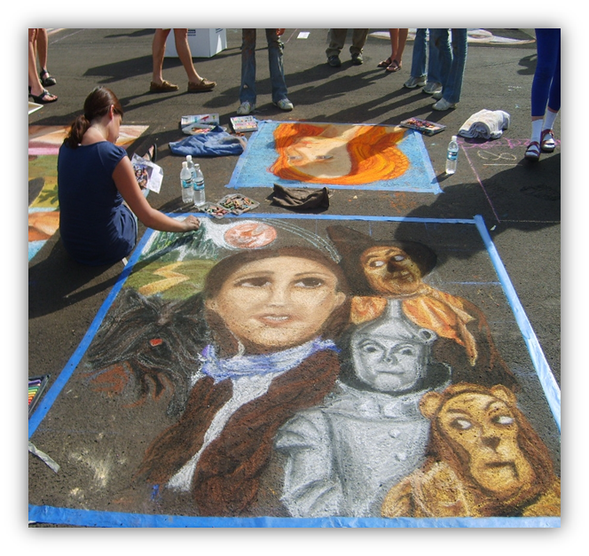
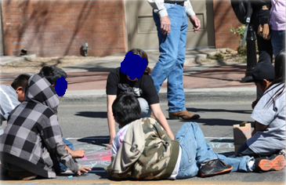
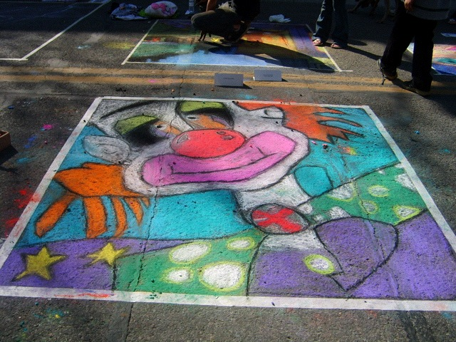
From:
To: >
Sent: Mon, March 8th, 2010 12:31:42 PM
Subject: Via Colori Street Painting Festival
Dear ,
I can’t thank you enough for convincing the xxxx group home to allow the boys to participate in the Via Colori Festival this year. There’s no better feeling than getting to use a personal passion to inspire others and this weekend I got to do just that! Last year’s event was a new and challenging experience for me as I completed my rendition of the Wizard of Oz. I didn’t anticipate the rush I would feel from creating art in front of a live audience. People were actually interested in my work and I was getting to see them enjoy it first-hand. I knew I could not keep this feeling to myself and immediately thought of returning to xxxx
It’s hard to believe the same boys who lacked the attention to finish projects and refused to work together just a few weeks ago, completed the entire mural in front of thousands of people. Seeing them confidently discuss their work with spectators and the amazing final piece they put together, I could tell the project was a huge success. I attached some photos so you can see what a great job they did. Looking forward to next year!
Sincerely,
Via Colori 2008 -
Via Colori 2010 - Glendale, AZ
Via Colori 2010

Slide 3
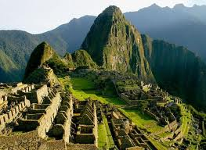
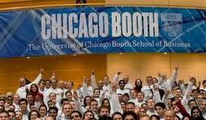
From:
To: joe.smith@ChicagoBooth.edu; jane.doe@ChicagoBooth.edu; bob.brown@ChicagoBooth.edu; jen.jones@ChicagoBooth.edu
Sent: Tues, January 24th, 2012 9:53:28 AM
Subject: Business Plan Competition
Hi All,
I am so excited to be working with you on the business plan competition this quarter. What a great team! Between all of us, we have professional experience in finance, entrepreneurship, design, marketing, advertising, technology, and strategy. Plus, coming from different parts of the world will give us a diverse set of perspectives when discussing ideas. I’m looking forward to learning from all of you and can definitely provide some real-world marketing tactics as we start putting this project together.
Joe, I’m obviously thrilled to team up with you after our Random Walk to Peru last Summer. If we can hike Machu Picchu, I have no doubt we can accomplish almost anything. Can’t wait to get to know the rest of you over the next few months. Let’s set up a time this week for an initial brainstorming session and see what we can come up with!
-

Slide 4
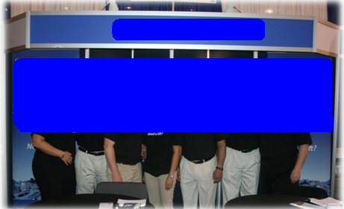

From:
To:
Sent: Wed, May 8, 2013 1:29:41PM
Subject: I Did it!
Hello ,
Hope you and your family are well. I am writing with some pretty exciting news. I just secured my first post-MBA job! You are hearing from Procter & Gamble’s new Associate Product Manager for the Tide brand. I will start in just a few weeks and thanks to the internship I did through Booth last Summer, I feel confident about what to expect and know this is the right position for me.
I want to thank you again for all your support. Your leadership and encouragement has really helped guide me to where I am today. Challenging me to take on new projects at xxxxxx, sincerely giving me your recommendation when I was applying to Booth, and taking a genuine interest in my progress have all given me the confidence to pursue my dreams. I have a feeling this is just the start to a fulfilling professional career and I look forward to mentoring others following in my footsteps the way you have done for me. I will be back in Phoenix next week and would love to get together for coffee. Can’t wait to catch up and tell you all about my new position!
Sincerely,

