Slide 1
GMAT QUANTITATIVE REVIEW

Slide 2
QUANTITATIVE SECTION STRUCTURE
DATA SUFFICIENCY
Yes/No: A Statement in a Yes/No question is SUFFICIENT if it allows us to answer “Yes” or “No” to the prompt with certainty. The same is true when we consider the statements together. DO NOT CONFUSE NO WITH INSUFFICIENCY.
Value: A Statement in a Value question is SUFFICIENT if we can identify exactly one value for the quantity in the prompt. It is INSUFFICIENT if we cannot find exactly one value. For example, if x² = 16, then x could be equal to 4 or -4. Hence, this would be insufficient to find the value of x
On harder questions, if you have determined that one statement is definitely insufficient, the answer is more likely to be C than E
Always re-phrase questions to the most basic form
In general, if you have a whole number constraint on a data sufficiency problem, you should suspect that you can answer the question with very little information. This pattern is not a hard-and-fast rule, but it can guide you in a pinch
UNLESS EXPLICITLY MENTIONED, always test for –
Positive / negative numbers
Even / odd numbers
Integers / fractions
0 , 1 and – 1
10 most important topics in order –
Ratios
Factors and Multiples
Systems of Equations
Rates
Overlapping Sets
Right Triangles
Inequalities
Exponents
Percents and Percent Change
Coordinate Geometry
37 questions – 75 minutes
Data sufficiency
Yes / No
Value
Problem solving
Value
At _ minutes.. | .. Be at question # …
60 | 10 | 15 minutes – 10 questions
40 | 20 | 20 minutes – 10 questions
20 | 30 | 20 minutes – 10 questions
15 | 32 | 5 minutes – 2 questions
0 | 37 | 15 minutes – 5 questions

Slide 3
GMAT STRATEGY/TIPS
DO NOT assume that a number is an integer unless explicitly stated in the problem or if the object of a problem has a physical restriction of being divided (such as votes, cards, pencils etc.)
Example: if p < q and p < r, is pqr < p?
Statement (1): pq < 0
Statement (2): pr < 0
Statement (1) INSUFFICIENT: We learn from this statement that either p or q is negative, but since we know from the question that p < q, p must be negative. To determine whether pqr < p, let's test values for p, q, and r. Our test values must meet only 2 conditions: p must be negative and q must be positive. However, r could be either positive or negative, and hence, the product could be either negative (may or may not be less than p) or positive (greater than p)
Statement (2) INSUFFICIENT: We learn from this statement that either p or r is negative, but since we know from the question that p < r, p must be negative and r must be positive. However, q could be either positive or negative.
If we look at both statements together, we know that p is negative and that both q and r are positive. To determine whether pqr < p, let's test values for p, q, and r. Our test values must meet 3 conditions: p must be negative, q must be positive, and r must be positive. For instance, if p = -2 , q = 10, r = 5; pqr = -100, which is less than p. Taking another example, if p = -2 , q = 7, r = 4; pqr = -56, which is also less than p. Therefore, at first glance, it may appear that we will always get a "YES" answer. But don't forget to test out fractional (decimal) values as well. The problem never specifies that p, q, and r must be integers. If p = -2, q = 0.3 and r = 0.4, pqr = -0.24, which is NOT less than p. Hence, the correct answer is E – Both statements together are insufficient
  GMAT can also hide POSITIVE CONSTRAINTS. Sides of a square, number of votes, etc. will always be positive. When you have a positive constraint, you can:
  Eliminate negative solutions from a quadratic function
  Multiply or divide an inequality by a variable
  Cross-multiply inequalities: x/y < y/x → x² < y²
  Change an inequality sign for reciprocals: x<y; 1/x > 1/y
DO NOT ASSUME THE SIGN OF A VARIABLE
Example: Is T/S > F/G?
(1) T < S
(2) F > G
If one assumes the signs for all four variables to be positive, then T/S (an improper fraction) is NOT greater than F/G (an improper fraction). However, if negative signs are taken into account, we cannot conclusively ascertain whether T/S > F/G

Slide 4
GMAT STRATEGY/TIPS
VERY IMPORTANT !!
STATEMENT | IMPLICATION
xy > 0 | x and y are both positive OR both negative
xy < 0 | x and y have different signs (one positive, one negative)
x² – x < 0 | x² < x, so 0 < x < 1 (i.e., x is a positive fraction)
x² > x | x is negative, or x > 1 (i.e., x cannot be equal to 0 or 1)
a²b³ < 0 | b < 0 (since a² will always be positive). However, it is important to note that we cannot determine the sign of “a” based on this inequality as an even exponent masks the sign of the base
Sum of 2 prime numbers is odd Product of x prime numbers is even | One of the prime numbers has to be 2
x is not a positive number | This means that x can either be negative or zero
x² is a positive number | x could be either positive or negative. The only deduction you can conclusively make is that x is not equal to zero
| x | = x | x is greater than or equal to zero . If |X| = - X, then X has to be either negative or zero because |X| will always be positive
n³ < n² | n³ will be smaller than n² if n is either a negative number or a positive fraction (i.e., between 1 and 0)
Is x > 0? | Is x positive?
(xy)² = xy | (xy)² – xy = 0 ; xy (xy – 1) = 0 ; So xy = 0 or 1 If xy = 0, either x or y (or both) must be zero If xy = 1, x and y are reciprocals of one another, x =1 and y =1 or x = -1 and y = -1
x² > y x < y² | Does not necessarily imply that x > y or x < y Be very careful when dealing with exponents, particularly even ones, as they mask the sign of the base which could be negative

Slide 5
GMAT STRATEGY/TIPS
VERY IMPORTANT !!
STATEMENT | IMPLICATION
a and b are integers, and a ≠ b, is |a|b > 0, given that |a|^{b} is a non-zero integer? | For |a|b > 0, a must be non-zero and b must be positive (since |a| will always be positive) If |a|^{b} is a non-zero integer, obviously |a| is not zero , as 0 raised to any exponent is 0. Therefore, the first condition is satisfied. Given that a is non-zero, |a| must be positive integer. At first glance, it seems that b must be positive because a positive integer raised to a negative integer is typically fractional (e.g., a⁻² = 1/a²). Hence, it appears that b cannot be negative. However, there is a special case where this is not so: If |a| = 1, then b could be anything (positive, negative, or zero) since |1|^{b} is always equal to 1, which is a non-zero integer . In addition, there is also the possibility that b = 0. If |b| = 0, then |a|⁰ is always 1, which is a non-zero integer. Hence, based on the statement provided, we cannot determine whether b is positive
SQUARING NUMBERS | Negative numbers and numbers greater than 1 get larger 0 and 1 stay the same Numbers between 0 and 1 get smaller
CUBING NUMBERS | Numbers between -1 and 0 and numbers greater than 1 get larger 1, 0 and -1 stay the same Numbers less than -1 and numbers between 0 and 1 get smaller
Quadratic equations | x² - y² = (x + y)(x – y) x² + 2xy + y² = (x + y)(x + y) = (x + y)² x² – 2xy + y² = (x - y)(x - y) = (x - y)² a³ + b³ = (a + b)(a² – ab + b²) a³ – b³ = (a – b)(a² + ab + b²) (a-b)³ = a³ - 3a²b + 3ab² -b³ (a + b)³ = a³ + 3a²b + 3ab² + b³
Grows by K | This means literally adding k to the original number. If the original number is x, the result is x+k
Grows by k times | This means the new number is the old number plus k times the number. If the original number is x, the result is x + kx = x (1+k)
Grows to k times | This means the new number is simply k times the old number. If the original number is x, the result is kx
Grows by k% | In this case, we simply add k% of the number to itself. If the original number is x, the result is x(1 + k/100)

Slide 6
GMAT STRATEGY/TIPS
VERY IMPORTANT !!
STATEMENT | IMPLICATION
The distance between p and m is the same as the distance between p and n | | p - m | = | p – n |

Slide 7
GMAT STRATEGY/TIPS
64 is the only number (besides 1) under 100 that is the square of an integer and the cube of an integer
16 and 81 are the only numbers (again, besides 1) that are both the square of an integer and the square of a square
30 and 42 are the smallest integers with at least three prime factors
The only integers with exactly three factors are the squares of prime numbers
When odd number n is doubled, 2n has twice as many factors as n
When even number is doubled, 2n has 1.5 more factors as n
All prime numbers above 3 are of the form 6n – 1 or 6n + 1 , because all other numbers are divisible by 2 or 3
X^{n} – y^{n} is always divisible by x – y and is divisible by x + y if n is even
Generally the last digit of 1! + 2! … + N! can take ONLY 3 values:
A. N=1 --> last digit 1;
B. N=3 --> last digit 9;
C. N=any other value --> last digit 3 (N=2 --> 1!+2!=3 and for N=4 --> 1!+2!+3!+4!=33, the terms after N=4 will end by 0 thus not affect last digit and it'll remain 3).
Finding the number of powers of a prime number P in n!
  n/p + n/p² + n/p³ …. Till p^{x} < n
  For example, what is the power of 2 in 25!?
    25/2 + 25/4 + 25/8 + 25/16 → 12+ 6 + 3 + 1 → 22
Finding the power of non-prime in n!
  For example, how many powers of 900 are in 50!?
    Step 1: Determine the prime factorization the number: PF of 900 is 2²*3²*5²
    Step 2: Find the powers of these prime numbers in n! (refer above)
      Power of 2 = 47, power of 3 = 22 and power of 5 = 12
    Step 3: We need all the prime {2,3,5} to be represented twice in 900, 5 can provide us with only 6 pairs, thus there is 900 in the power of 6 in 50!

Slide 8
OVERLAPPING SETS

Slide 9
2 OVERLAPPING SETS – VENN DIAGRAMS
a
b
Only in group A = a
Only in group B = b
Both in group A & B = X
Neither = N
X
Formula: Total – Neither = A + B – X
Formula for elements who are AT LEAST one of the two groups: A + B – X
Formula for elements who are in ONLY one of the two groups: A + B – 2X
Question | Solution
In an office having a certain number of employees, 20 like coffee, 30 like tea, 5 like neither of the two and 10 like both the beverages | The number of employees who likes at least one: (20+30 – 10) = 40 The number of employees who likes only one: (20+30 – 20) = 30 The total staff in the office, if there are no other persons than those given in the question above: At least one (40) + None (5) = 45
If the drama club and music club are combined, what percentage of the combined membership will be male? Of the 16 members of the drama club, 15 are male (2) Of the 15 members of the music club, 10 are male | BOTH STATEMENTS TOGETHER ARE INSUFFICIENT since we don’t know how many members of the drama club were also members of the music club. We cannot assume that there was no overlap

Slide 10
DOUBLE SET MATRIX – 2 MUTUALLY EXCLUSIVE OPTIONS FOR A DECISION
For GMAT problems involving only two categorizations or decisions, the most efficient tool is the Double Set Matrix: a table whose rows correspond to the options for one decision and whose columns correspond to the options for the other decision.
The rows should correspond to the mutually exclusive options for one decision. Likewise, the columns should correspond to the mutually exclusive options for the other. For instance, if a problem deals with students getting either right or wrong answers on problems 1 and 2, the columns should not be "problem 1" and "problem 2," and the rows should not be "right" and "wrong." Instead, the columns should list options for one decision-problem 1 correct, problem 1 incorrect, total-and the rows should list options for the other decision-problem 2 correct, problem 2 incorrect, total
Example # 1: Of 30 integers, 15 are in set A, 22 are in set B, and 8 are in both set A and B. How many of the integers are in NEITHER set A nor set B?
 | A | NOT A | TOTAL
B | 8 | 14 | 22
NOT B | 7 | 1 | 8
TOTAL | 15 | 15 | 30
Example # 2: 50% of the apartments in a certain building have windows and hardwood floors. 25% of the apartments without windows have hardwood floors. If 40% of the apartments do not have hardwood floors, what percentage of the apartments with windows have hardwood floors?
 | Hardwood Floors | No Hardwood Floors | TOTAL
Windows | 50
No Windows | 0.25x |  | x
TOTAL | 60 | 40 | 100 (assumed)
50 + 0.25x = 60 0.25x = 10 x = 40 Therefore, total number of apartments with windows is 60, and the percentage of apartments with windows that have hardwood floors = (50/60)*100 = 83.33%
Example # 3: In a group of 80 college students, how many own a car? Of the students who do not own a car, 14 are male Of the students who own a car, 42% are female
 | Male | Female | TOTAL
Own a car |  | 0.42x | x
Do not own a car | 14
TOTAL |  |  | 80
Of the students who own a car, 42% are female --> let # of students who own a car be x. Therefore 0.42x = # of females who own a car. But 0.42x must be an integer, as it represent # of females. Therefore, 21x/50 must be an integer, which is only possible if x is a multiple of 50. Since the total # of students who own car must also be less than (or equal to) 80. x = 50

Slide 11
3 OVERLAPPING SETS
Formula: Total – Neither = A + B + C – (a+b+c+2x)
Formula for elements who are AT LEAST one of the three groups: A + B + C – (a + b + c + 2x)
It is important to note that “a” represents elements that belong ONLY to A and C (not B)
Total = A + B + C – (a+ x + b + x + c + x) + x
Formula for elements in any two of the groups: a+ b + c
Note: Work from the inside out
Only A = A – a – b – x
Only B = B – b – c – x
Only C = C – a – c – x
Only A
Only C
Only B
b
a
x
c
Problem | Solution
In a class of 100 students who play any of the three games, 35 play football, 45 play volley ball and 50 play baseball. If 10 play all three games, then how many play only two games | Total – Neither = A + B + C – (a+b+c+2x) 100 – 0 = 35 + 45 + 50 – ( a + b + c) – 2(10) 100 = 110 – (a + b + c) Therefore, number of students who play only two games is 10
A social club has 200 members. Everyone in the club who speaks German also speaks English. 70 members only speak Spanish. If no one speaks all 3 languages, how many speak 2 out of 3 languages? 1) 60 only speak English 2) 20 don't speak any of the 3 languages | Statement 1: From the prompt, we know that there are no members who speak only German, and there are no members who speak all 3 languages. Therefore, the number of members who speak 2 out the 3 languages will be: 200 – members who speak none of the languages = only English + only Spanish – 2 of 3 languages. However, we don’t have any information about the number of members who don’t speak any language. Hence, INSUFFICIENT Statement 2: INSUFFICIENT because we do not know the members who speak only English Statement 1 and 2 TOGETHER are SUFFICIENT

Slide 12
3 OVERLAPPING SETS
Problem | Solution
Workers are grouped by their areas of expertise, and are placed on at least one team. 20 are on the marketing team, 30 are on the Sales team, and 40 are on the Vision team. 5 workers are on both the Marketing and Sales teams, 6 workers are on both the Sales and Vision teams, 9 workers are on both the Marketing and Vision teams, and 4 workers are on all three teams. How many workers are there in total? | Workers are placed on at least one team – this implies that number of workers on none of the teams = 0 Marketing = 20 Sales = 30 Vision = 40 Marketing + Sales = 5 – this could include people who are part of the vision team as well. We cannot assume that 5 members exclusively belong to the marketing and sales team Sales + Vision = 6 Marketing + Vision = 9 All three = 4 Exclusively on Marketing + Sales = 1 Exclusively on Sales + Vision = 2 Exclusively on Marketing + Vision = 5 Therefore, total = 20 + 30 + 40 – (1+2+5 + 4*2) Total = 74 Alternatively, total = 20 + 30 + 40 – (6+9+4) + 4

Slide 13
STATISTICS

Slide 14
MEAN – THE AVERAGE
MEAN = MEDIAN in a set of consecutive integers
If each one of the given numbers is increased (or decreased) by K, their average is increased (or decreased) by k
If each one of some given numbers is multiplied by K, their average is multiplied by K
The sum of first “n” natural numbers is given by n (n + 1)/2
If the average of a few consecutive integers is 0, then either all the numbers are zero or there will be an odd number of integers
DETERMINING THE MEAN
Mean = Sum of terms/ number of terms
CHANGE IN MEAN
Change in mean = New term – Old mean/ New number of terms
RESIDUALS
Residuals = Data point – Mean
For an evenly spaced set (i.e., series where the difference between any two consecutive numbers is the same – 3, 6, 9), or a set of consecutive integers
Mean = (first term + last term) / 2
Mean = middle term (if the number of terms in the set is even, then the mean is the average of the middle two terms)
IMPORTANT: The mean of a set of consecutive integers will be an INTEGER only if the number of elements in the set is ODD or if the difference between/sum of the “consecutive” terms is divisible by 2. For example, in the case of 2,4,6 and 8, the average is 5
If a set currently has 9 terms and a mean value of 56, and you add a tenth term of 71, then the mean will increase by (71 - 56)/10 = 1.5
You can interpret this formula conceptually as taking the "excess" or "deficit" in the new term relative to the mean and redistributing that excess (or deficit) evenly to all of the terms in the set, including that new term. For instance, in the example above, the new term (71) exceeds the average by 71 - 56 = 15. When you add the new term to the set, those 15 "extra points" are distributed evenly among all ten data points, increasing each by 1.5
For any set, the residuals sum to zero. Alternatively, the positive residuals ("overs") and negative residuals ("unders") for any set will cancel out
If the mean of the set {97, 100, 85, 90, 94, 80, 92, x} is 91, what is the value of x?
You could certainly solve this problem with the traditional formula for averages, but you would waste a lot of time on arithmetic. Instead, just use the given mean of 91 to compute the residuals for all the terms except x: +6, +9, -6, -1, +3, -11, + 1. These residuals sum to +1.Therefore, x must leave a residual of -1, since all the residuals sum to zero. As a result, x is one less than the mean, or 90

Slide 15
MEDIAN – THE MIDDLE TERM
DETERMINING THE MEDIAN
VALUE OF THE MEDIAN
ADVANCED PROPERTIES OF MEDIANS
To find the median, list the numbers in ascending or descending order, and find the middle term
When number of terms N is large, then the following two formulae are useful for finding the middle term:
  When N is odd, the middle term is (N+1)/2th term
  When N is even, the median will be the average of the middle two terms, i.e., average of the (N/2)^{th} term and the (N/2)^{th} + 1 term
When the number of items in a set of integers is odd, the median is an integer
When the number of terms in a set of integers is even, the median can only end with 0.5 as it is the average of the middle two terms. However, it is important to note that the median does not ALWAYS end in 0.5 when the number of terms in the set is even. For example, the median for 2,4,6,8,10,12 is 7
Median of combined set will always lie between the two medians or could be equal to one or both the medians of the two sets
For example: a,b,c are integers and a<b<c. S is the set of all integers from a to b, inclusive. Q is the set of all integers from b to c, inclusive. The median of set S is (3/4)*b. The median of set Q is (7/8)*c. If R is the set of all integers from a to c, inclusive, what fraction of c is the median of set R?
Since we the sets contain consecutive integers, the median = (largest + smallest term)/2
Therefore, equate (a+b)/2 to (3/4)*b for Set S and (b+c)/2 to (7/8)*c for Set Q. Similarly, equate (a+c)/2
MEAN = MEDIAN in a set of consecutive integers. However, just because the mean and the median are equal does not mean that the set comprises of evenly spaced/consecutive integers
Ultimately, if your mean and median are the same, what it tells you is that your data is arranged symmetrically around the median. For every bit over the mean on one side, there's a corresponding bit under the mean on the other side, balancing it out. When they're different, that tells you that this symmetry has been broken

Slide 16
WEIGHTED AVERAGE
(weight1*data point 1) + (weight2*data point 2) (weight 1 + weight 2)
SUM OF THE WEIGHTS
ADVANCED PROPERTIES
DATA SUFFICIENCY QUESTIONS
The sum of the weights must equal to 1. However, if the sum of the weights does not equal 1, we need to divide by the sum of the weights. If the "weights" are fractions or percentages, then the denominator of the weighted-average expression (sum of weights) will already be 1
Example:
If we put a weight of 2 on 20 and a weight of 3 on 30, we have to divide by 5 to get weights that sum to 1, as shown below:
[2(20) + 3(30)]/ 5 = (2/5)*20 + (3/5)* 30
Average = 26
A weighted average of only two values will fall closer to whichever value is weighted more heavily
For instance, if a drink is made by mixing 2 shots of a liquor containing 15% alcohol with 3 shots of a liquor containing 20% alcohol, then the alcohol content of the mixed drink will be closer to 20% than to 15%
The ratio that determines how to weight the averages of two or more subgroups in a weighted average ALSO REFLECTS the ratio of the distances from the weighted average to each subgroup’s average
If the average weight of the entire group was twice as close to the average weight of the men as it was to the average weight of the women, there must be twice as many men as women
In case two groups have an equal number of elements, then the weighted average of the two groups combined will be the average of the individual averages of the two groups
Importantly for Data Sufficiency problems-you do not necessarily need concrete values for the weights in a weighted-average problem. Having just the ratios of the weights will allow you to find a weighted average. Simply write the ratio as a fraction, and use the numerator and the denominator as weights
A mixture of "lean" ground beef (10% fat) and "super-lean" ground beef (4% fat) contains twice as much lean beef as super-lean beef. What is the percentage of fat in the mixture?
The ratio of lean beef to super-lean beef is 2 : 1, and so we can use 2 as the weight for the lean beef and 1 as the weight for the super-lean beef
The percentage of fat in the mixture is [ (10%)*2} + (4%)*1 ]/ (2+ 1) = 24%/3 = 8%

Slide 17
MODE, RANGE AND STANDARD DEVIATION
Mode is the term that occurs most frequently. There may be no mode, or more than one mode in a given series
RANGE
Maximum value – minimum value
Range does not change when a constant value is either added to or subtracted from every term in a set
Range is multiplied or divided by that constant value which is used to multiply/ divide every term in a set
Range = 0 when all values are the same
Range is always >= 0
Range of a set has to be equal or greater than difference between any two numbers in the set
STANDARD DEVIATION
Formula: √ (term₁ – average)² + (term₂ – average)² + (term₃ – average)² / √number of terms
Rules
The set in which numbers are farther away from each other than the numbers in some other set will have greater value of standard deviation
  A = {2,4,6,8,10}
  B = {3,6,9,12,15}
  In set B, the numbers are wider away from each other and hence will have greater value of standard deviation
Standard deviation does not change when a constant value is either added to or subtracted from every term in a set
Standard deviation is multiplied or divided by that constant value which is used to multiply or divide every term in a set
Taking the absolute value of the elements of a set will not change the standard deviation if all elements are positive or negative
If y=ax + b, and if the standard deviation of x series is ‘S’, then the standard deviation of y series will be a*s
The SD of any list is not dependent on the average, but on the deviation of the numbers from the average. So just by knowing that two lists having different averages doesn't say anything about their standard deviation - different averages can have the same SD
If mean = maximum value it means that all values are equal and SD is 0
VARIANCE = STANDARD DEVIATION²

Slide 18
FRACTIONS,DIGITS AND DECIMALS AND PERCENTAGES

Slide 19
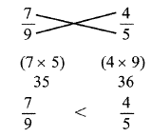
FRACTIONS
PROPER FRACTIONS
Proper fractions fall between 0 and 1. In proper fractions, the numerator is always smaller than the denominator
IMPROPER FRACTIONS
In improper fractions, the numerator is always greater than the denominator. Improper fractions are therefore always greater than 1. For example, 3/2 = 1.5, 5/4 = 1.25
Improper fractions can be rewritten as mixed numbers, i.e. as an integer and a proper fraction
COMPARING FRACTIONS
The traditional method of comparing fractions entails finding a common denominator and comparing the numerators
The shortcut method entails multiplying the numerator of one fraction with the denominator of the other fraction
FRACTION RULES FOR POSITIVE, PROPER FRACTIONS
As the numerator increases, the value of the fraction increases as it approaches 1, assuming that the denominator is held constant
As the denominator increases, the value of the fraction decreases as it approaches 1, assuming that the numerator is held constant
Increasing both the numerator and denominator by the same value brings the fraction closer to 1, regardless of the original value of the fraction. Hence, a proper fraction will increase in value, while an improper fraction will decrease in value
Example: 3/2 > 4/3 > 13/12 > 1,013/1,012
IMPACT OF ARITHMETIC OPERATIONS ON PROPER FRACTIONS
Adding fractions increase their value
Subtracting fractions decrease their value
Multiplying fractions decrease their value
Squaring a positive fraction reduces its value. For example, (1/2)² = (1/4), where 1/ 2 > 1/ 4
Squaring a negative fraction increases its value. For example, (-1/2)² = (1/4), where 1/ 4 > - 1/ 2
Cubing a positive fraction reduces its value
Cubing a negative fraction increases its value (i.e., it becomes a smaller NEGATIVE number)
Multiplying the numerator of a positive, proper fraction increases the value of the fraction as it approaches 1
There will be no change in the value of the fraction if both the numerator and the denominator are multiplied by the same constant
Dividing fractions increase their value
Taking the square root of a fraction increases its value
If there is an addition or subtraction operation in the denominator, the fraction CANNOT be simplified further

Slide 20
DIGITS AND DECIMALS
OPERATION | DESCRIPTION | EXAMPLE
Place Value | Every digit in a number has a particular place value depending on its location within the number For example, in the number 452, the digit 2 is in the ones (or "units") place, the digit 5 is in the tens place, and the digit 4 is in the hundreds place. The name of each location corresponds to the "value" of that place. Thus: 2 is worth two "units" (two "ones"), or 2 (2 x 1) 5 is worth five tens, or 50 (5 x 10) 4 is worth four hundreds, or 400 ( 4 x 100) We can now write the number 452 as the sum of these products: 452 = 4 x 100 + 5 x 10 + 2 x 1 For instance, a two digit number XY would be 10X + Y | A and B are both 2 digit numbers. If A and B contain the same digits, but in reverse order, what integer must be a factor of (A+B)? To solve this problem, assign two variables to the numbers A and B: x and y. A can be expressed as 10x + y. Therefore, B can be expressed as 10y + x. The sum of A and B can be expressed as 10x + y + 10y + x. This is equal to 11 (x + y). Therefore, 11 is a factor of (A + B)
Rounding to the nearest place value | If the right-digit-neighbor is 5 or greater, round UP, else the digit in question remains the same | 5.3485 rounded to the nearest tenth = 5.3 5.3485 rounded to the nearest hundredth = 5.35 5.3485 rounded to the nearest thousandth = 5.349
Multiplying by a power of ten | Move the decimal forward (right) by the specified number of places For negative powers of ten, reverse the process (i.e., when multiplying by a negative power of ten, move the decimal backward (left) by the specified number of places) | What is the hundredths digit of decimal Z? The tenths digit is 100Z is 2 The units digit of 1000Z is 2 Let's say z = a.bcd Hundredths digit would be the value of c . So the question is, what is the value of c? (1) The tenths digit is 100z is 2 → 100Z = 100*a.bcd, which is equal to abc.d. The tenths digit of is the value of d, which is 2. Not sufficient to calculate c (2) The units digit of 1,000z is 2 → 1000Z = abcd. The units digit is the value of d, which is 2. Not sufficient to calculate c (1)+(2) No new info, only the value of d is known. Not sufficient
Dividing by a power of ten | Move the decimal backward (left) by the specified number of places For negative powers of ten, reverse the process (i.e., when dividing by a negative power of ten, move the decimal forward (right) by the specified number of places)

Slide 21
DECIMALS – ADVANCED CONCEPTS
OPERATION | DESCRIPTION | EXAMPLE
Terminating Decimals | For fraction a/b to be a terminating decimal, the numerator must be an integer and the denominator must be an integer that can be expressed in the form of 2^{x}5^{y} where x and y are non-negative integers Any integer divided by a power of 2 or 5 will result in a terminating decimal
Converting repeating decimals to fractions | Numerator: repeated numbers Denominator: number of 9s to be the same as the number of digits that get repeated in the numerator | Example # 1 .4545454545 = 45/99 Example # 2 .1405405405 Multiply and divide by 10 to make it a repeating decimal = 1.405405405/ 10 = (1 + .405405405405)/10 = (1 + 405/999)/10 = (1+15/37)/10 = 52/(10*37) = 26/185
Trailing Zeros | Product of 5 and 2 is 10 and any number when multiplied with 10 or a power of 10 will have one or as many zeroes as the power of 10 with which it has been multiplied | How many trailing zeros will be there after the rightmost non-zero digit in the value of 25!? 25! is factorial 25 whose value = 25*24*23*22*....*1. When a number that has 5 as its factor is multiplied by another number that has 2 as its factor, the result will have '0' in its units digit. In 25!, the numbers that have 5 as their factor are 5, 10, 15, 20, and 25. 25 is the square of 5 and hence has two 5s in it. Therefore, 25! contains in it 6 fives. There are more than 6 even numbers in 25!. Hence, the limiting factor is the number of 5s. And hence, the number 25! will have 6 trailing zeroes in it

Slide 22
DIGITS – LAST DIGIT
Last digit of a product
Solve the problem step by step. However, pay attention only to the last digit of the intermediate product
Note 1: you just need a 5 and a 2 (or a multiple of 2) to decide the units digit, as it will be always be 0 if you find these two numbers in a product
Example:
What is the units digit of 5*5*9*9*4*4*4?
5*5 = 25; 9*9 = 81; 4*4*4= 64; Multiply the last digit of each of the intermediary products 5*1*4 = 20; Units digit will therefore be 0
Last digit of a power
Last digit of (xyz)^{n} is the same as that of Z^{n}
Determine the cyclicity number of Z
Integer ending with 0, 1, 5 or 6, in the integer power k>0, has the same last digit as the base
Integers ending with 2, 3, 7 and 8 have a cyclicity of 4
2 – 2, 4, 8, 6
3 – 3, 9, 7, 1
7 – 7, 9, 3, 1
8 – 8, 4, 2, 6
- Integers ending with 4 have a cyclicity of 2. When n is odd, last digit will be 4 and when n is even, last digit will be 6
- Integers ending with 9 have a cyclicity of 2. When n is odd, last digit will be 9 and when n is even, last digit will be 1
  Find the remainder when n is divided by the cyclicity
  When the remainder > 0, the last digit will be the same as Z^{r}
  When remainder = 0, the last digit will be the Z^{C}, where c is the cyclicity number
What is the units digit of 17²⁷ ?
17²⁷ will end in the same units digit as 7²⁷
27 / 4 results in a remainder of 3. Therefore, the units digit of 17²⁷ will be the same as the units digit of 7³ , which is 3
If x is a positive integer, what is the units digit of 24^{(2x+1)} 33^{(x+1)} 17^{(x+2)} 9 ^{(2x)}
Note that x is a positive integer, so 2x is always even, while 2x + 1 is always odd. Thus,
(4)^{(2x + 1)} = (4)^{(odd)}, which always has a units digit of 4
(9)^{(2x)} = (9)^{(even)}, which always has a units digit of 1
That leaves us to find the units digit of (3)^{(x + 1)}(7)^{(x + 2)}. Rewriting, and dropping all but the units digit at each intermediate step,
(3)^{(x + 1)}(7)^{(x + 2)}
= (3)^{(x + 1)}(7)^{(x + 1)}(7)
= (3 × 7)^{(x + 1)}(7)
= (21)^{(x + 1)}(7)
= (1)^{(x + 1)}(7) = 7, for any value of x.
So, the units digit of (4)^{(2x + 1)}(3)^{(x + 1)}(7)^{(x + 2)}(9)^{(2x)} is (4)(7)(1) = 28, then once again drop all but the units digit to get 8
Example # 1:
What is the last digit of 127³⁹?
Last digit of 127³⁹ is the same as that of 7³⁹. First we need to determine the cyclicity of 7, which is 4.
Now divide 39 (power) by 4 (cyclicity), remainder is 3. Therefore, the last digit of 127³⁹ is the same as the last digit of 7³ which is 3
Example # 2:
Given that x is a positive integer, what is the units digit of 24^{(2x+1)}* 33 ^{(x+1)}* 17^{(x+2)}* 9^{(2x)}
x is a positive integer, so 2x is always even, while 2x + 1 is always odd
Thus,
4^{(2x + 1)} = (4)^{(odd)}, which always has a units digit of 4
9^{(2x)} = 9^{(even)}, which always has a units digit of 1
That leaves us to find the units digit of (3)^{(x + 1)}*(7)^{(x + 2)}. Rewriting, and dropping all but the units digit at each intermediate step,
= (3)^{(x + 1)}(7)^{(x + 2)}
= (3)^{(x + 1)}(7)^{(x + 1)}(7)
= (3 × 7)^{(x + 1)}(7)
= (21)^{(x + 1)}(7)
= (1)^{(x + 1)}(7) = 7, for any value of x
So, the units digit of is (4)(7)(1) = 28, then once again drop all but the units digit to get

Slide 23
PERCENTAGES – 1
CONCEPT | FORMULA | EXAMPLE
Percentage Increase | (Difference/Original)*100 | The height of a student was 120 cms last year. He is 130 cms this year. What is the percentage increase in height? % increase = (10/120)*100 = 8.5%
Percentage Decrease | (Difference/Original)*100 | The price of a book is $48. Next month, it will be $40. What is the percentage decrease in the book’s price? % decrease = (8/48)*100 = 16%
Percentage of X more than Y | (Difference/Smaller value)*100 | The weight of a student A is 60 kg and the weight of another student B is 52kg. How much percentage is the weight of A more than the weight of B? A’s weight is 8 kg more if B’s weight is 52kg. A’s weight is x kg more if B’s weight were 100 kg. X = (8/52)*100% = 15%
Percentage of X less than Y | (Difference/Larger value)*100 | The salary of student A is $2000 and the salary of another student B is $2500. How much percentage is A less than B? X = (500/2500)* 100% = 20%
Two Successive percentage changes | [x + y + (x*y/100)] If a number A is increased successively by X% followed by Y%, and then by Z%, then the final value of A will be: A (1+ x/100) (1 + y/100)(1+z/100) | The price of a book, which is $60, is increased by 20%. The price is subsequently increased by 25%. What is the new price of the book? Using the formula, [20 + 25 + (20*25)/100] = 45 + 5 = 50%. Hence, the actual percentage increase after two successive percentage increases of 20 and 25 is 50%. Note that the final value will be (1 + 50/100)*60 ** Suppose first the price is decreased by 20% and then increased by 25%, then the actual percentage change in the price of the book is: –20 + 25 + [(-20) (25)/100] = 5 – 5 = 0%

Slide 24
PERCENTAGES – 2
MIXTURE PROBLEMS
The first type of problem will have a mixture of two components and will ask you to alter the make-up of the mixture by adding or subtracting one of the components
For example, a 50-ounce mixture of sugar and water is made up of 40% sugar and 60% water. How much sugar should you add so that the mixture is 60% sugar and 40% water
Always remember: the key to these problems is the component that does not change. In this case, we are adding sugar, while water remains constant. Therefore, we will focus on the water for most of the problem
First, determine how much water is in the mixture; 60% of 50 is 30 ounces
Because we are not adding or subtracting any water, we will still have 30 ounces of it after we add more sugar. However, we now want that 30 ounces to represent 40% of the total, rather than 60%. Therefore, 40% * x = 30; x = 75
Since the increase in total volume is only made up of additional sugar, and we went from 50 total ounces to 75 total ounces, we must add 25 ounces of sugar
In the second type of mixture problem, substances with different characteristics are combined, and it is necessary to determine the characteristics of the resulting mixture
This is similar to a weighted average problem
For example, mixture X is 10% acid and mixture Y is 30% acid. If mixture X and mixture Y are combined, the new mixture is 15% acid. What percentage of the new mixture is mixture X?
(0.1X + 0.30Y)/ (X+Y) = 0.15
Solving for X and Y, we get 0.05 X = 0.15 Y
X/Y = 3 / 1, which means that for every 3 parts of X, there is 1 part of Y
The ratio of mixture X to the total ratio is 3/4. Therefore, mixture X constitutes 75% of the new mixture
How many liters of a solution that is 15 percent salt must be added to 5 liters of a solution that is 8 percent salt so that the resulting solution is 10 percent salt?
Let n represent the number of liters of the 15% solution. The amount of salt in the 15% solution [0.15n] plus the amount of salt in the 8% solution [(0.08)(5)] must be equal to the amount of salt in the 10% mixture [0.10 (n + 5)]. Therefore,
0.15n + 0.08(5) = 0.10(n + 5)
15n + 40 = 10n + 50
5n = 10
n = 2 liters

Slide 25
PERCENTAGES – 3
DISCOUNT PROBLEMS
If a price is discounted by n percent, then the price becomes (100 – n) percent of the original price
Discount is calculated on Marked price and NOT on Cost price
Example # 1
A certain customer paid $24 for a dress. If that price represented a 25 percent discount on the original price of the dress, what was the original price of the dress?
Solution # 1
If p is the original price of the dress, then 0.75p is the discounted price and 0.75p = $24, or p = $32. The original price of the dress was $32.
Example #2
The price of an item is discounted by 20 percent and then this reduced price is discounted by an additional 30 percent. These two discounts are equal to an overall discount of what percent?
Solution # 2
If p is the original price of the item, then 0.8p is the price after the first discount. The price after the second discount is (0.7)(0.8)p = 0.56p. This represents an overall discount of 44 percent (100% – 56%)
SIMPLE INTEREST
SI = Simple Interest, P = Principal, T = Time period in years, R = Rate of interest per annum
S. I. = (PTR)/100
If simple interest for 2 years is 200, then S.I for 4 years is 400, for 1 year it is 100, for 10 years it is 1000. If S.I. for any length of time is known, then it can be calculated for any other length of time
A man invests $1000 in a bank which pays him 10% p.a. rate of simple interest for 2 years. How much does the man get after 2 years?
S.I. = (1000 ×2 ×10)/100 = 200
Therefore, amount after 2 years = P + S.I. = 1000 + 200 = 1200
COMPOUND INTEREST
A = P × [1 + (R/100)] ^n
If interest is compounded monthly, divide the annual rate by 12, and multiply n by 12
If interest is compounded quarterly, divide the annual rate by 4, and multiply n by 4
If interest is compounded semi-annually, divide the annual rate by 2, and multiply n by 2

Slide 26
PERCENTAGES – 4
Original Value | New Value | % Increase | Value Increase
X | 2X | 100% | TWICE
X | 3X | 200% | THRICE
X | 4X | 300% | QUADRUPLED
X | XN | (N-1)% | N TIMES
33% INCREASE = 4/3 → 133.33% of the original value
IMPORTANT If A is 25% more than B, then it is not same as “B is 25% less than A” A% of B = B % of A

Slide 27
PERCENTAGES – 5
All of the furniture for sale at Al’s Discount Furniture is offered for less than the manufacturer’s suggested retail price. Once a year, Al’s holds a clearance sale. If jamie purchased a certain desk during the sale, did she get a discount of more than 50% of Al’s regular price for the desk?
Al’s regular price for the desk is 60%, rounded to the nearest percent, of the MSRP of $2000
The sale price was $601 less than Al’s regular price for the desk
In order to determine the percent discount received by Jamie, we need to know two things: the regular price of the desk and the sale price of the desk. Alternatively, we could calculate the percent discount from the price reduction and either the regular price or the sale price
(1) INSUFFICIENT: This statement tells us the regular price of the desk at Al’s, but provides no information about how much Jamie actually paid for the desk during the annual sale.
(2) INSUFFICIENT: This statement tells us how much the price of the desk was reduced during the sale, but provides no information about the regular price. For example, if the regular price was $6010, then the discount was only 10%. On the other hand, if the regular price was $602, then the discount was nearly 100%.
(1) AND (2) INSUFFICIENT: At first glance, it seems that the statements together provide enough information
Statement (1) seems to provide the regular price of the desk, while statement (2) provides the discount in dollars. However, pay attention to the words “rounded to the nearest percent” in statement (1). This indicates that the regular price of the desk at Al’s is 60% of the MSRP, plus or minus 0.5% of the MSRP. Rather than clearly stating that the regular price is (0.60)($2000) = $1200, this statement gives a range of values for the regular price: $1200 plus or minus $10 (0.5% of 2000), or between $1190 and $1210. If the regular price was $1190, then the discount was ($601/$1190) × 100% = 50.5% (you can actually see that this is greater than 50% without calculating). If the regular price was $1210, then the discount was ($601/$1210) × 100% = 49.7% (you can actually see that this is less than 50% without calculating).
The uncertainty about the regular price means that we cannot answer with certainty whether the discount was more than 50% of the regular price.
The correct answer is E

Slide 28
COMMON FRACTIONS, DECIMALS AND PERCENTAGE EQUIVALENTS
FRACTION | DECIMAL | PERCENTAGE
1/100 | 0.01 | 1%
1/50 | 0.02 | 2%
1/25 | 0.04 | 4%
1/20 | 0.05 | 5%
1/10 | 0.1 | 10%
1/9 | 0.11 | 11%
1/8 | 0.125 | 12.5%
1/6 | 0.167 | 16.7%
1/5 | 0.2 | 20%
1/4 | 0.25 | 25%
3/10 | 0.3 | 30%
1/3 | 0.333 | 33.3%
3/8 | 0.375 | 37.5%
2/5 | 0.4 | 40%
1/2 | 0.5 | 50%
FRACTION | DECIMAL | PERCENTAGE
3/5 | 0.6 | 60%
5/8 | 0.625 | 62.5%
2/3 | 0.6677 | 66.67%
7/10 | 0.7 | 70%
3/4 | 0.75 | 75%
4/5 | 0.8 | 80%
5/6 | 0.833 | 83.33%
7/8 | 0.875 | 87.5%
9/10 | 0.9 | 90%
5/4 | 1.25 | 125%
4/3 | 1.33 | 133%
3/2 | 1.5 | 150%
7/4 | 1.75 | 175%

Slide 29
RATIO AND PROPORTION

Slide 30
RATIO AND PROPORTION
A ratio expresses a particular relationship between two or more quantities. Here are some examples of ratios:
The two partners spend time working in the ratio of 1 to 3. For every 1 hour the first partner works, the second partner works 3 hours.
Three sisters invest in a certain stock in the ratio of 2 to 3 to 8. For every $2 the first sister invests, the second sister invests $3, and the third sister invests $8
The ratio of men to women in the room is 3 to 4. For every 3 men, there are 4 women
Ratios can express a part-part relationship or a part-whole relationship
A part-part relationship: The ratio of men to women in the office is 3:4
A part-whole relationship: There are 3 men for every 7 employees
Notice that if there are only two parts in the whole, you can derive a part-whole ratio from a part-part ratio, and vice versa
Remember that ratios only express a relationship between two or more items; they do not provide enough information, on their own, to determine the exact quantity for each item. For example, knowing that the ratio of men to women in an office is 3 to 4 does NOT tell us exactly how many men and how many women are in the office. All we know is that the number of men is less than the number of women. However, ratios are surprisingly powerful on Data Sufficiency - they often provide enough information to answer the question
Multiple ratios: Make a common Term
      If C:A = 3:2, and C:L = 5:4, what is A:L?
      C : A : L C : A : L
      3 : 2 : → Multiply by 5 → 15 : 10 :
      5 : : 4 → Multiply by 3 → 15 : : 12
      Once you have converted C to make both ratios equal (15), you can combine the ratios
      Combined Ratio C:A:L = 15:10:12, and ratio A:L = 10:12 or 5:6
    If a/b = c/d, then:
    (a+b)/b = (c+d)/d
    (a – b)/b = (c – d)/d
    (a + b)/(a – b) = (c + d)/(c – d)

Slide 31
EXPONENTS & ROOTS

Slide 32
EXPONENTS
CONCEPT | DESCRIPTION OF CONCEPT | EXAMPLE
POSITIVE BASES GREATER THAN 1 | An important property of exponents is that for positive bases greater than 1, the greater the exponent, the greater the rate of increase | 5¹ = 5 5² = 25 (increased by 20) 5³ = 125 (increased by 100) 5⁴= 625 (increased by 500)
THE SIGN OF THE BASE - MAY BE EITHER POSITIVE OR NEGATIVE | With a negative base, simply multiply the negative number as many times as the exponent requires. If there are an even number of negative numbers (i.e., the exponent is even), the product will be positive. Similarly, if there are an odd number of negative numbers (i.e., the exponent is odd), the product will be negative | 3² = 9 (-3)² = 9 (-3)³ = - 27 3³ = 27
THE EVEN EXPONENT IS DANGEROUS: IT HIDES THE SIGN OF THE BASE | When a base is raised to an even exponent, the resulting answer may either keep or change the original sign of the base. For example, (-3)⁴ = 81; 2² = 4 Odd exponents are harmless and always keep the sign of the base. Therefore, if x³ = 64, x can only be equal to 4 (and not -4) ** X² = -9 has no solutions, as squaring cannot produce a negative number | If X² = 16, is X equal to 4? We cannot answer the question without additional information because x may either be -4 or 4
AN EXPONENTIAL EXPRESSION BASE OF ZERO, 1 OR -1 | ZERO: always yields 0, regardless of the exponent 1: always yields 1, regardless of the exponent -1: yields 1 when the exponent is even, and yields -1 when the exponent is odd | If you are told that x⁶ = x⁷ = x⁸ you know that x must be either 0 or 1 (Note: -1 does not fit the equation) If you are told that x⁶ = x⁸ = x¹⁰, x could be 0, 1 or -1
FRACTIONAL BASE | The value of a positive fraction decreases as the exponent increases
COMPOUND BASES | When the base of an exponential expression is a product, we can multiply the base together and then raise it to the exponent, OR we can distribute the exponent to each number in the base You cannot do this with a sum, however. You must add the numbers inside the parentheses first | (2 * 5)³ = 10³ = 1000 OR 2³*5³ = 8 * 125 = 1000 (2+5)³ ≠ 2³ + 5³

Slide 33
EXPONENTS
RULE | EXAMPLE
When we multiply terms with the same base, we ADD the exponents xª * x^{b} = x^{(a+b)} | 3⁴x 3²= 3⁽⁴⁺²⁾= 3⁶
When we divide terms with the same base, we SUBTRACT the exponents xª / x^{b} = x^{(a-b)} | 3⁶ / 3²= 3⁽⁶⁻²⁾= 3⁴
a^{x} * b^{x} = (ab)^{x} | 2⁴.3⁴ = 6⁴
When raising a power to a power, combine exponents by MULTIPLYING (a^{x})^{y} = a^{xy} | (3²)⁴ = 3⁸
NEGATIVE EXPONENTS x ^{– a} = 1 / xª | 2x⁻⁴ = 2/x⁴
x^{(a/b)} = ^{b} √xª | ⁵ √x¹⁵ = x ^{15/5} = x³
a^{x} + a^{x} + a^{x} = 3a^{x} | 3⁴ + 3⁴ + 3⁴ = 3 * 3⁴ = 3⁵
AN EXPONENT OF 1 – When you see a base without an exponent, write in an exponent of 1 | 3 * 3^{x}=3¹ * 3^{x} = 3^{(1+x)} = 3^{x + 1}
AN EXPONENT OF ZERO – any non-zero base raised to the power of 0 is equal to 1 | 3⁰ = 1
    Simplifying exponential expressions
      Always try to simplify exponential expressions when they have the same base or the same exponent. You can only simplify exponential expressions that are linked by multiplication or division. When expressions with the same base are linked by a sum, you cannot simplify but you can factor the expression:
      7² + 7³ = 7².(7 + 1) = 49.8
      Example: what is the largest prime factor of 4²¹ + 4²² + 4²³?
      Answer: 4²¹ + 4²² + 4²³ = 4²¹(1 + 4 + 16) = 4²¹.(21) = 4²¹(3.7). The largest prime factor of 4²¹ + 4²² + 4²³ is 7
*** When both sides of the equation are broken down to the product of prime bases, the respective exponents of like bases must be equal

Slide 34
ROOTS
A ROOT is the inverse operation of raising a number to an exponent, and answers the question: Which number do I multiply by itself n times in order to get a product of b ?
EVEN ROOTS ONLY HAVE ONE SOLUTION – A POSITIVE VALUE
Unlike even exponents, which yield both a positive and a negative solution, even roots have only one solution. √4 can only be 2, and not -2
A root can only have a negative value if it is an odd root, and the base is negative
SIMPLIFYING A ROOT
  GMAT very often tries to trick you by giving a root linked by addition where it is tempting to simplify the terms, for example: √(25 + 16). It is tempting to think that this will result into 5 + 4, but you can only simplify roots when the terms inside/outside are linked by multiplication or division
  Simplifying radicals in the denominator with conjugate radical expressions is very useful on challenging GMAT radical questions
  Examples of roots simplification:
  √25.16 = √25 . √16 = 5.4
  √50 . √18 = √50.18 = √900 = 30
  √144:16 = √144 : √16 = 12/4 = 3
  √25+16 = √41 → you cannot simplify this one
  2√7 + 3√7 = 5√7
KNOWING COMMON ROOTS
  GMAT requires you to know all the perfect square roots from 1 to 30 and also the following imperfect rules:
  √2 ≈ 1.4
  √3 ≈ 1.7
  √5 ≈ 2.25
  SUM OF THE ROOTS OF AN EQUATION ax²+bx+c=0 IS (-B/A)

Slide 35
COMMON EXPONENTS AND ROOTS
SQUARES
2² | 4 | 17² | 289
3² | 9 | 18² | 324
4² | 16 | 19² | 361
5² | 25 | 20² | 400
6² | 36 | 21² | 441
7² | 49 | 22² | 484
8² | 64 | 23² | 529
9² | 81 | 24² | 576
10² | 100 | 25² | 625
11² | 121 | 26² | 676
12² | 144 | 27² | 729
13² | 169 | 28² | 784
14² | 196 | 29² | 841
15² | 225 | 30² | 900
16² | 256
CUBES
2³ | 8
3³ | 27
4³ | 64
5³ | 125
6³ | 216
7³ | 343
8³ | 512
9³ | 729
10³ | 1000
11³ | 1331
12³ | 1728
13³ | 2197
14³ | 2744
15³ | 3375
16³ | 4096
HIGHER POWERS
2⁴ | 16
2⁵ | 32
2⁶ | 64
2⁷ | 128
2⁸ | 256
2⁹ | 512
2¹⁰ | 1024
3⁴ | 81
3⁵ | 243
3⁶ | 729

Slide 36
RATE AND WORK
Basic motion problems (speed, distance, time)
Average rate problems
Simultaneous motion problems
Work problems
Population problems

Slide 37
RATE, DISTANCE TIME
RATE = DISTANCE / TIME
RATE * TIME = DISTANCE
RATE
Rate is expressed as a ratio of distance and time, with two corresponding units. Some examples of rates include: 30 miles per hour, 10 meters/second etc.
DISTANCE
Distance is expressed using a unit of distance. Some examples of distances include: 18 miles, 20 meters, 100 kilometres
TIME
Time is expressed using a unit of time. Some examples of times include: 6 hours, 23 seconds, 5 months, etc.
Speed and time are inversely proportional to each other. Therefore, if a man increases his speed by 3/2, then the time taken will become 2/3*original time
If three men cover the same distance with speeds in the ratio a : b : c, the times taken by these three will be in the ratio 1/a : 1/b : 1/c respectively
RTD CHART
RATE | x | TIME | = | DISTANCE
All units in the RTD chart must match up with one another For example, it takes an elevator four seconds to go up one floor. How many floors will the elevator rise in two minutes? The rate is 1 floor/4 seconds, which simplifies to 0.25 floors/second. Note: the rate is NOT 4 seconds per floor! This is an extremely frequent error. Always express rates as “distance over time”, not as “time over distance” The time is 2 minutes The distance is unknown We know that distance = rate * time. Watch out though! The rate is expressed in floors per second, but the time is expressed in minutes. This will yield an incorrect answer. To correct it, we change the time into seconds (i.e., 60*2 = 120 seconds). Therefore, d = 120*0.25 = 60 floors

Slide 38
MULTIPLE RATE, DISTANCE TIME PROBLEMS – SPEED RELATIONS
RELATION | EXAMPLE |  | RATE (miles/hour) | x | TIME (hours) | = | DISTANCE (miles)
TWICE/ HALF/ N TIMES AS FAST AS | Train A is traveling at twice the speed of Train B | Train A | 2R
 |  | Train B | R
SLOWER/FASTER | Wendy walks 1 mile per hour more slowly than Maurice | Wendy | R – 1
 |  | Maurice | R
RELATIVE RATES | Car A and Car B are driving directly towards each other For example, if Car A is going 30 miles per hour and Car B is going 40 miles per hour, then the distance between them is shrinking at a rate of 70 miles per hour. If the cars are driving away from each other, then the distance grows at a rate of (a + b) miles per hour. Either way, the rates add up | Car A | a
 |  | Car B | b
 |  | Shrinking distance between Car A and Car B | a + b
RELATIVE RATES | Car A is chasing Car B and catching up For example, if Car A is going 55 miles per hour, but Car B is going only 40 miles per, then Car A is catching up at 15 miles per hour that is, the gap shrinks at that rate For example, a cop clocks a motorcyclist speeding down the highway at 90 mph. 2 minutes later the cop tears off after him averaging a speed of 120mph. At this rate how long will it take for our friendly copper to catch the speeder? In 2 minutes, the motorcyclist covers 3 miles [(90*2)/60] Relative speed = 30mph Therefore, at 30mph, 3 miles will be covered in 6 minutes | Car A | a
 |  | Car B | b
 |  | Shrinking distance between Car A and Car B | a – b
RELATIVE RATES | Car A is chasing car B and falling behind | Car A | a
 |  | Car B | b
 |  | Growing distance between Car A and Car B | a + b

Slide 39
MULTIPLE RATE, DISTANCE TIME PROBLEMS
TIME RELATIONS
RELATION | EXAMPLE |  | RATE (miles/hour) | x | TIME (hours) | = | DISTANCE (miles)
SLOWER/FASTER | Joey runs a race 30 seconds faster than Tommy * These signs are the opposites of the ones for the "slower I faster" rate relations. If Joey runs a race faster than Tommy, then Joey's speed is higher, but his time is lower | Joey |  |  | t – 30
 |  | Tommy |  |  | t
LEFT… AND MET/ARRIVED | Sue left her office at the same time (i.e., 1:00pm) as Tara left hers. They met sometime later * Sue and Tara traveled for the same amount of time | Sue |  |  | t
 |  | Tara |  |  | t
LEFT… AND MET/ARRIVED | Sue left her office at the same time as Tara left hers, but Sue arrived one hour earlier *Sue traveled for 1 hour less than Tara | Sue |  |  | t -1
 |  | Tara |  |  | t
LEFT… AND MET/ARRIVED | Sue left office 1 hour after Tara, but they met on the road *Sue traveled for 1 hour less than Tara | Sue |  |  | t -1
 |  | Tara |  |  | t

Slide 40
MULTIPLE RATE, DISTANCE TIME PROBLEMS – THE KISS/CRASH
SAMPLE SITUATION |  | RATE (miles/hour) | x | TIME (hours) | = | DISTANCE (miles)
The kiss/crash Car A and Car B start driving toward each other at the same time*. Eventually they crash into each other (i.e., point they meet) ** This means that they have been traveling for the same amount of time | Car A | a |  | t |  | A’s distance
 | Car B | b |  | t |  | B’s distance
 | Total | a + b |  | t |  | A’s Distance + B’s distance = Total distance covered
Examples
Stacy and Heather are 20 miles apart and walk towards each other along the same route. Stacy walks at a constant rate that is 1 mile per hour faster than Heather's constant rate of 5 miles/hour. If Heather starts her journey 24 minutes after Stacy, how far from her original destination has Heather walked when the two meet? | Stacy | 6 |  | t + 0.4 |  | 6t + 2.4
 | Heather | 5 |  | t |  | 5t
 | Fill in all the numbers that you know or can compute very simply: Heather's speed is 5 miles/hour, and Stacy's speed is 5 + 1 = 6 miles/hour. Next, try to introduce only one variable. Let t stand for Heather's time. Also, we know that Stacy walked for 0.4 hours more than Heather, so Stacy's time is t + 0.4 Finish the table by multiplying across rows and by adding the one column that can be added (distance in this case). Because Stacy started walking earlier than Heather, you should not simply add the rates in this scenario. You can only add the rates for the period during which the women are both walking. The table produces the equation (6t+ 2.4) + 5t= 20, yielding t= 1.6. Heather's distance is therefore 5t, or 8 miles

Slide 41
MULTIPLE RATE, DISTANCE TIME PROBLEMS – CATCHING UP/OVERTAKING
SAMPLE SITUATION |  | RATE (miles/hour) | x | TIME (hours) | = | DISTANCE (miles)
Catching up/Overtaking Car A is chasing Car B. How long does it take for Car A to catch up with Car B? ** The key to these problems is that at the moment when one person/car catches up with the other, they have traveled the same distance | Car A | a |  | t1 |  | A’s distance
 | Car B | b |  | t2 |  | B’s distance
 | Relative Positive | a - b
EXAMPLES
Scott starts jogging from point X to Point Y. A half-hour later, this friend Garrett who jogs 1 mile per hour slower than twice Scott’s rate starts from the same point and follows the same path. If Garrett overtakes Scott in 2 hours, how many miles will Garrett have covered? | Scott | r |  | 2.5 |  | 2.5r
 | Garrett | 2r – 1 |  | 2 |  | 4r -2
 |  |  |  |  |  | 2.5 r = 4r – 2 2 = 1.5r r = 4/ 3 Garrett traveled (4*4/3) -2 miles = 3 1/3 miles

Slide 42
MULTIPLE RATE, DISTANCE TIME PROBLEMS – ROUND TRIP
SAMPLE SITUATION |  | RATE (miles/hour) | x | TIME (hours) | = | DISTANCE (miles)
The round trip Jan drives from home to work in the morning, and then takes the same route home in the evening **The key to these problems is that the distance going is the same as the distance returning | Going |  |  | Time going |  | D
 | Return |  |  | Time coming |  | D
 | Total | VARIES |  | Total time (ADD) |  | 2D (ADD)
EXAMPLES
A cyclist travels 20 miles at a speed of 15mph. If he returns along the same path and the entire trip takes 2 hours, what speed did he return? | Going | 15 |  | 4/3 hours |  | 20
 | Return | 30 |  | 2 – 4/3 = 2/3 |  | 20
 | Total |  |  | 2 |  | 40

Slide 43
MULTIPLE RATE, DISTANCE TIME PROBLEMS – SAMPLE SITUATIONS
SAMPLE SITUATION |  | RATE (miles/hour) | x | TIME (hours) | = | DISTANCE (miles)
Following footsteps Jan drives from home to the store along the same route as Bill | Jan |  |  |  |  | D
 | Bill |  |  |  |  | D
 |  | VARIES |  | VARIES |  | D (same)
SAMPLE SITUATION |  | RATE (miles/hour) | x | TIME (hours) | = | DISTANCE (miles)
Second-guessing Jan drove home from work. If she had driven along the same route 10 miles per second faster.. | Actual | r |  |  |  | D
 | Hypothetical | r + 10 |  |  |  | D
 |  | VARIES |  | VARIES |  | D (same)
SAMPLE SITUATION |  | RATE (miles/hour) | x | TIME (hours) | = | DISTANCE (miles)
Opposite Directions In this type of problem, two people start at the same point and travel in different directions Two people start jogging at the same point and time but in opposite directions. If the rate of A is 2mph faster than the rate of B, and after 3 hours they are 30 miles apart, what is the rate of A? | A | r + 2 |  | 3 |  | 3r + 6
 | B | r |  | 3 |  | 3r
 | Total |  |  |  |  | 3r + 6 + 3r = 30 6r + 6 = 30 6r = 24 r = 4
**The key to these problems is that the total distance is the sum of the individual distances traveled

Slide 44
MISCELLANEOUS PROBLEMS
 |  | Speed | Time | Speed * Time | = | Distance covered by the train relative to the object
1 | Train crosses a stationary object, which has no length | Speed of train = X Speed of object = Y | T | X* T |  | Length of the train
2 | Train crosses a stationary object with length L (Object) | Speed of train = X Speed of object = Y | T | X * T |  | Length of train + Length of the object
3 | Train crosses a moving object, which has no length – same direction | Speed of train = X Speed of object = Y | T | (X-Y)* T |  | Length of the train
 | Train crosses a moving object, which has no length – opposite direction | Speed of train = X Speed of object = Y | T | (X+Y)*T |  | Length of the train
4 | Train crosses a moving object with length L (Object) – same direction | Speed of train = X Speed of object = Y | T | (X-Y)* T |  | Length of train + Length of the object
 | Train crosses a moving object with length L (Object) – opposite direction | Speed of train = X Speed of object = Y | T | (X+Y)*T |  | Length of train + Length of the object
BOAT PROBLEMS
If the speed of a boat (or man) in still water is X km/hour, and the speed of the stream (or current) is Y km/hour, then:
Speed of boat with the stream (or Downstream or D/S) = (X + Y) km/hour
Speed of boat against the stream (or upstream or U/S) = (X – Y) km/hour
X = [(X + Y) + (X – Y)] / 2 and Y = [(X + Y) – (X – Y)] / 2
Boat’s speed in still water = [Speed downstream + Speed upstream] / 2
Speed of current = [Speed downstream – Speed upstream] / 2

Slide 45
AVERAGE RATE / RELATIVE SPEED
AVERAGE RATE = TOTAL DISTANCE/ TOTAL TIME
OR
AVERAGE SPEED = (2*SPEED OF A*SPEED OF B) / (SPEED A + B) → only to be used when the distance travelled is the same
If an object moves the same distance twice, but at different rates, then the average rate will NEVER be the average of the two rates given for the two legs of the journey. In fact, because the object spends more time traveling at the slower rate, the average rate will be closer to the slower of the two rates than to the faster
It is not necessary to know the total distance travelled or the total time taken while computing the average speed
When two objects travel in the same direction, the time to catch up/overtake will be = lead distance/ difference of speeds (note: in order for A to overtake B, A needs to be traveling at a higher speed than B otherwise A will never catch up)
When two objects travel in different directions, time to meet will be = lead distance/ sum of speeds
EXAMPLE |  | RATE (miles/hour) | x | TIME (hours) | = | DISTANCE (miles)
If Lucy walks to work at a rate of 4 miles per hour, but she walks home by the same route at a rate of 6 miles per hour, what is Lucy's average walking rate for the round trip? Pick a Smart Number for the distance. Since 12 is a multiple of the two rates in the problem, 4 and 6, 12 is an ideal choice The times can be found using the RTD equation. For the GOING trip, 4t =12, so t = 3 hrs. For the RETURN trip, 6t = 12, so t = 2 hrs. Thus, the total time is 5 hrs. Now that we have the total Time and the total Distance, we can find the Average Rate using the RTD formula: RT=D t(5) = 24 r = 4.8 miles per hour | Going | 4 |  | 3 |  | 12
 | Coming | 6 |  | 2 |  | 12
 | Total | ?? |  | 5 |  | 24

Slide 46
SPEED , DISTANCE, TIME PROBLEMS
DISTANCE IS CONSTANT – SPEED AND TIME ARE VARIED
A person leaves his home everyday at 11:00 am and reaches his office at 12:00 pm. One day he left his house at normal time but travelled the first half of the distance at a speed of 2/3 of the normal speed. What should be the speed of second half so that he reaches at the same time? | Time taken to reach the office normally = 60 minutes. At half the distance time taken = 30 minutes. If the traveling speed is 2/3 of the normal speed for the first half, the time taken is 3/2 of the time taken to reach the first half: (3/ 2) * 30 = 45 minutes. Therefore, to reach the office in 1 hour, he needs to travel the second half in 60 – 45 = 15 minutes With the normal speed he travels the second half in 30 minutes, now using the above result if he needs to cover the second half in 15 minutes, he should double his speed If he travels the second half of the journey at 3/2 the speed, then the time taken to complete the second half of the journey will be 2/3 of the normal time, i.e., (2/3)*30 = 20 minutes. If he takes 45 minutes to travel the first half, and 20 minutes to travel the second half, he will take 65 minutes to travel the entire distance from his home to office, and hence, will reach at 12:05 pm If he travels the entire distance at 3/4 of his normal speed, and is late by 15 minutes, how long does he usually take to reach the office? The time taken with the revised speed with be 4/3 of the original time Difference between new time and old time is 15 minutes (i.e., 4t/3 – t = 15) Therefore, t = 45 minutes
A, B, and C starts from the same place and travel in the same direction at speeds of 30,40,60 respectively. B starts 2 hours after A, but B and C overtake A at the same instant. How many hours after A did C start? | At the point at which B and C overtake A, the distance travelled by each of them is the same Time taken by A = T , speed of A = 30 Time taken by B = T - 2 , speed of B = 40 Time taken by C = T - C , speed of C = 60 Time taken by A / Time taken by B = Speed of B / Speed of A = 8 Time taken by A / Time taken by C = Speed of C / Speed of A = 4 Therefore, C started 8 – 4 hours after A

Slide 47
WORK
In distance problems, if the rate (speed) is known, it will normally be given to you as a ready-to-use number. In work problems, though, you will usually have to figure out the rate from some given information about how many jobs the agent can complete in a given amount of time
For example, if Oscar can perform one surgery in 1.5 hours, the work rate = # of given jobs/ given amount of time i.e., 1/1.5 hours, which is equal to 2/3 surgeries per hour
WORKING TOGETHER – ADD WORK RATES
If A can finish a job alone in x days and B can finish the same job in y days alone, then
One-day work of both A and B is (x + y)/x*y
Number of days A and B take to finish the same job working together is: (x*y) / (x + y)
Exception: one agent undoes the other’s work, like a pump putting water into a tank and another drawing water out. Rate will be x – y
      Example: Working alone, A finish a job in 2 days and B can finish a job in 3 days. If A and B work together, in how many days will they finish the work?
      A’s rate = 1/ 2
      B’s rate = 1/ 3
      In one day, A and B finish 5 / 6 of the job; therefore, they take 6/ 5 days to complete the job
      Example: Four men working together all day, can finish a piece of work in 11 days; but two of them having other engagements can work only one half–time and quarter time respectively. How long will it take them to complete the work ?
      Each man will take 11 x 4 = 44 days to complete the work. If one man works half day/day he will take 44 x 2 = 88 days to finish the work. Similarly, a man working quarter day/day will take 44 x 4 = 176 days to finish the work. When these work together they will require 1 / [ (1/44) + (1/44) + (1/88) + (1/176) ] = 16 days
      Men * hours * days
Example: If 2 men can finish a job in 3 days working 4 hours per day, then how many days will 3 men working 2 hours per day take to finish the same job?
Solution: In the first set the product is: 2 men ×3 days× 4 hours. This must remain constant in the second set in which we need to find number of days: 2 men × 3 days × 4 hours = 3 men × N days × 2 hours
2 × 3 × 4 = 3 × N ×2
Therefore, N = 4 days
If a man can do a piece of work in N days (or hours or any other unit of time), then the work done by him in one day will be 1/N of the total work
If A is twice as good a workman as B, then A will take half the time B takes to finish a piece of work

Slide 48
WORK – 2
Jack can paint a wall in 3 hours. John can do the same job in 5 hours. How long will it take if they work together? | Jack’s rate is 1/3 (i.e., Jack can paint 1/3rd of the room in an hour) John’s rate is 1/5 (i.e., John can paint 1/5th of the room in an hour) Jack and John’s rate COMBINED is 1/3 + 1/5 → 8 / 15 (i.e., Jack and John TOGETHER can paint 8/15th of the room in an hour) Therefore, it will take them 15/8 hours to finish painting the room We can also approach these problems as we approach SDT problems. For example, distance (work) in this case is 1, and the time taken is 5 hours. Therefore, rate will be 1/5 Time equals distance (work) / rate
Working independently X takes 12 hours to finish a certain work. He finishes 2/3 of the work. The rest of the work is finished by Y whose rate is (1/10) of X. In how much time does Y finish his work? | X’s rate is 1/12 Y’s rate is 1/120 Therefore, Y would take 120*(1/3) hours to complete the remaining 1/3 of the work
Working together, printer A and printer B would finish a task in 24 minutes. Printer A alone would finish the task in 60 minutes. How many pages does the task contain if printer B prints 5 pages a minute more than printer A? | Working together, printer A and printer B would finish a task in 24 minutes - This tells us that A and B combined would work at the rate of (1/24) per minute Printer A alone would finish the task in 60 minutes - This tells us that A works at a rate of (1/60) per minute At this point, it should strike you that with just this much information, it is possible to calculate the rate at which B works. Rate at which B works = (1/24) – (1/60) = (1/40) B prints 5 pages a minute more than printer A - This means that the difference between the amount of work B and A complete in one minute corresponds to 5 pages. So let us calculate that difference. It will be = (1/40) – (1/60) = (1/120) If (1/120) of the job consists of 5 pages, then the 1 job will consist of (5*1)/(1/120) = 600 pages
Machine A and Machine B are used to manufacture 660 sprockets. It takes machine A ten hours longer to produce 660 sprockets than machine B. Machine B produces 10% more sprockets per hour than machine A. How many sprockets per hour does machine A produce? | It takes machine A ten hours longer to produce 660 sprockets than machine B - Let machine A produce 660 sprockets in ‘x’ hours. Therefore, machine B will produce 660 sprockets in ‘x – 10’ hours With this information, we can calculate the amount of work machine A and B do per hour respectively Rate at which machine A works = [1/x] per hour Rate at which machine B works = [1/(x – 10)] per hour Machine B produces 10% more sprockets per hour than machine A - If machine A produces [1/x] sprockets an hour, then machine B will produce (1/x) +(10/100)*(1/x) = (11/10x) But we already know that rate at which machine B works = [1/(x – 10)] per hour. Therefore, equating it to (11/10x) we get the following equation: (11/10x) = 1/(x-10) → x = 110 hours If in 110 hours A produces 660 sprockets, then in 1 hour A will produce (660*1)/110 = 6

Slide 49
NUMBER PROPERTIES OF INTEGERS
IMPORTANT CONCEPTS TO ALWAYS KEEP IN MIND
An integer is any number in the following set – {..-3,-2,-1,0,1,2,3..}
An integer can be either positive or negative, even or odd, a prime or a consonant (0 and 1 are neither prime nor consonant)
Never assume a number to be an integer unless EXPLICITLY stated in the problem
If n2 is an integer, it is not necessary that n is also an integer. For example, the square of √2 is 2.
Impact of arithmetic operations on integers
  When integers are added to, subtracted from, or multiplied with each other, the result is ALWAYS an integer. However, during division, it is not necessary that the result will be an integer – when an even number is divided by an odd number, it may result in a non – integer (Example: 10/4). Similarly, an odd integer divided by an odd integer may result in a non – integer (Example: 11/3). An odd integer divided by an even integer ALWAYS results in a non – integer
Divisibility
The product of 2 even numbers will always be divisible by 4
The product of x consecutive integers will always be divisible by x and x!. For example, x*(x +1)* (x+2) will be divisible by 3
The sum of x consecutive integers
    If x is odd, the sum of the integers is always divisible by x. Example, 2+3+4 = 9, which is divisible by 3
    If x is even, the sum of the integers is never divisible by x. Example, 5+6+7+8 = 26, which is not divisible by 4
Prime factorization – Lowest Common Multiple (LCM), Greatest Common Factor (GCF)
LCM: The smallest number that has all given numbers as a factor
GCF: The largest number which is a factor of all given numbers
Product of two numbers = LCM * GCF

Slide 50
PROPERTIES OF ZERO
EVEN
NEITHER POSITIVE NOR NEGATIVE
MULTIPLE OF ALL NUMBERS
FACTOR OF NO NUMBER

Slide 51
PRIME NUMBERS
POSITIVE INTEGER greater than 1 that has EXACTLY TWO different positive factors – ONE AND ITSELF
Note: If a positive integer greater than or equal to 2 has only two factors, then the integer must be a prime number
EXAMPLES
What is the value of integer x?
(1) x has exactly 2 factors.
(2) When x is divided by 2, the remainder is 0
Statement (1) indicates that x is prime, because it has only 2 factors. This statement is insufficient by itself, since there are infinitely many prime numbers
Statement (2) indicates that 2 divides evenly into x, meaning that x is even; that is also insufficient by itself
Taken together, however, the two statements reveal that x must be an even prime-and the only even prime number is 2. The answer is (C): BOTH statements TOGETHER are sufficient
TWO is the smallest and only EVEN prime number
If the product of two primes is even or if the sum of two primes is odd, one of the primes has to be 2
Conversely, if you know that 2 CANNOT be one of the primes in the sum, then the sum of the two primes must be even
ONE is NOT a prime number
Method to determine a prime number
Find approximate square root of the number. Then check if all the prime numbers below the square root are factors of the given number. If none are then the number is prime else not
For example: the approximate square root of 91 is 10, and the prime numbers below 10 are 2,3,5,7. 91 is not divisible by 2,3 or 5, but it is divisible by 7. Hence, it is not a prime number
First 100 prime numbers: 2,3,5,7,11,13,17,19,23,29,31,37,41,43,47,53,59,61,67,71,73,79,83,89,97

Slide 52
DIVISIBILITY RULES
Divisible by | If..
2 | Last digit is 0,2,4,6,8
3 | The sum of the digits is a multiple of 3
4 | If the last two digits are divisible by 4 If the number can be divided by two twice If the last two digits are zero Pattern of two-digit numbers that are divisible by 4: even0, even4, even8, odd2, odd6
5 | The last digit is zero or five
6 | Divisible by both two and three
7 | Double the last digit, then subtract the answer from the remaining digits. If the remainder is divisible by 7, so is the original number
8 | Divisible by two three times Last three digits are 0
9 | Sum of the digits are divisible by 9
11 | Add up the odd-numbered digits (the 1st, 3rd, etc.) and add up the even-numbered digits (the 2nd, 4th etc.) and subtract them. If the difference is 0, or if it is divisible by 11, then the number is divisible by 11
12 | Divisible by both three and four
For any integer n, n³ – n is divisible by 3, n⁵ – n is divisible by 5, n¹¹ – n is divisible by 11, n¹³ – n is divisible by 13. In general, if p is a prime number then for any whole number a, a^{p} – a is divisible by p. For example, 5³ – 5 is divisible by 3: (5³ – 5) = 120, which is divisible by 3
FACTORIALS: The factorial of N, symbolized by N!, is the product of all integers from 1 up to and including N. For instance, 6! = 6 x 5 x 4 x 3 x 2 x 1 = 720. Because it is the product of all the integers from 1 to N, any factorial N! must be divisible by all integers from 1 to N. Another way of saying this is that N! is a multiple of all the integers from 1 to N

Slide 53
PRIME FACTORIZATION
COMMON FACTOR
GREATEST COMMON FACTOR (GCF)
LOWEST COMMON MULTIPLE (LCM)
Break down both numbers to their prime factors to see what factors they have in common. Multiply shared prime factors to find all common factors
What factors greater than 1 do 135 and 225 have in common?
135 = 3 x 3 x 3 x 5
225 = 3 x 3 x 5 x 5
Both share 3 x 3 x 5 in common—find all combinations of these numbers: 3 x 3 = 9; 3 x 5 = 15; 3 x 3 x 5 = 45
The number that contains all the factors common to both numbers (i.e., biggest number that will divide into both the numbers)
Note: If the numbers do not share any common factors, then the GCF is 1
The GCF for two consecutive numbers is always 1. However, just because the GCF is 1 doesn’t guarantee that the numbers are consecutive
Example:
The prime factorizations for 2940 & 3150 are:
2940 = 2 x 2 x 3 x 5 x 7 x 7
3150 = 2 x 3 x 3 x 5 x 5 x 7
Therefore, GCF is 2 x 3 x 5 x 7 = 210
The LCM is the smallest number that contains both numbers as factors i.e. the smallest number that is a multiple of both these values
L.C.M of two numbers x and y is maximum power of the prime factors in x and y
Example:
The prime factorizations for 2940 & 3150 are:
2940 = 2 x 2 x 3 x 5 x 7 x 7
3150 = 2 x 3 x 3 x 5 x 5 x 7
Therefore, LCM is 2 x 2 x 3 x 3 x 5 x 5 x 7 x 7 = 44,100
LCM * GCF = PRODUCT OF TWO NUMBERS (DOES NOT WORK FOR MORE THAN TWO NUMBERS)
GCF of fractions = GCF of numerators ÷ LCM of denominators
LCM of fractions = LCM of numerators ÷ GCF of denominators

Slide 54
PRIME FACTORIZATION AND DIVISIBILITY – EXAMPLES
Examples
If a is divided by 7 or by 18, an integer results. Is a/ 42 an integer? | If a is divisible by 7 and by 18, its prime factors include 2,3,3, and 7. Therefore, any integer that can be constructed as a product of any of these prime factors is also a factor of a 42 = 2 x 3 x 7 Therefore, 42 is also a factor of a.
If 60 is a factor of u, is 18 a factor of u? | If u is divisible by 60, its prime factors include 2, 2, 3, and 5. Therefore, any integer that can be constructed as a product of any of these prime factors is also a factor of u. 18 = 2 x 3 x 3. Since there is only one 3 as a factor of 60, we cannot determine whether or not 18 is a factor of u. As numerical examples, we could take u = 60, in which case 18 is NOT a factor of u, or u = 180, in which case 18 IS a factor of u
Is N divisible by 7? N = x - y, where x and y are integers x is divisible by 7, and y is not divisible by 7 | Statement (1) tells us that N is the difference between two integers (x and y), but it does not tell us anything about whether x or y is divisible by 7. INSUFFICIENT Statement (2) tells us nothing about N. INSUFFICIENT Statements (1) and (2) combined tell us that x is a multiple of 7, but y is not a multiple of 7. The difference between x and y can NEVER be divisible by 7 if x is divisible by 7 but y is not. SUFFICIENT: N cannot be a multiple of 7
Professor Morton grades a test paper in 14 minutes, whereas Professor Newton takes only 12 minutes. If both professors start grading at 10:00 a.m., when will it be the first time they will finish grading a test paper at the same time? | Professor Morton will grade m papers in 14m minutes. Professor Newton will grade n papers in 12n minutes. To finish grading at the same time, 14m = 12n. Note that m and n must be integers because they denote number of test papers. Thus, the task is to find a common multiple of 14 and 12. Since the first time they finish together is needed, the LCM is required. Now, 14 = 2 × 7 and 12 = 2 × 2 × 3. When the common factor 2 is deleted in one of the products, the LCM is 2 × 2 × 3 × 7 = 84. The two professors will finish grading a test paper at the same time 84 minutes after starting, i.e., at 11:24 a. m
The least common multiplier of A and B is 120, the ratio of A and B is 3:4, what is the largest common divisor? | Given LCM = 120 and the ratio of the numbers = 3:4, we need to find GCF. Let the numbers be 3x and 4x. So it is clear that their GCF= x LCM x GCF = product of the two numbers 120*x = 3x*4x Therefore, x = 10
Is the integer z divisible by 6? (1) The greatest common factor of z and 12 is 3 (2) The greatest common factor of z and 15 is 15 | When we calculate the GCF for a set of numbers, we determine the prime factors of each number and then take each prime factor to the LOWEST power it appears in any factorization. In this problem, we are TOLD what the GCF is Statement (1) tells us that Z and 12 (2 x 2x 3) have a GCF of 3. Since the GCF contains each prime factor to the power it appears the LEAST, we know that z must also contain at least one 3. Therefore, z is divisible by 3. Notice also that the GCF contains NO 2's. Since 12 contains two 2's, z must not contain any 2's. Therefore, z is NOT divisible by 2. Since z is not divisible by 2, it cannot be divisible by 6. SUFFICIENT. Statement (2) tells us that z and 15 (3 x5) have a GCF of 15. The GCF of 15 and z contains a 3. Since the GCF contains each prime factor to the power it appears the LEAST, we know that it must also contain at least one 3. Therefore, Z is divisible by 3. Also, the GCF contains a 5. Since the GCF contains each prime factor to the power it appears the LEAST, we mow that z must also contain a 5. Therefore, z is divisible by 5 However, this does NOT tells us whether z contains any 2's. We need z to contain at least one 2 and at least one 3 in its prime factorization for it to be divisible by 6. If z had 2 as a prime factor, 2 would still not be part of the GCF, because 15 has no 2's. Thus, we cannot tell whether z has a 2 in its prime factorization. INSUFFICIENT

Slide 55
FACTORS AND MULTIPLES
Y = X*INTEGER
Where x and y are both integers, and x is not equal to zero
FACTORS/DIVISORS
MULTIPLES
X IS A FACTOR OF Y
Essentially, a factor is a POSITIVE integer that divides evenly into an integer. Ex: 1,2,4 and 8 are all the factors of 8
One is a factor of all numbers
The largest factor of a number is the number itself
Y IS A MULTIPLE OF X
Essentially, a multiple of an integer is formed by multiplying that integer by any integer, so 8, 16,24, and 32 are some of the multiples of 8
For the purpose of the GMAT, multiples are always POSITIVE
** Divisibility can be stated in multiple ways. For example, 12 items can be shared among 3 people so that each person has the same number of items. This just means that 12 (y) is divisible by 3 (x), and that each of the individuals has 4 items each (n)
The smallest multiple of a number is the number itself

Slide 56
FACTORS AND MULTIPLES – IMPORTANT CONCEPTS
PERFECT SQUARES
Always have an odd number of factors. Therefore, if an integer has an odd number of factors, it has to be a perfect square
The prime factorization of a perfect square contains only even powers of primes. This is because perfect squares are formed from the product of two copies of the same prime factors. For example, 90² = (2*3²*5) * (2*3²*5). By contrast, if a number's prime factorization contains any odd powers of primes, then the number is not a perfect square. For instance, 132,300 = 2² x 3³ X 5² X 7² is not a perfect square, because the 3 is raised to an odd power. If this number is multiplied by 3, then the result, 396,900, is a perfect square: 396,900 = 2² x 3⁴ X 5²x 7²
The sum of all distinct factors of a perfect square is always odd
PERFECT CUBES
- If a number is a perfect cube, then it is formed from three identical sets of primes, so all the powers of primes are multiples of 3 in the factorization of a perfect cube. For instance, 90³ = (2 X 3² x 5) * (2 X 3² x 5) * (2 X 3² x 5) = 2³ x 3⁶ x 5³
THE SUM OR DIFFERENCE OF TWO MULTIPLES OF A NUMBER IS ALSO A MULTIPLE OF THAT NUMBER
Algebraically, if N is a divisor of X and of Y, then N is a divisor of (X+Y)
Example: 55 and 155 are both multiples of 5. Thus, 55 + 155 = 210 and 155 – 55 = 100 are also multiples of 5
If you add two non-multiples of N, the result could be either a multiple of N or a non-multiple of N
  19 + 13 = 32 (Non-multiple of 3) + (Non-multiple of 3) = (Non-multiple of 3)
  19 + 14 = 33 (Non-multiple of 3) + (Non-multiple of 3) = (Multiple of 3)
If you add a multiple of N to a non-multiple of N, the result is a non-multiple of N
IF A NUMBER IS A FACTOR OF TWO OTHER NUMBERS, IT IS A FACTOR OF THEIR SUM OR DIFFERENCE
Example: 4 is a factor of 64 and 44. Thus, 4 is a factor of 64 + 44 = 108 and 64 – 44 = 20
FACTOR FOUNDATION RULE
If a is a factor of b, and b is a factor of c, then a is actor of c
All the factors of both x and y must be factors of the product, x*y
Example:
  Given that the integer n is divisible by 3, 7, and 11, what other numbers must be divisors (factors) of n?
  Since we know that 3, 7, and 11 are prime factors of n, we know that n must also be divisible by all the possible products of the primes (3, 7 and 11): 21, 33, 77, and 231 (given that n > 231)
IN ANY LIST OF N CONSECUTIVE INTEGERS, EXACTLY ONE OF THE INTEGERS IS A MULTIPLE OF N. AS A RESULT, THE PRODUCT OF N CONSECUTIVE INTEGERS IS ALWAYS A MULTIPLE OF N (OR, IT IS DIVISIBLE BY N)
In any list of three consecutive integers, one number (33) is a multiple of 3 → 33, 34, 35
Products of 113 × 114 × 115 and (y + 5)(y + 6)(y + 7) are both divisible by 3
THE NUMBER OF FACTORS A NUMBER HAS (INCLUDING 1 AND THE NUMBER ITSELF) CAN BE COMPUTED BY FOLLOWING THE STEPS DETAILED BELOW:
First, determine all the prime factors of the number through LCM
Second, determine the number of copies of each of the prime factors and express them in the following format - p^a * q^b * .... *r^k
Third, the number of factors would be (a+1)*(b+1)*...(k+1)
Example
If your number is 360, the factors are 8, 9 and 5
8*9*5 = 2^3 * 3^2 * 5^1
The number of factors is (3+1)*(2+1)*(1+1) = 24

Slide 57
QUOTIENTS AND REMAINDERS
Y = (QUOTIENT * DIVISOR) + REMAINDER
CONCEPT | DESCRIPTION
CREATING NUMBERS WITH A CERTAIN REMAINDER | Some GMAT problems require you to generate arbitrary numbers that yield a certain remainder upon division For example, if you need a number that leaves a remainder of 5 when divided by 7, you can pick 14 (a multiple of 7) and add 5 to get 19. If you want to write a general algebraic form, you can write T*integer: + 5, where integer represents some random integer. 7*integer is therefore a multiple of 7, and 7*integer + 5 is a multiple of 7, plus 5
RANGE OF POSSIBLE REMAINDERS | When you divide an integer by a positive integer N, the possible remainders range from 0 to (N - 1). There are thus N possible remainders. Negative remainders are not possible, nor are remainders equal to or larger than N. For example, for an integer divided by 7, the remainder could be 0, 1,2, 3, 4,5,or 6 Example: If a/ b yields a remainder of 5, c / d yields a remainder of 8, and a, b, c and d are all integers, what is the smallest possible value for b + d? Since the remainder must be smaller than the divisor, 5 must be smaller than b. b must be an integer, so b is at least 6. Similarly, 8 must be smaller than d, and d must be an integer, so d must be at least 9. Therefore the smallest possible value for b + d is 6 + 9 = 15
REMAINDER OF ZERO | If x divided by y yields a remainder of zero, then x is divisible by y
ARTIHEMETIC WITH REMAINDERS | You can add and subtract remainders directly, as long as you correct excess or negative remainders. If x leaves a remainder of 4 after division by 7 and z leaves a remainder of 5 after division by 7, then adding the remainders together yields 9. This number is too high, however. The remainder must be non-negative and less than 7. We can take an additional 7 out of the remainder, because 7 is the excess portion. Thus x + z leaves a remainder of 9 -7 = 2 after division by 7 You can multiply remainders, as long as you correct excess remainders. Again, if x has a remainder of 4 upon division by 7 and z has a remainder of 5 upon division by 7, then 4 x 5 gives 20. Two additional 7's can: be taken out of this remainder, so x-z will have remainder 6 upon division by 7
If the divisor leaves a remainder ‘r’, all its factors will leave the same remainder, provided that the value of the remainder is smaller than the value of the factor. For example, if the remainder of a number divided by 21 is 5, then the remainder of that same number when divided by 7 (factor of 21) will also be 5 If the value of the remainder is greater than the value of the factor, we will need to divide the remainder with the divisor. For example, if the remainder of a number divided by 21 is 5, then the remainder of that same number when divided by 3 (factor of 21) will be 5/3, which is 2

Slide 58
QUOTIENTS AND REMAINDERS
CONCEPT | DESCRIPTION | EXAMPLE
REMAINDERS AND DECIMALS | We say that 17 is not divisible by 5, because it leaves a remainder of 2 after, division by 5. However, if you punch "17 + 5 =" into a calculator, it gives you a number back: 3.4. This quotient has an integer portion (3) and a decimal portion (0.4). The decimal portion represents the remainder 2 divided by 5 DECIMAL PORTION = REMAINDER/DIVISOR DECIMAL PORTION * DIVISOR = REMAINDER | When positive integer A is divided by positive integer B, the result is 4.35. Which of the following could be the remainder when A is divided by B? 13 (B) 14 (C) 15 (D) 16 (E) 17 We isolate the decimal part of the division result: 0.35. Now we set that decimal equal to the unknown remainder R divided by the divisor B: 0.35 = R/B 0.35 = 35/100 = 7/20 = R/B 7B = 20 R Now, since both Band R are integers, we can see that R must contain a 7 in its prime factorization; otherwise, there is no way for a 7 to appear on the left side. Thus, R must be a multiple of7. The only answer choice that in multiple of7 is 14, which is the correct answer
 | Remainder of x*y when divided by n → (Remainder of X/N)*(Remainder of Y/N)/N | Remainder of 20*27 when divided by 25 is: [Remainder of (20/25)*Remainder of (27/25)]/ 25 Remainder of [20*2]/25 Remainder is 15 Remainder of 225/13 is: [Remainder of (15/13)*Remainder of (15/13)]/ 13 Remainder of [2*2]/13 Remainder is 4

Slide 59
QUOTIENTS AND REMAINDERS
Question | Solution
When integer m is divided by 13, the quotient is q and the remainder is 2. When m is divided by 17, the remainder is also 2. What is the remainder when q is divided by 17? | From the definition of quotients and remainders, we have: m = 13q + 2 m = 17a + 2 So we have: 13q + 2 = 17a + 2 13q = 17a Since this equation involves only integers, the primes that divide the right side must divide the left, and vice versa. That is, q must be divisible by 17, and a must be divisible by 13. If q is divisible by 17, the remainder is zero when you divide q by 17
When positive integer n is divided by 3, the remainder is 2; and when positive integer t is divided by 5, the remainder is 3. What is the remainder when the product nt is divided by 15? (1) n-2 is divisible by 5. (2) t is divisible by 3 | When positive integer n is divided by 3, the remainder is 2; I say n = 3a + 2 ( a is a non negative integer) and when positive integer t is divided by 5, the remainder is 3. So t = 5b + 3 (b is a non negative integer.) What is the remainder when the product nt is divided by 15? So nt = (3a + 2)(5b + 3) = 15ab + 9a + 10b + 6 15ab is divisible by 15. But I don't know anything about (9a + 10b + 6) yet. Statement 1: n-2 is divisible by 5 From above, n - 2 is just 3a. If n - 2 is divisible by 5, then 'a' must be divisible by 5. So I get that 9a is divisible by 15. I still don't know anything about b. If b = 1, remainder of nt is 1. If b = 2, remainder of nt is 11 and so on... Not sufficient. Statement 2: t is divisible by 3. If t is divisible by 3, then (5b + 3) is divisible by 3. Therefore, b must be divisible by 3. (If this is unclear, think: 15 + 3 will be divisible by 3 but 20 + 3 will not be. If the second term is 3, the first term must also be divisible by 3 to make the whole expression divisible by 3). So 10b is divisible by 15 but we do not know anything about a. If a = 1, remainder of nt is 0, if a = 2, remainder of nt is 9. Not sufficient. Using both statements together, we know 9a and 10b are divisible by 15. So remainder must be 6. Sufficient. Answer (C)

Slide 60
QUOTIENTS AND REMAINDERS
Question | Solution
When positive integer n is divided by 5, the remainder is 1. When n is divided by 7, the remainder is 3. What is the smallest positive integer k such that k+n is a multiple of 35? A. 3 B. 4 C. 12 D. 32 E. 35 | Positive integer n is divided by 5, the remainder is 1 --> n = 5q + 1 , where q is the quotient --> 1, 6, 11, 16, 21, 26, 31, ... Positive integer n is divided by 7, the remainder is 3 --> n = 7p + 3, where is the quotient --> 3, 10, 17, 24, 31, .... You can not use the same variable for quotients in both formulas, because quotient may not be the same upon division n by two different numbers. For example 31/5, quotient q=6 but 31/7, quotient p=4. There is a way to derive general formula for n (of a type n = mx + r , where x is divisor and r is a remainder) based on above two statements: Divisor x would be the least common multiple of above two divisors 5 and 7, hence x = 35 Remainder r would be the first common integer in above two patterns, hence r = 31 Therefore general formula based on both statements is n = 35m + 1. Thus the smallest positive integer k such that k+n is a multiple of 35 is 4 --> n + 4= 35K + 31 + 4 = 35 (k+1)

Slide 61
EVEN AND ODD INTEGERS
ONLY integers can be even/odd
An odd integer can be expressed as 2n + 1 and an even integer can be expressed as 2n
Sum of two different prime numbers will ALWAYS be EVEN, unless one of the numbers is 2
If two even integers are multiplied, the result will be divisible by 4, and if three even integers are multiplied, the result will be divisible by 8 etc.
Example: If x is even, and N = (x)(x+1)(x+2), is N divisible by 24?
Yes. The terms x and x+2 must each have a factor of 2, and the product (x)(x+1)(x+2) must have factors 1, 2, 3 and 4 Therefore, the prime factorization of N must be a multiple of 1*2*3*2*2 = 24
ADDING AND SUBTRACTING | MULTIPLYING | DIVIDING
When the values are the same type, the result is always even; else odd If there are an odd number of odd integers, the result will be ODD, regardless of the number of even integers present When adding an odd number of consecutive integers, the result can be either even or odd Example: 1 + 2 + 3 = 6 2 + 3 + 4 = 9 | A single even value will make the result even, else odd | EVEN/EVEN Even (8/4 = 2) Odd (24/8 = 3) Non integer (10/4 = 2.5) EVEN/ODD Even (12/3 = 4) Non integer (12/5 = 2.4) ** For the quotient to be even, the dividend (numerator) MUST BE EVEN ** The product of an odd integer and a non-integer can produce an even result | ODD/ODD Odd (25/5 = 3) Non integer (25/3 = 8. 3) ODD/EVEN Non integer (7/2 = 3.5)
Example: If m, n and p are integers, is m + n odd? m = p² + 4p + 4 n = p² + 2m + 1 (1) If p is even, m = even, and if p is odd, m = odd Thus we don't know whether m is even or odd. Additionally, we don’t know anything about n (2) If p is even, n = odd and if p is odd, n = even Thus we don't know whether n is even or odd. Additionally, we know nothing about m (1) AND (2) SUFFICIENT: If p is even, then m will be even and n will be odd. If p is odd, then m will be odd and n will be even. In either scenario, m + n will be odd. The correct answer is C |  | Example: If a, b and c are integers and ab²/c is a positive even integer, which of the following must be true? ab is even ab > 0 c is even If ab² were odd, the quotient would never be divisible by 2, regardless of what c is. If ab² is even, either a is even or b is even TRUE: Since a or b is even, the product ab must be even NOT NECESSARILY: For the quotient to be positive, a and c must have the same sign since b² is definitely positive. We know nothing about the sign of b. The product of ab could be negative or positive NOT NECESSARILY: For the quotient to be even, ab² must be even but c could be even or odd. An even number divided by an odd number could be even (ex: 18/3), as could an even number divided by an even number (ex: 16/4)

Slide 62
POSITIVE AND NEGATIVE INTEGERS
ZERO is neither positive nor negative – be very careful !
ADDING AND SUBTRACTING | MULTIPLYING AND DIVIDING
Positive + Positive = Positive Negative + Negative = Negative Positive – Negative = Positive Negative – Positive = Negative Positive + Negative = Depends on the magnitude | When both values are of the same sign, the result is positive; else negative ** If there are an odd number of negatives, the result will be negative, given that none of the other elements is zero
 | Example: Is the product of all elements in set S negative? (1) All the elements in set S are negative (2) There are five negative elements in S At first glance, it may seem that statement (2) is sufficient because an odd number of negative integers yields a negative result. However, we do not know whether Set S contains zero or not, and hence, cannot conclude whether the product of the elements of set S is negative. INSUFFICIENT Statement (1) tells us that all of the numbers in the set are negative. If there are an even number of negatives in Set s, the product of its elements will be positive; if there are an odd number of negatives, the product will be negative. This also is INSUFFICIENT Combining both statements, we know that there are 5 elements in the set, all of which are negative. Hence, the product will be negative

Slide 63
CONSECUTIVE INTEGERS
DETERMINING THE NUMBER OF INTEGERS IN A RANGE
SUM OF INTEGERS IN A SET = AVERAGE * # OF ITEMS
THE NUMBER OF INTEGERS INCLUSIVE OF A AND B
THE NUMBER OF INTEGERS EXCLUSIVE OF A AND B (I.E., GREATER THAN A BUT LESS THAN B)
Example
What is the sum of all integers from 20 to 100, inclusive?
Average the first and last term to find the precise "middle" of the set → (100+20)/2 = 60
Count the number of terms: 100 - 20 = 80, plus 1 yields 81
Multiply the "middle" number by the number of terms to find the sum: 60 x 81 = 4,860
CONSECUTIVE INTEGERS: B – A + 1
MULTIPLES: [(B—A)/INCREMENT] + 1
Example
What is the number of even integers between 12 and 24?
= [(24-12)/2] + 1
= 7 (12, 14, 16,18, 20, 22, 24)
CONSECUTIVE INTEGERS: B – A – 1
MULTIPLES: [(B—A)/INCREMENT] – 1
Example
What is the number of integers between 9 and 15, exclusive?
= (15-9) - 1 , which is equal to 5
IMPORTANT PROPERTIES The PRODUCT of a set of two consecutive integers is ALWAYS EVEN The SUM of a set of two consecutive integers is ALWAYS ODD For any set of consecutive integers with an ODD number of items, the sum of all the integers is ALWAYS a multiple of the number of items The product of a set of p consecutive integers will be divisible by p! – 4 consecutive integers will be divisible by 24

Slide 64
EQUATIONS

Slide 65
BASIC EQUATIONS (THOSE WITHOUT EXPONENTS)
SIMULTANEOUS EQUATIONS – THREE VARIABLES
Look for ways to simplify the work. Look especially for shortcuts or symmetries in the form of the equations to reduce the number of steps needed to solve the system
Example: What is the sum of x, y and z?
x + y=8; x + z=1; y + z=7
In this case, DO NOT try to solve for x, y, and z individually. Instead, notice the symmetry of the equations-each one adds exactly two of the variables-and add them all together. Therefore, 2x + 2y + 2z = 26; and x + y+ z = 13
MISMATCH PROBLEMS
MISMATCH problems, which are particularly common on the Data Sufficiency portion of the test, are those in which the number of unknown variables does NOT correspond to the number of given equations
A MASTER RULE for determining whether 2 equations involving 2 variables (say, x and y) will be sufficient to solve for the variables is this: (1) If both of the equations are linear-that is, if there are no squared terms (such as x² or y²) and no xy terms-the equations will be sufficient UNLESS the two equations are mathematically identical (e.g., x +y = 10 is identical to 2x + 2y = 20) and (2) If there are ANY non linear terms in either of the equations (such as x², y², x/y, or xy), there will USUALLY be two (or more) different solutions for each of the variables and the equations will not be sufficient.
Example:
What is X?
3x/ (3y + 5z) = 8 ; 6y + 10 z = 18
It is tempting to say that these two equations are not sufficient to solve for x, since there are 3 variables and only 2 equations. However, the question does NOT ask you to solve for all three variables. It only asks you to solve for x, which IS possible. First, get the x term on one side of the equation: 3x = 8(3y + 5z). Then, notice that the second equation gives us a value for 3y + 5z, which we can substitute into the first equation in order to solve for x. Thus, BOTH statements TOGETHER are sufficient
COMBO PROBLEMS – MANIPULATION
The GMAT often asks you to solve for a combination of variables, called COMBO problems. For example, a question might ask, what is the value of x +y?
In these cases, since you are not asked to solve for one specific variable, you should generally NOT try to solve for the individual variables right away. Instead, you should try to manipulate the given equation(s) so that the COMBO is isolated on one side of the equation. There are four easy manipulations that are the key to solving most COMBO problems:
M: Multiply or divide the whole equation by a certain number
A: Add or subtract a number on both sides of the equation
D: Distribute or factor an expression on ONE side of the equation.
S: Square or un square both sides of the equation
Combo problems occur most frequently in Data Sufficiency. Whenever you detect this is a Data Sufficiency question that may involve a combo, you should try to manipulate the given equation(s) in either the question or the statement, so that the combo is isolated on one side of the equation. Then, if the other side of an equation from a statement contains a VALUE, that equation is SUFFICIENT. If the other side of the equation contains a VARIABLE EXPRESSION, that equation is NOT SUFFICIENT

Slide 66
ABSOLUTE VALUE EQUATIONS
Absolute value refers to the POSITIVE value of the expression within the absolute value brackets. Equations that involve absolute value generally have TWO SOLUTIONS. In other words, there are TWO numbers that the variable could equal in order to make the equation true. The reason is that the value of the expression inside the absolute value brackets could be POSITIVE OR NEGATIVE. For instance, if we know |x| = 5, then x could be either 5 or -5, and the equation would still be true
If |x| > x then x must be negative
The following three-step method should be used when solving for a variable expression inside absolute value brackets. Consider the following example: Solve for w, given that 12 + |w – 4| = 30.
Isolate the expression within the absolute value brackets: |w – 4| = 18
Remove the absolute value brackets and solve the equation for 2 different cases (positive and negative)
w – 4 = 18; w = 22
- (w – 4 ) = - 18; - w + 4 = 18; - w = 14; w = -14
3. Check to see whether each solution is valid by putting each one back into the original equation and verifying that the two sides of the equation are in fact equal. The possibility of a failed solution is a peculiarity of absolute value equations. For most other types of equations, it is good to check your solutions, but doing so is less critical

Slide 67
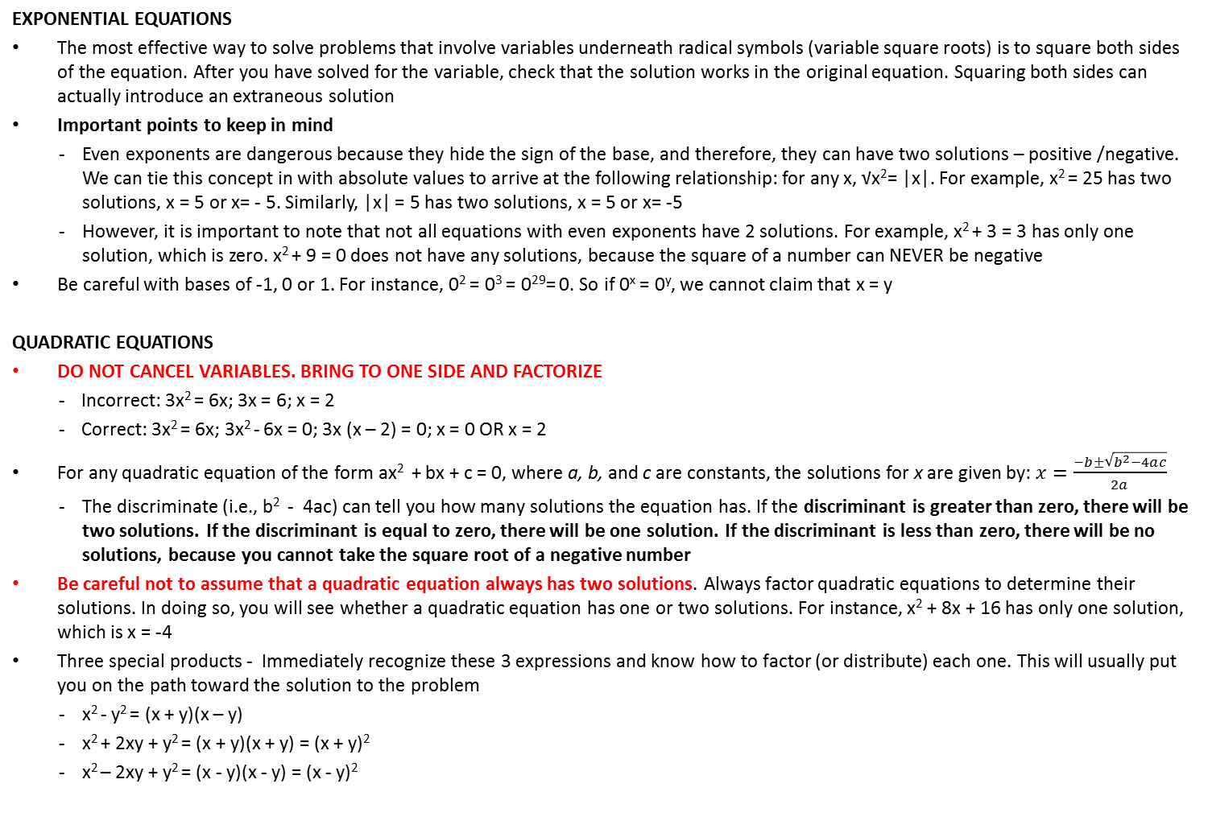
EXPONENTIAL AND QUADRATIC EQUATIONS
EXPONENTIAL EQUATIONS
The most effective way to solve problems that involve variables underneath radical symbols (variable square roots) is to square both sides of the equation. After you have solved for the variable, check that the solution works in the original equation. Squaring both sides can actually introduce an extraneous solution
Important points to keep in mind
Even exponents are dangerous because they hide the sign of the base, and therefore, they can have two solutions – positive /negative. We can tie this concept in with absolute values to arrive at the following relationship: for any x, √x²= |x|. For example, x² = 25 has two solutions, x = 5 or x= - 5. Similarly, |x| = 5 has two solutions, x = 5 or x= -5
However, it is important to note that not all equations with even exponents have 2 solutions. For example, x² + 3 = 3 has only one solution, which is zero. x² + 9 = 0 does not have any solutions, because the square of a number can NEVER be negative
Be careful with bases of -1, 0 or 1. For instance, 0² = 0³ = 0²⁹= 0. So if 0^{x} = 0^{y}, we cannot claim that x = y
QUADRATIC EQUATIONS
DO NOT CANCEL VARIABLES. BRING TO ONE SIDE AND FACTORIZE
Incorrect: 3x² = 6x; 3x = 6; x = 2
Correct: 3x² = 6x; 3x² - 6x = 0; 3x (x – 2) = 0; x = 0 OR x = 2
For any quadratic equation of the form ax² + bx + c = 0, where a, b, and c are constants, the solutions for x are given by: $x=\frac{−b±\sqrt{b^{2}−4ac}}{2a}$
The discriminate (i.e., b² - 4ac) can tell you how many solutions the equation has. If the discriminant is greater than zero, there will be two solutions. If the discriminant is equal to zero, there will be one solution. If the discriminant is less than zero, there will be no solutions, because you cannot take the square root of a negative number
Be careful not to assume that a quadratic equation always has two solutions. Always factor quadratic equations to determine their solutions. In doing so, you will see whether a quadratic equation has one or two solutions. For instance, x² + 8x + 16 has only one solution, which is x = -4
Three special products - Immediately recognize these 3 expressions and know how to factor (or distribute) each one. This will usually put you on the path toward the solution to the problem
x² - y² = (x + y)(x – y)
x² + 2xy + y² = (x + y)(x + y) = (x + y)²
x² – 2xy + y² = (x - y)(x - y) = (x - y)²

Slide 68
INEQUALITIES

Slide 69
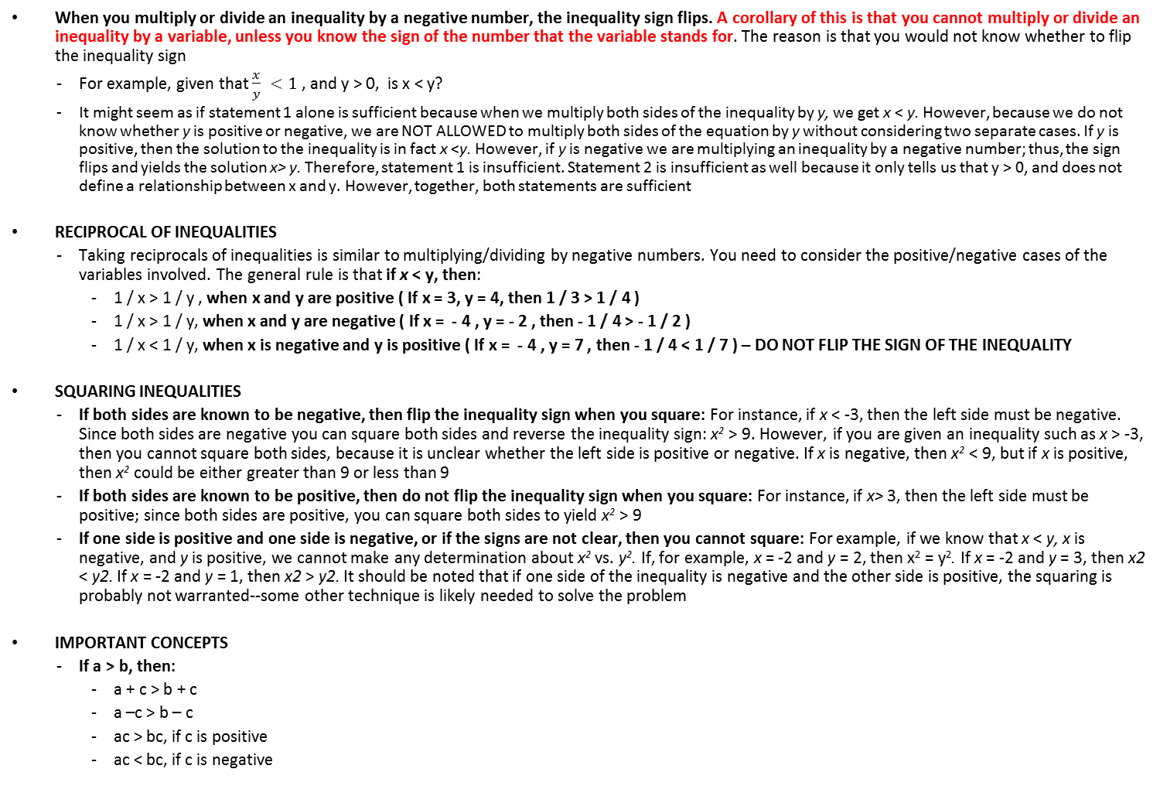
INEQUALITIES
When you multiply or divide an inequality by a negative number, the inequality sign flips. A corollary of this is that you cannot multiply or divide an inequality by a variable, unless you know the sign of the number that the variable stands for. The reason is that you would not know whether to flip the inequality sign
For example, given that $\frac{x}{y} <1$, and y > 0, is x < y?
It might seem as if statement 1 alone is sufficient because when we multiply both sides of the inequality by y, we get x < y. However, because we do not know whether y is positive or negative, we are NOT ALLOWED to multiply both sides of the equation by y without considering two separate cases. If y is positive, then the solution to the inequality is in fact x <y. However, if y is negative we are multiplying an inequality by a negative number; thus, the sign flips and yields the solution x> y. Therefore, statement 1 is insufficient. Statement 2 is insufficient as well because it only tells us that y > 0, and does not define a relationship between x and y. However, together, both statements are sufficient
RECIPROCAL OF INEQUALITIES
Taking reciprocals of inequalities is similar to multiplying/dividing by negative numbers. You need to consider the positive/negative cases of the variables involved. The general rule is that if x < y, then:
1 / x > 1 / y , when x and y are positive ( If x = 3, y = 4, then 1 / 3 > 1 / 4 )
1 / x > 1 / y, when x and y are negative ( If x = - 4 , y = - 2 , then - 1 / 4 > - 1 / 2 )
1 / x < 1 / y, when x is negative and y is positive ( If x = - 4 , y = 7 , then - 1 / 4 < 1 / 7 ) – DO NOT FLIP THE SIGN OF THE INEQUALITY
SQUARING INEQUALITIES
If both sides are known to be negative, then flip the inequality sign when you square: For instance, if x < -3, then the left side must be negative. Since both sides are negative you can square both sides and reverse the inequality sign: x² > 9. However, if you are given an inequality such as x > -3, then you cannot square both sides, because it is unclear whether the left side is positive or negative. If x is negative, then x² < 9, but if x is positive, then x² could be either greater than 9 or less than 9
If both sides are known to be positive, then do not flip the inequality sign when you square: For instance, if x> 3, then the left side must be positive; since both sides are positive, you can square both sides to yield x² > 9
If one side is positive and one side is negative, or if the signs are not clear, then you cannot square: For example, if we know that x < y, x is negative, and y is positive, we cannot make any determination about x² vs. y². If, for example, x = -2 and y = 2, then x² = y². If x = -2 and y = 3, then x2 < y2. If x = -2 and y = 1, then x2 > y2. It should be noted that if one side of the inequality is negative and the other side is positive, the squaring is probably not warranted--some other technique is likely needed to solve the problem
IMPORTANT CONCEPTS
If a > b, then:
  a + c > b + c
  a –c > b – c
  ac > bc, if c is positive
  ac < bc, if c is negative

Slide 70
INEQUALITIES
COMBINING INEQUALITIES
Many GMAT inequality problems involve more than one inequality. To solve such problems, you may need to convert several inequalities to a compound inequality, which is a series of inequalities strung together
For example, If x > 8, x < 17, and x + 5 < 19, what is the range of possible values for x?
First, solve any inequalities that need to be solved. In this example, only the last inequality needs to be solved: x < 14
Second, simplify the inequalities so that all the inequality symbols point in the same direction, preferably to the left (less than): 8 < x, x <17, x < 14
Third, combine the inequalities by taking the more limiting upper and lower extremes: 8 < x < 14
Another helpful approach is to combine inequalities by adding the inequalities together. However, note that we should never subtract or divide two inequalities, and can only multiply inequalities together under certain circumstances
For example, is mn < 10 given that (1) m < 2 (2) n < 5
It is tempting to multiply these two statements together and conclude that mn < 10. That would be a mistake, however, because both m and n could be negative numbers that yield a number larger than 10 when multiplied together. For example, if m = -2 and n = -6, then mn = 12, which is greater than 10. Since you can find cases with mn < 10 and cases with mn > 10, the correct answer is (E): The two statements together are INSUFFICIENT
Consider the following variation: if both m and n are positive, is mn < 10 given that (1) m < 2 (2) n < 5 . Since the variables are positive, we can multiply these inequalities together and conclude that mn < 10. The correct answer is (C)
MANIPULATING COMPOUND INEQUALITIES
Sometimes a problem with compound inequalities will require you to manipulate the inequalities in order to solve the problem. You can perform operations on a compound inequality as long as you remember to perform those operations on every term in the inequality, not just the outside terms.
For example, consider the equation x + 3 <Y < x + 5
Wrong: x < y < x + 2 ( 3 needs to be subtracted from each term)
Correct: x < y - 3 < x + 2
ADDING INEQUALITIES – very powerful technique!
In order to add inequalities, we must make sure the inequality signs are facing the same direction. If x < y and w < z, then x + w < y + z
For example, is a < c, given that (1) b > d and (2) ab² – b > b²c – d
This is a multiple variable inequality problem, so you must solve it by doing algebraic manipulations on the inequalities
(1) INSUFFICIENT: Statement (1) relates b to d, while giving us no knowledge about a and c
(2) INSUFFICIENT: Statement (2) does give a relationship between a and c, but it still depends on the values of b and d. One way to see this clearly is by realizing that only the right side of the equation contains the variable d. Perhaps ab² – b is greater than b²c – d simply because of the magnitude of d. Therefore there is no way to draw any conclusions about the relationship between a and c.
(1) AND (2) SUFFICIENT: By adding the two inequalities from statements (1) and (2) together, we can come to the conclusion that a > c. Two inequalities can always be added together as long as the direction of the inequality signs is the same:
ab² – b > b²c – d
(+) b > d
-----------------------
ab² > b²c
Now divide both sides by b². Since b² is always positive, you don't have to worry about reversing the direction of the inequality. The final result: a > c

Slide 71
INEQUALITIES – USING EXTREME VALUES
One effective technique for solving GMAT inequality problems is to focus on the EXTREME VALUES of a given inequality. This is particularly helpful when solving the following types of inequality problems:
Problems with multiple inequalities where the question involves the potential range of values for variables in the problem
Problems involving both equations and inequalities
PROBLEM TYPE | EXAMPLE
INEQUALITIES WITH RANGES | Given that 0 <= x <= 3, and y < 8, which of the following could NOT be the value of xy? 0, 8, 12, 16, 24 What is the lowest value for xy? Plug in the lowest values for both x and y. In this problem, y has no lower limit, so there is no lower limit to xy. What is the highest value for xy? Plug in the highest values for both x and y. In this problem, the highest value for x is 3, and the highest value for y is less than 8. Because the upper extreme for xy is less than 24, xy CANNOT be 24. Notice that we would run into trouble if x did not have to be non-negative. Consider this slight variation: Given that -1 <= x <= 3, and y < 8, what is the possible range of values for xy? Because x could be negative and because y could be a large negative number, there is no longer an upper extreme on xy. For example, if x = -1 and y = -1,000, then xy = 1,000. Obviously, much larger results are possible for xy if both x and y are negative. Therefore, xy can equal any number.
INEQUALITIES WITH EQUATIONS | If 2h + k < 8, g + 3h = 15, and k = 4, what is the possible range of values for g? First, we can simplify the inequality by plugging 4 in for k to simplify the inequality: h < 2 G = 15 – 3 (less than 2) G = 15 – Less than 6 G = Greater than 9 (Notice that when we subtract LT6 from 15, we have to CHANGE the extreme value sign from LT to GT. Think of it this way; if we subtract 6 from 15, the result is 9. But if we subtract a number SMALLER than 6 from 15, the result will be LARGER than 9)
OPERATION | EXAMPLE | PROCEDURE
Addition | 8 + < 2 | Add just like regular numbers: 8 + LT2 = LTI0 (i.e., < 10)
Subtraction | 8 - <2 | Subtract and flip the extreme value: 8 - LT2 = GT6 (i.e., > 6)
Multiplication | a) 8 * <2 b) -7 * <2 | a) Multiply just like regular numbers: 8 * LT2 = LT16 (i.e., < 16) b) Multiply and flip the extreme value: -7 * LT2 = GT(-14) (i.e., > -14)
Division | 8 / <2 | Divide and flip the extreme value (if we know that LT2 is positive): 8 / LT2 = GT4 (i.e., > 4)
Multiply two extreme values | < 8 * < 2 | Multiply just like regular numbers (if we know that both extreme values are positive) LT8* LT2 = LT16 (i.e., < 16)

Slide 72
INEQUALITIES AND ABSOLUTE VALUES
Solving inequalities
√x² = |x|
It is often helpful to try to visualize the problem with a number line. For example, take the inequality |x| = 5. One way to understand this inequality is to say "x must be less than 5 units from zero on the number line." Indeed, one interpretation of absolute value is simply distance on the number line. For a simple absolute value expression such as lx|, we are evaluating distance from zero. The range therefore, would be -5 < x < 5
Equations involving absolute value require you to consider two scenarios: one where the expression inside the absolute value brackets is positive, and one where the expression is negative. The same is true for inequalities. Note that you should never change I x – 5 |to x + 5. Remember, when you drop the absolute value signs, you either leave the expression alone or enclose the ENTIRE expression in parentheses and put a negative sign in front.
Example: Given that | x – 2 | < 5, what is the range of possible values of x?
To work out the FIRST scenario, we simply remove the absolute value brackets and solve: x – 2 < 5 ; x < 7
To work out the SECOND scenario, we reverse the signs of the terms inside the absolute value brackets, remove the brackets, and solve again: - (x - 2) < 5 ; - x + 2 < 5 ; - x < 3 ; x > - 3
Therefore, range is -3 < x < 7
iii. Inequalities with two absolute value expressions
Because there are two absolute value expressions, each of which yields two algebraic cases, it seems that we need to test four cases overall: positive/positive, positive/negative, negative/positive, and negative/negative
Example: Given that | x – 2 | = |2x – 3 |, what is the range of possible values of x?
The positive/positive case: (x- 2) = (2x- 3)
The positive/negative case: (x - 2) = -(2x - 3)
The negative/positive case: - (x - 2) = (2x- 3)
The negative/negative case: - (x- 2) = - (2x- 3)

Slide 73
INEQUALITIES AND ABSOLUTE VALUES – EXAMPLES
Problem | Solution
If |x| + |y| = - x – y and xy does not equal 0, which of the following must be true x + y > 0 x + y < 0 x – y > 0 x – y < 0 x² ⁻ y^{2 >} 0 | The |x| + |y| on the left side of the equation will always add the positive value of x to the positive value of y, yielding a positive value. Therefore, the -x and the -y on the right side of the equation must also each yield a positive value. The only way for -x and -y to each yield positive values is if both x and y are negative A. FALSE: For x + y to be greater than zero, either x or y has to be positive B. TRUE: Since x has to be negative and y has to be negative, the sum of x and y will always be negative C, D and E: UNCERTAIN: All that is certain is that x and y have to be negative. Since x can have a larger magnitude than y and vice-versa, x – y could be greater/less than zero.
If x and y are integers and xy does not equal 0, is xy < 0 ? y = x⁴ – x³ -12y² – y²x + x²y² > 0 | The question asks if xy < 0. Knowing the rules for positives and negatives, we can rephrase the question as: Do x and y have the same sign? (1) INSUFFICIENT: We can factor the right side of the equation y = x⁴ – x³ as follows: y = x⁴ – x³ y = x³(x – 1) Let's consider two cases: when x is negative and when x is positive. When x is negative, x³ will be negative (a negative integer raised to an odd exponent results in a negative), and (x – 1) will be negative. Thus, y will be the product of two negatives, giving a positive value for y. When x is positive, x³ will be positive and (x – 1) will be positive (remember that the question includes the constraint that xy is not equal to 0, which means y cannot be 0, which in turn means that x cannot be 1). Thus, y will be the product of two positives, giving a positive value for y. In both cases, y is positive. However, we don't have enough information to determine the sign of x. Therefore, this statement alone is insufficient. (2) INSUFFICIENT: Let's factor the left side of the given inequality: -12y² – y²x + x²y² > 0 y²(-12 – x + x²) > 0 y²(x² – x – 12) > 0 y²(x + 3)(x – 4) > 0 The expression y² will obviously be positive, but it tells us nothing about the sign of y; it could be positive or negative. Since y does not appear anywhere else in the inequality, we can conclude that statement 2 alone is insufficient (without determining anything about x) because the statement tells us nothing about y. (1) AND (2) INSUFFICIENT: We know from statement (1) that y is positive; we now need to examine statement 2 further to see what we can determine about x. We previously determined that y²(x + 3)(x – 4) > 0. Thus, in order for y²(x + 3)(x – 4) to be greater than 0, (x + 3) and (x – 4) must have the same sign. There are two ways for this to happen: both (x + 3) and (x – 4) are positive, or both (x + 3) and (x – 4) are negative. For both expressions to be positive, x must be greater than 4, and for both expressions to be negative, x must be less than -3. In conclusion, statement (2) tells us that x > 4 OR x < -3. This is obviously not enough to determine the sign of x. Since the sign of x is still unknown, the answer is E

Slide 74
INEQUALITIES AND ABSOLUTE VALUES – EXAMPLES
Problem | Solution
What is x? |x| < 2 |x| = 3x -2 | (1) INSUFFICIENT: This expression provides only a range of possible values for x (i.e., -2 < x < 2) (2) SUFFICIENT: Absolute value problems often -- but not always -- have multiple solutions because the expression within the absolute value bars can be either positive or negative even though the absolute value of the expression is always positive. In order to determine the possible solutions for x, it is necessary to solve for x under both possible conditions. For the case where x > 0: x = 3x – 2 -2x = -2 x = 1 For the case when x < 0: x = -1(3x – 2) We multiply by -1 to make x equal a negative quantity. x = 2 – 3x 4x = 2 x = 1/2 Note however, that the second solution x = 1/2 contradicts the stipulation that x < 0, hence there is no solution for x where x < 0. Therefore, x = 1 is the only valid solution for (2). The correct answer is B

Slide 75
SEQUENCES AND FUNCTIONS
Sequences may be of two major types – arithmetic or geometric
Arithmetic progression is a series of numbers in which every term after the first can be derived from the immediately preceding term by adding to it a fixed quantity called common difference (d)
Geometric progression is a series of numbers in which each term is formed from the preceding by multiplying it by a constant factor ( r ). The constant factor is called the common ratio and is formed by dividing any term by the term which precedes it
To answer a question about a sequence, we not only need to know the rule the sequence follows, but also at least one term in the sequence

Slide 76
PROGRESSIONS AND SEQUENCES – ARITHMETIC PROGRESSION
Arithmetic progression is a series of numbers in which every term after the first can be derived from the immediately preceding term by adding to it a fixed quantity called common difference (d)
a, a + d, a + 2d, a + 3d are in Arithmetic Progression
Three numbers in an A.P should be taken as a – d, a, a+ d
Four numbers in an A.P. should be taken as a – 3d, a – d, a + d, a + 3d
A series of quantities is said to be in harmonic progression when their reciprocals are in A.P
IMPORTANT FORMULAE
nth term | first term + [(n – 1) *difference)] | A man receives $60 the first week and $3 more each week than the preceding. What does he get in the 20th week ? T₂₀ = 60 + (20 – 1)(3) = 117
Sum of the first n terms when the last term is unknown | n/2 [2a + (n – 1) *difference] | A person saves each year $100 more than he saved in the preceding year, and he saves $200 the first year. How many years would it take for his savings, not including interest, to amount to $23000 ? Let n be the number of years required; a = 200, d = 100 n/2 x [2(200) + (n – 1) 100] = 23000 n² + 3n – 460 = 0 (n – 20)(n + 23) = 0 n = 20 or n = –23 (rejected)
Sum of the first n terms when the last term is known | Average * number of terms
Sum of first n odd integers Note: “The sum of the first n odd numbers” does not mean the “sum of all odd numbers between 1 and n” For example, the sum of the odd numbers between 1 and 10 is different from the sum of the first 10 odd numbers | n² | What is the value of K if the sum of consecutive positive odd integers from 1 to K is 441? n² = 441 n = 21 (i.e., sum of the FIRST 21 odd integers, not the sum of odd integers between 1 and 21) Value of the nth term (in this case K) = 1 + (21-1)*2 K = 41
Sum of first n even integers | n*(n + 1) | What is the sum of even integers between 2 and 100? → 50*51
Sum of squares of first n integers | [n*(n+1)*(2n+1)]/6
Sum of cubes of first n integers | [{n*(n + 1)}/2]

Slide 77
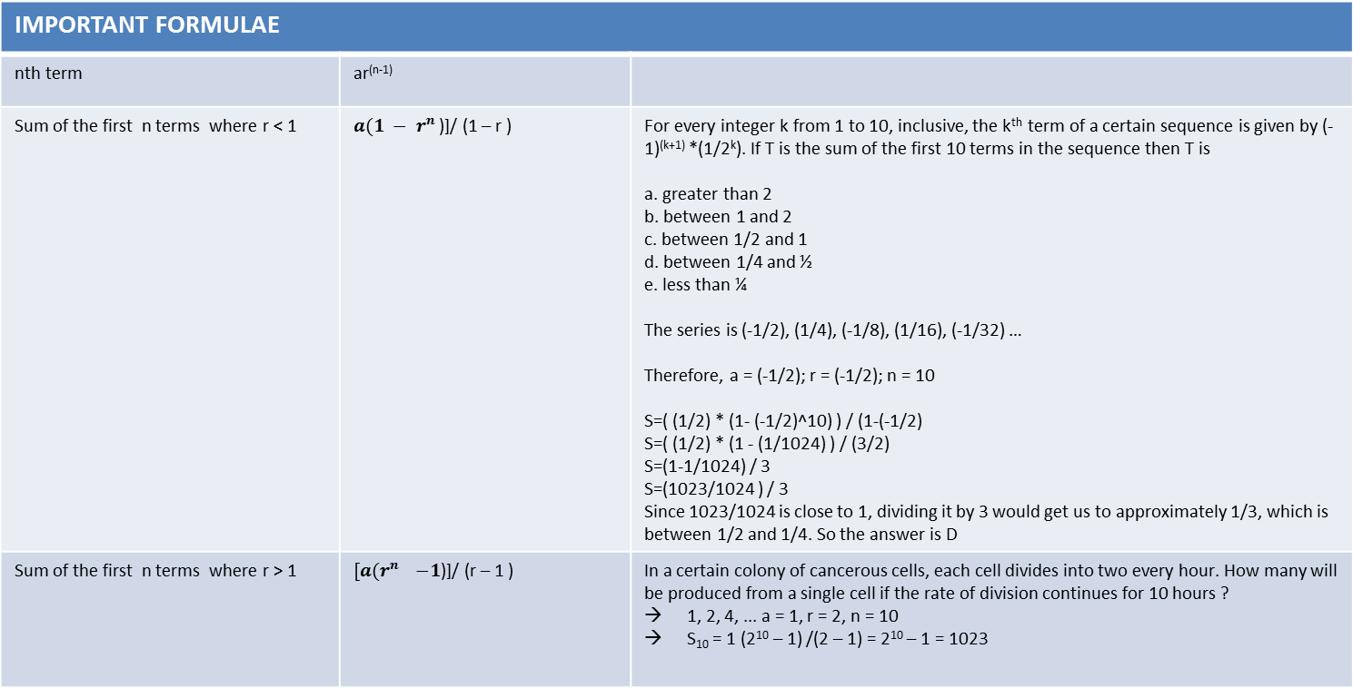
PROGRESSIONS AND SEQUENCES – GEOMETRIC PROGRESSION
Geometric progression is a series of numbers in which each term is formed from the preceding by multiplying it by a constant factor ( r ). The constant factor is called the common ratio and is formed by dividing any term by the term which precedes it. For example, in the series 3,9,27,81 and 243, the factor is 3
Three numbers in a G.P. should be taken as a/r, a, ar
Four numbers in a G.P. should be taken as a/r³, a/r, ar, ar³
IMPORTANT FORMULAE
nth term | ar^{(n-1)}
Sum of the first n terms where r < 1 | $a{(1 − r}^{n }$)]/ (1 – r ) | For every integer k from 1 to 10, inclusive, the k^{th} term of a certain sequence is given by (-1)^{(k+1)} *(1/2^{k}). If T is the sum of the first 10 terms in the sequence then T is a. greater than 2 b. between 1 and 2 c. between 1/2 and 1 d. between 1/4 and ½ e. less than ¼ The series is (-1/2), (1/4), (-1/8), (1/16), (-1/32) … Therefore, a = (-1/2); r = (-1/2); n = 10 S=( (1/2) * (1- (-1/2)^10) ) / (1-(-1/2) S=( (1/2) * (1 - (1/1024) ) / (3/2) S=(1-1/1024) / 3 S=(1023/1024 ) / 3 Since 1023/1024 is close to 1, dividing it by 3 would get us to approximately 1/3, which is between 1/2 and 1/4. So the answer is D
Sum of the first n terms where r > 1 | $[a{(r}^{n }−1$)]/ (r – 1 ) | In a certain colony of cancerous cells, each cell divides into two every hour. How many will be produced from a single cell if the rate of division continues for 10 hours ? 1, 2, 4, ... a = 1, r = 2, n = 10 S₁₀ = 1 (2¹⁰ – 1) /(2 – 1) = 2¹⁰ – 1 = 1023

Slide 78
FUNCTIONS
The "domain" of a function indicates the possible inputs and the "range" of a function indicates the possible outputs. For instance, the function f(x) = x² can take any input but never produces a negative number. So the domain is all numbers, but the range is f(x) >= O
COMPOUND FUNCTIONS – work from the INSIDE out
    If f(x) = x³ + √x and g(x) = 4x – 3, what is f(g(3))?
    First, solve g(3): 4.3 – 3 = 9. Now, plug-in 9 on f(x): 9³ + √9 = 729 + 3
DETERMINING WHETHER A FUNCTION IS EVEN/ODD - To do this, you take the function and plug –x in for x, and then simplify. If you end up with the exact same function that you started with (that is, if f(–x) = f(x), so all of the signs are the same), then the function is even. If you end up with the exact opposite of what you started with (that is, if f(–x) = –f(x), so all of the "plus" signs become "minus" signs, and vice versa), then the function is odd. So I'll plug –x in for x, and simplify: In all other cases, the function is "neither even nor odd“
Example # 1 : Determine algebraically whether f(x) = –3x² + 4 is even, odd, or neither
f(–x) = –3(–x)² + 4
= –3(x2) + 4
= –3x² + 4
Since the new expression is the same as the initial expression, the function is even
    COMMON FUNCTION TYPES
i) Direct proportionality means that the two quantities always change by the same factor and in the same direction. For instance, tripling the input will cause the output to triple as well. Direct proportionality relationships are of the form Y = kx, where x is the input value, y is the output value and k is the proportionality constant. This equation can also be written as y/x = k
Example: The maximum height reached by an object thrown directly upward is directly proportional to the square of the velocity with which the object is thrown. If an object thrown upward at 16 feet per second reaches a maximum height of 4 feet, with what speed must the object be thrown upward to reach a maximum height of 9 feet?
Solution: Typically with direct proportion problems, you will be given "before" and "after" values. Simply set up ratios to solve the problem for example, y1 and x1 can be used for the "before” values and y2 and x2 can be used for the "after" values. We then write y1/x1 = y2/x2 , since both ratios are equal to the same constant k. In the problem given above, note that the direct proportion is between the height and the square of the velocity, not the velocity itself. Therefore, write the proportion as (4/16²) = 9/v² ; v² = 576; v = 24
ii) Inverse proportionality means that the two quantities change by RECIPROCAL factors. Cutting the input in half will actually double the output. Inverse proportionality relationships are of the form yx = k. In these cases, set up the ratio as a product, and then solve
    iii) Linear growth - Many GMAT problems, especially word problems, feature quantities with linear growth (or decay), i.e., they grow at a constant rate. Such quantities are determined by the linear function: Y = mx + b. In this equation, the slope m is the constant rate at which the quantity grows. The y-intercept b is the value of the quantity at time zero, and the variable (in this case, x) stands for time. For instance, if a baby weighs 9 pounds at birth and gains 1.2 pounds per month, the function of his weight is: w = 1.2t + 9 (t = nº of months)

Slide 79
COMBINATORICS AND PROBABILITY

Slide 80
COMBINATORICS
“Does it matter if the two items (or however many items you have) positions are changed?” If the answer is yes, it is a permutations problem, if not, it is a combinations problem
PERMUTATION
      ORDER MATTERS - a permutation is nothing but an ordered combination. Essentially, permutation questions are about taking a group of objects and totaling the number of ways in which they can be arranged in specific/pre-defined ways
      The number of permutations of r items, chosen from a pool of n items, is n! / (n-r)!
      The number of permutations when things are not all different : If there be n things, p of them of one kind, q of another kind, r of still another kind and so on, then the total number of permutations is given by n! / (p! q! r!...)
As a special case, the number of permutations of all n items in a pool of n items is just n! , and the number of ways to arrange n distinct objects along a fixed circle is: (n – 1)!
COMBINATION
ORDER DOES NOT MATTER (i.e., whether the events are taking place simultaneously or sequentially). Since the order does not matter, we need to remove all the “duplicate” cases
The number of combinations of r items, chosen from a pool of n items, is n! / (n-r)! r!
Replacement / Repetition
Potential outcomes that are replaced or constant
Examples
  How many possibilities for a combination lock with 40 numbers that requires 3 selections
Non – replacement
Potential outcomes that decrease with each selection
Examples
  How many possibilities for a combination lock with 40 numbers that requires 3 selections and cannot have the same number twice
Combinations from multiple groups
In this situation, combinations are being drawn from several groups to form a complete set. Figure out the combinations from each group and then multiply them together
Combinations from pairings
These are pairing questions – so they must take place in two
Example: 7 basketball teams with five players each are at a tournament. If each player shakes hands with every other player NOT on his own team, how many handshakes take place?
How many people take part in a handshake? Two. There are 35 people who could be in the first spot, but that person cannot shake hands with anyone on his own team. So that person has only 30 people who’s hands he can shake. Therefore, the number of combinations is (35*30)/2

Slide 81
PERMUTATIONS VS. COMBINATIONS
Permutation | Combination
Committees with position titles It matters if one person is the president and the other a vice president, or the other way around | Generic committees There is no rank so the committee is just one large union
Layer of colors used in a painting or project It matters if blue goes first and then red, or the other way around | Different colors used in a painting or project If the colors are not layered, then they are all on the canvas just the same
Combination of safe or lock 1435 is different from 1345 | Sum of the combination of a safe or lock 1 + 4 + 3 + 5 is the same as 1 + 3 + 4 + 5
Different outfits to wear from a full wardrobe Wearing a red shirt and blue pants is different from wearing a blue shirt and red pants | Different clothes to take on vacation from a larger selection If a red shirt, blue shirt, red pants, and blue pants are all put in a suitcase it does not matter which one is first or last
Order of winning 1st, 2nd, 3rd in a race (also Gold, Silver, Bronze) As in the Olympics, if one person wins the gold and another the silver that is different than the other way around | Different prizes to take home from a larger selection If you bring home a stuffed animal and a hat you can only bring both home one way
Arranging people in a row Steve, Maria and John in a row are different than Maria, Steve, and John | Putting people in a class If Steve, Maria and John are all in a class together, there is no first or last
Saying Hello You can say hello to a friend and he/she can say hello back, and they are two different events | Handshakes If you and a friend shake hands you are both doing the same act at the same time, so there can be no order
One concept that you need to know for the exam is that when dealing with combinations and permutations, each result corresponds to a unique set of circumstances. For example, if you have z people and know that choosing two of them would result in 15 different possible groups of two, it must be true that z = 6. No other value of z would yield exactly 15 different groups of two. So if you know how many subgroups of a certain size you can choose from an unknown original larger group, you can deduce the size of the larger group
Seating 5 people in 3 chairs, is the same as seating 3 people in 5 chairs

Slide 82
SOLVING COMBINATORICS PROBLEMS – BASIC STRATEGIES
FUNDAMENTAL COUNTING PRINCIPLE
If you must make a number of separate decisions, then multiply the number of ways to make each individual decision to find the number of ways to make all decisions together
Example: If you have 4 types of bread, 3 types of cheese and 2 types of ham and wish to make a sandwich, you can make it in 4*3*2 = 24 different ways
SLOT METHOD
For problems where some choices are restricted and/or affect other choices, choose most restricted options first (slot method)
      For example, you must insert a 5-digit lock code, but the first and last numbers need to be odd, and no repetition is allowed. How many codes are possible?
      In this problem, you do not want to choose the five digits in order. Instead, you should start by picking the first and last digits (which must be odd), because these digits are the most restricted. Because there are 5 different odd digits (1, 3, 5, 7, and 9), there are 5 ways of picking the first digit. Since no repetition is allowed, there are only 4 odd digits left for the last digit. You can then pick the other three digits in any order, but make sure you account for the lack of repetition. For those three choices, you have only 8, 7, and 6 digits available. Therefore, the total number of lock codes is 4 x 5 x 8 x 7 x 6 = 6,720
      SIMPLE FACTORIALS
The number of ways in which n different things can be arranged in a straight line, such that no one thing is allowed to appear more than once in any of the arrangements (i.e. when repetitions are not allowed) is n!. n! counts the rearrangements of n distinct objects as a special (but very common) application of the Slot Method
For example, In staging a house, a real-estate agent must place six different books on a bookshelf. In how many different orders can she arrange the books? Using the Fundamental Counting Principle, we see that we have 6 choices for the book that goes first, 5 choices for the book that goes next, and so forth. Ultimately, we have this total: 6! = 6 x 5 x 4 x 3 x 2 x 1 = 720 different orders
ANAGRAMS
An anagram is a rearrangement of the letters in a word or phrase. For instance, the word DEDUCTIONS is an anagram of DISCOUNTED, and so is the gibberish "word“ CDDEINOSTU
Anagrams with repeated words
The number of anagrams of a word is the factorial of the total number of letters, divided by the factorial(s) corresponding to each set of repeated letters
Example # 1
How many different anagrams (meaningful or nonsense) are possible for the word PIZZAZZ?
We might expect 7! possible combinations from the 7 letters in the word PIZZAZZ. However, there are only 210. Why are there, relatively speaking, so few anagrams? The answer lies in repetition: the four Z's are indistinguishable from each other. If the four Z's were all different letters, then we would have 7! = 5,040 different anagrams. To picture that scenario, imagine labeling the Z's with subscripts: Z1, Z2, Z3 and Z4. We could then list the 5,040 anagram. Now erase the subscripts from those 5,040 anagrams. You will notice that many "different“ arrangements-like AIPZ1Z2Z3Z4, AIPZ4Z2Z3Z1' and so on-are now the same. In fact, for any genuinely unique anagram-like AIPZZZZ-there are now 4! = 24 identical copies in the list of 5,040 anagrams, because there are 4! = 24 ways to rearrange the four Z's in the word PIZZAZZ without changing anything. Because this 24-fold repetition occurs for every unique anagram of PIZZAZZ, we take 7! (which counts the arrangements as if the letters were all distinct) and divide by 4! (= 24) to account for the 4 repeated Z's

Slide 83
SOLVING COMBINATORICS PROBLEMS – ADVANCED STRATEGIES
ARRANGEMENTS WITH CONSTRAINTS
Greg, Marcia, Peter, Jan, Bobby, and Cindy go to a movie and sit next to each other in 6 adjacent seats in the front row of the theatre. If Marcia and Jan will not sit next to each other, in how many different arrangements can the six people sit? | This is a simple arrangement with one unusual constraint: Marcia and Jan will not sit next to each other. To solve the problem, ignore the constraint for now. Just find the number of ways in which six people can sit in 6 chairs: 6! = 6 x 5 x 4 x 3 x 2 x 1 = 720. Because of the constraint on Jan and Marcia, though, not all of those no seating arrangements are viable. So you should count the arrangements in which Jan is sitting next to Marcia (the undesirable seating arrangements), and subtract them from the total of no. To count the ways in which Jan must sit next to Marcia, use the Glue Method: For problems in which items or people must be next to each other, pretend that the items "stuck together" are actually one larger item. We imagine that Jan and Marcia are "stuck together" into one person. There are now effectively 5 "people": JM (stuck together), G, P, B, and C. The arrangements can now be counted. These 5 "people" can be arranged in 5! = 120 different ways. Each of those 120 different ways, though, represents two different possibilities, because the "stuck together" movie-goers could be in order either as J-M or as M-J. Therefore, the total number of seating arrangements with Jan next to Marcia is 2 x 120 = 240. Finally, do not forget that those 240 possibilities are the ones to be excluded from consideration. The number of allowed seating arrangements is therefore 720 - 240, or 480
A woman has seven cookies – four chocolate chip and three oatmeal. She gives one cookie to each of her six children. If Deborah will only eat the kind of cookie that Kim eats, in how many different ways can the cookie be distributed? (the leftover cookie will be given to the dog) | There are two possibilities in this problem. Either Kim and Deborah will both get chocolate chip cookies or Kim and Deborah will both get oatmeal cookies. If Kim and Deborah both get chocolate chip cookies, then there are 3 oatmeal cookies and 2 chocolate chip cookies left for the remaining four children. There are 5!/3!2! = 10 ways for these 5 remaining cookies to be distributed--four of the cookies will go to the children, one to the dog. (There are 5! ways to arrange 5 objects but the three oatmeal cookies are identical so we divide by 3!, and the two chocolate chip cookies are identical so we divide by 2!.) If Kim and Deborah both get oatmeal cookies, there are 4 chocolate chip cookies and 1 oatmeal cookie left for the remaining four children. There are 5!/4! = 5 ways for these 5 remaining cookies to be distributed--four of the cookies will go to the children, one to the dog. (There are 5! ways to arrange 5 objects but the four chocolate chip cookies are identical so we divide by 4!.) Accounting for both possibilities, there are 10 + 5 = 15 ways for the cookies to be distributed
How many different combinations of outcomes can you make by rolling three standard (6-sided) dice if the order of the dice does not matter? | The three-dice combinations fall into 3 categories of outcomes: All three dice have the same number Two of the dice have the same number with the third having a different number than the pair All three dice have different numbers By calculating the number of combinations in each category, we can determine the total number of different possible outcomes by summing the number of possible outcomes in each category. First, let’s calculate how many combinations can be made if all 3 dice have the same number. Since there are only 6 numbers, there are only 6 ways for all three dice to have the same number (i.e., all 1’s, or all 2’s, etc.). Second, we can determine how many combinations can occur if only 2 of the dice have the same number. There are 6 different ways that 2 dice can be paired (i.e., two 1’s, or two 2’s or two 3’s, etc.). For each given pair of 2 dice, the third die can be one of the five other numbers. (For example if two of the dice are 1’s, then the third die must have one of the 5 other numbers: 2, 3, 4, 5, or 6.) Therefore there are 6 x 5 = 30 combinations of outcomes that involve 2 dice with the same number. Third, determine how many combinations can occur if all three dice have different numbers. Think of choosing three of the 6 items (each of the numbers) to fill three "slots." For the first slot, we can choose from 6 possible items. For the second slot, we can choose from the 5 remaining items. For the third slot, we can choose from the 4 remaining items. Hence, there are 6 x 5 x 4 = 120 ways to fill the three slots. However, we do not care about the order of the items, so permutations like {1,2,5}, {5, 2, 1}, {2, 5, 1}, {2, 1, 5}, {5, 1, 2}, and {1, 5, 2} are all considered to be the same result. There are 3! = 6 ways that each group of three numbers can be ordered, so we must divide 120 by 6 in order to obtain the number of combinations where order does not matter (every 1 combination has 6 equivalent permutations). Thus, there are 120/6 combinations where all dice have different numbers. The total number of combinations is the sum of those in each category or 6 + 30 + 20 = 56

Slide 84
SOLVING COMBINATORICS PROBLEMS – ADVANCED STRATEGIES
How many ways are there to split a group of 6 boys into two groups of 3 boys each? (The order of the groups does not matter) | Out of 6 boys, you can choose 3 in 6C3 ways and make the first group. The second group is of the remaining 3 boys. But when you do that, you have ordered the groups into first and second. The question mentions that the order of the groups does not matter. Hence, you need to divide your answer i.e. 6C3 by 2! to undo the ordering of the groups. That is, 6C3 gives you 20 ways. This includes: G1 - ABC and G2 - DEF G1 - DEF and G2 - ABC As two different ways but it is actually just one way because there is no G1 and G2. In both the cases, the two groups are ABC and DEF. Therefore, answer will be 20/2! = 10
A group of 8 friends want to play doubles tennis. How many different ways can the group be divided into 4 teams of 2 people? | Formula = The number of ways in which MN different items can be divided equally into M groups, each containing N objects and the order of the groups is not important is (mn)!/n^m*m! so its 8!/(2^4*4!) = 105
A certain restaurant offers 6 kinds of cheese and 2 kinds of fruits for its dessert platter. If each dessert platter contains an equal number of kinds of cheese and kinds of fruit, how many different desert platters could the restaurant offer? | 1 of each: 1 fruit * 1 cheese = 2 * 6 = 12 possibilities 2 of each: Well, you only have 2 fruits, so only one choice here. With 6 cheese, and 2 places, where order does not matter, you get 6!/(6-2)!2! = 6!/4!2 = 6*5/2 = 15 So 15 + 12 = 27 total possible platters
Two couples and one single person are seated at random in a row of five chairs. What is the probability that neither of the couples sits together in adjacent chairs? | Outcomes of couple A sitting together: 2*4!, outcomes of couple B sitting together: 2*4!, but we must deduct the possibility the 2 couples sitting together: 3!*2!*2! So outcomes of at least one couple sitting together= 48+48-24=72 Outcomes of no couple sitting together: 5!-72=48 possibility of no couple sitting together: 48/5!=2/5
In how many different ways can the letters A,A,B,B,B,C,D,E be arranged if the letter C must be to the right of the letter D? A.1680 B.2160 C.2520 D.3240 E.3360 | We have 8 letters out of which A appears twice and B appears three time. Total number of permutation of these letters (without restriction) would be: 8! / 2! 3! Now, in half of these cases D will be to the right of C and in half of these cases to the left, hence the final answer would be 3360/2 = 1680
How many ways can you arrange 30 people on a ferris wheel with 30 seats? | 29! since it is a circular permutation
How many ways can you arrange 5 people on a ferris wheel with 6 seats? | 5! Because it is a circular permutation of essentially 6 things - 5 people and one empty seat and there are (n-1)! circular permutations of n things. Here n = 6. If there were 4 people and 2 empty seats the answer would not be 5! any longer since the 4 people are different, but the 2 empty seats are indistinguishable. For example, let a, b, c, and d be the 4 people and e1 and e2 be the empty seats. There is no real difference between a b c d e1 e2 and a b c d e2 e1, but if you gave the answer (6-1)! = 5! you would count these identical permutations twice. The answer for this situation would be 5!/2! = 5*4*3 = 60

Slide 85
SOLVING COMBINATORICS PROBLEMS – ADVANCED STRATEGIES
Suppose you want to arrange 7 people, A, B, C, D, E, F, and G, in seats at a movie theater, subject to the rules: A, B, and C must sit together D must sit next to C | For example: first consider all the ways that the people can be arranged with A, B, and C sitting next to each other: 5!3! = 120 x 6 = 720 Now instead of asking how many of those arrangements have D sitting next to C, ask how many of those arrangements have D sitting next to the ABC-group. If we still consider the ABC-group to be a single clump, then we have a group of 5 "objects" to sort: ABC-group, D, E, F, and G. How many ways can they be arranged with D next to the ABC-group? We group ABC-group and D into a larger group. Now we have 4 "objects" to sort: ABC-D-group, E, F, and G, so they can be arranged in 4! ways. For each of those arrangements, within the ABC-D-group, the two sub-clumps -- the ABC-group and the element D -- can be ordered in 2! ways. And finally, within the ABC-group itself, its members can be ordered in 3! ways. So the number of arrangements such that: A, B, and C are sitting next to each other and D is sitting next to the ABC-group is 4! x 3! x 2 = 288. n all the arrangements that have D sitting next to the ABC-group, D is only sitting next to one member of that group. Since there are 3 possibilities for which member that will be, exactly 1/3 of the time D is sitting next to C. So if there are 288 arrangements where D is sitting next to the ABC-group, the number where D is sitting next to C is 288/3 = 96
A firm is divided into four departments, each of which contains four people. If a project is to be assigned to a team of three people, none of which can be from the same department, what is the greatest number of distinct teams to which the project could be assigned? (A) 4^3 (B) 4^4 (C) 4^5 (D) 6(4^4) (E) 4(3^6) | To choose 1st team member = we have 16 options (4 departments x 4 people) To choose 2nd member = we have 12 options (3 departments x 4 people) To choose 3rd member = we have 8 options ( 2 departments x 4 people) Total number of ways = 16 * 12 * 8 / 3! (because the order does not matter)

Slide 86
PROBABILITY
PROBABILITY = NUMBER OF FAVORABLE OUTCOMES TOTAL NUMBER OF OUTCOMES
PROBABILITY OF MULTIPLE EVENTS
AND
If two events have to occur together, generally an "and" is used. For example: "I will only be happy today if I get email and win the lottery." The "and" means that both events are expected to happen together
In the case of “and,” we multiply probabilities together to get a lower overall probability
Example:
If a coin is tossed twice, what is the probability that on the first toss the coin lands heads and on the second toss the coin lands tails?
The probability that the coin will land on heads is 1/2. The probability that the coin will land on Tails is also 1/2. Since we want them to happen together, we multiply individual probabilities 1/2 × 1/2 = 1/4
OR
If both events do not necessarily have to occur together, an “or” may be used. For example, I will be happy today if I win the lottery OR have email
“OR” means that we add probabilities together to get a higher overall probability
Example:
John will win $100 if, from a deck of 52 standard playing cards, he chooses either a 7 or a 9 when pulling a single card from the deck. What is the probability that John will win $100?
How can John win? He can win by pulling out either a 7 or a 9. His chances of doing that are higher than if he could win only by pulling out a 7. In that case, he’d only have 4 cards that would make him win $100 (because there are 4 7's in a standard deck), now he has 8 cards. To find the total probability, we need to figure out the probability of each event and then add them together. Therefore probability = (4/52) + (4/52) = 2/13
INDEPENDENT EVENTS
Events where the outcome of first event does not affect the probability of the second event
Example: coin toss
DEPENDENT EVENTS
Events where the probability of the second event is affected by the outcome of the first event
Example: Drawing from a pack of cards without replacing the card drawn
MUTUALLY EXCLUSIVE EVENTS
Two events cannot occur together → Add the probabilities of individual events
EVENTS CAN OCCUR TOGETHER
P (A or B) = P(A) + P(B) – P (A&B)
If you simply add P(A) and P(B) in situations when A and B can occur together, then you are overestimating the probability of either A or B (or both) occurring

Slide 87
PROBABILITY – 2
The greatest probability- the certainty that an event will occur-is 1. Thus, a probability of 1 means that the event must occur
The lowest probability-the impossibility that an event will occur is 0. Thus, a probability of 0 means that an event will NOT occur. For example, the probability that you roll a fair die once and it lands on the number 9 is impossible, or 0
If on a GMAT problem, "success“ contains multiple possibilities –especially if the wording contains phrases such as “at least" and “at most“ then consider finding the probability that success does not happen. If you can find this “failure" probability more easily (call it x) the probability you really want to find will be 1 – x
  Example: What is the probability that, on three rolls of a single fair die, at least of the rolls will be a six?
  Failure: What is the probability that NONE of the rolls will yield a 6? On each roll, there is a 5/6 probability that the die will not yield a 6. Thus, the probability that on all 3 rolls the die will not yield a 6 is (5/6)*(5/6)*(5*6) = 125/216
  Now, we originally defined success as rolling at least one six. Since we have found the probability of failure, we answer the original question by subtracting this probability from 1: 1 – (125/216) = 91/256

Slide 88
GEOMETRY

Slide 89
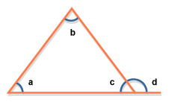
LINES AND ANGLES
Two straight lines which meet at a point form an angle between them
  Acute angle is between 0 and 90 degrees
  Right angle is 90 degrees
  Obtuse angle is between 90 degrees and 180 degrees
  Reflex angle is between 180 degrees and 360 degrees
A straight line is the shortest distance between two points and measures 180 degrees
Parallel lines are lines that never intersect, no matter how far they are stretched, and are equidistant
Perpendicular lines intersect at 90 degrees (may or may not bisect the line segment)
The sum of angles at a point is 360 degrees
INTERSECTING LINES
EXTERIOR ANGLES OF A TRIANGLE
    The interior angles formed by the intersecting lines form a circle, so the sum of these interior angles (i.e., a,b,c, and d) is 360 degrees
    The interior angles that combine to form a line sum to 180 degrees. These are termed supplementary angles. Thus, in the diagram, (a+b) = 180 degrees. Other supplementary angles are (b+c), (c+d), and (d+a)
    The angles formed opposite each other where these two lines intersect are equal. These are called vertical angles. Thus, a = c and b = d
a
Properties
d
b
c
    a + b + c = 180
    c + d = 180
    d = a + b
    Sum of the exterior angle is equal to the sum of the two interior opposite angles
    These properties are frequently tested on GMAT
Properties

Slide 90
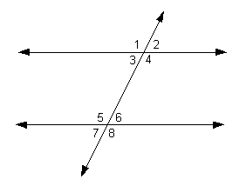
LINES AND ANGLES
PARALLEL LINES CUT BY A TRANSVERSAL
    GMAT can disguise the lines, by not drawing them completely. Extending them can help you to find out whether they are transversal or parallel. GMAT uses the symbol II to indicate 2 lines are parallel. MN II OP means those segments are parallel
    Alternate interior angles are equal
    Angles 3 and 6 are equal; angles 4 and 5 are equal
    Alternate exterior angles are equal
    Angles 1 and 8 are equal; angles 2 and 7 are equal
    Corresponding angles are equal (corresponding angles are one interior and one exterior angle that are on the same side of the transversal)
    Angles 1 and 5
    Angles 2 and 6
    Angles 3 and 7
    Angles 4 and 8
    It is important to note that if two lines cut by a transversal have any of the above properties, then the two lines must be parallel. For example, if alternate interior angles are equal, then the two lines cut by a transversal must be parallel
Properties

Slide 91
TWO – DIMENSIAL POLYGONS
TWO DIMENSIONAL POLYGONS
TRIANGLES – 3 SIDED
QUADRILATERALS – 4 SIDED
OTHERS – N SIDED
Equilateral
Isosceles
Scalene
Irregular quadrilaterals
Parallelogram
Rectangle
Rhombus
Square
All quadrilaterals are not necessarily parallelograms. For a quadrilateral to be a parallelogram opposite sides and opposite angles have to be equal and parallel
Trapezium
Pentagon – 5 sides
Hexagon – 6 sides
Comprised of 6 equilateral triangles. Therefore, the area of a hexagon will be 6 * area of an equilateral triangle
Octagon – 8 sides
SUM OF THE INTERIOR ANGLES OF A POLYGON – This depends on the number of sides (n) a polygon has: (n-2)*180
SUM OF THE EXTERIOR ANGLES OF A POLYGON = 360

Slide 92
TRIANGLES
TYPES OF TRIANGLES – SIDES
EQUILATERAL
ISOSCELES
SCALENE
All THREE SIDES ARE EQUAL
TWO SIDES ARE EQUAL AND THE THIRD SIDE IS LESS THAN THE SUM OF THE OTHER TWO SIDES
ALL THREE SIDES ARE DIFFERENT
TYPES OF TRIANGLES – ANGLES
ACUTE
OBTUSE
RIGHT – ANGLED
ALL ANGLES ARE LESS THAN 90 DEGREES
In a triangle ABC with the vertex at B, AB² + BC² > AC²
ONE ANGLE IS GREATER THAN 90 DEGREES
In a triangle ABC with the vertex at B, AB² + BC² < AC²
ONE ANGLE IS 90 DEGREES
The 45-45-90 Triangle is known as a right-angled isosceles triangle
In a triangle ABC with the vertex at B, AB² + BC² = AC²

Slide 93
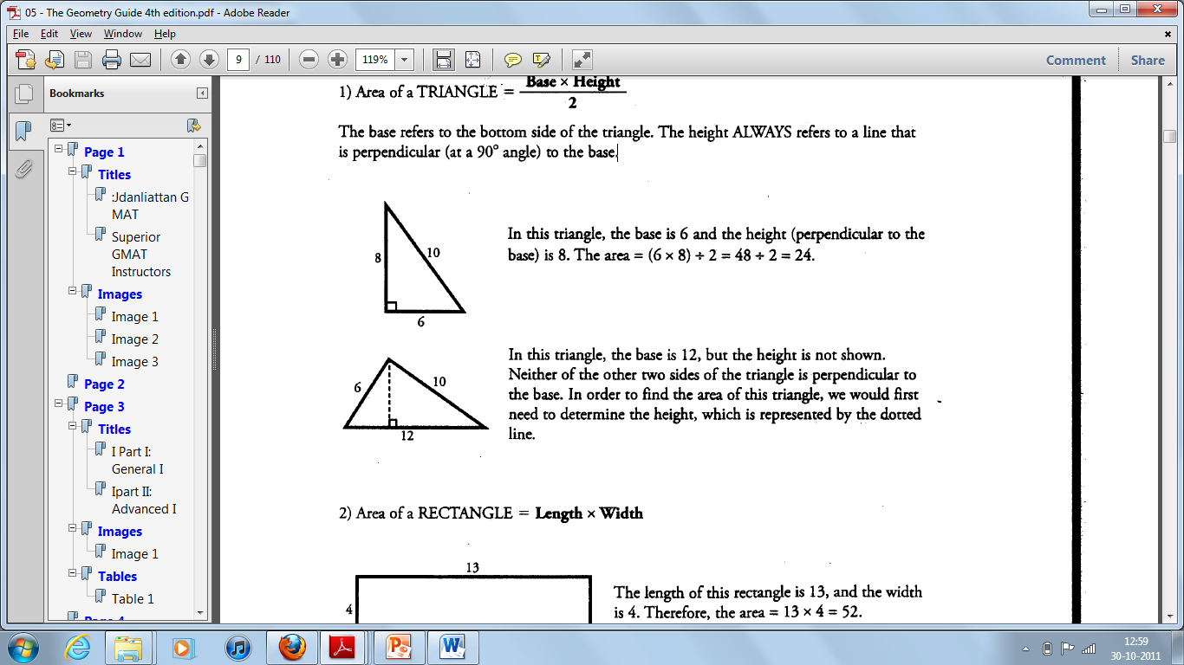
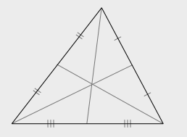
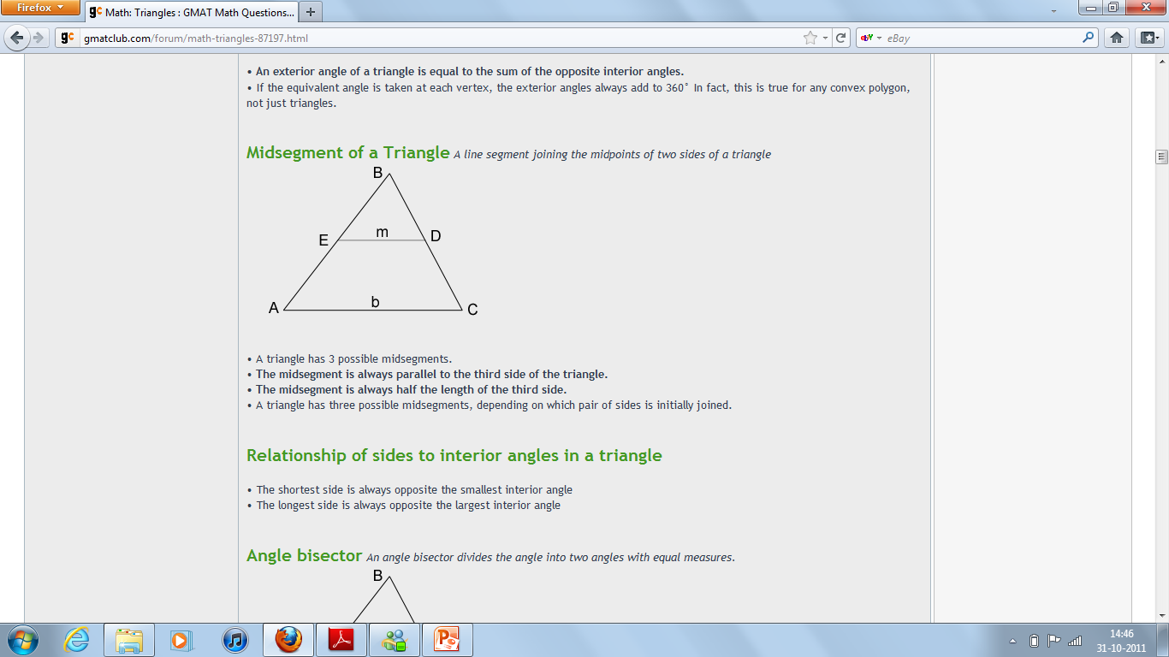
BASIC PROPERTIES OF TRIANGLES – A
Vertex | Refers to the corners of a triangle
Base | Refers to the bottom side of the triangle. Any one of the three sides can form the base
Height/Altitude | Refers to a line that is drawn perpendicular (at a 90 degree angle) to the base from the opposite vertex
Median | The median of a triangle is a line from a vertex to the midpoint of the opposite side Each median divides the triangle into two smaller triangles which have the same area Two-thirds of the length of each median is between the vertex and the centroid (point at which the three medians intersect), while one-third is between the centroid and the midpoint of the opposite side The triangle formed by joining the mid-points of the sides of an equilateral triangle will be half in perimeter and one- fourth in area
Area of a triangle | Area of a triangle is 1/2 * b * h The area of an equilateral triangle of side S is equal to (S² *√3 )/ 4
Mid segment of a triangle | The mid segment of a triangle is the line segment joining the midpoints of two sides of a triangle A triangle has 3 possible mid segments The mid segment is always parallel to the third side of the triangle The mid segment is always half the length of the third side
 | If two similar triangles have corresponding side lengths in ratio a:b, then their areas will be in ratio a²:b² For triangles with the same area, the perimeter is minimum for an equilateral triangle For triangles with same perimeter, the area is maximum for an equilateral triangle

Slide 94
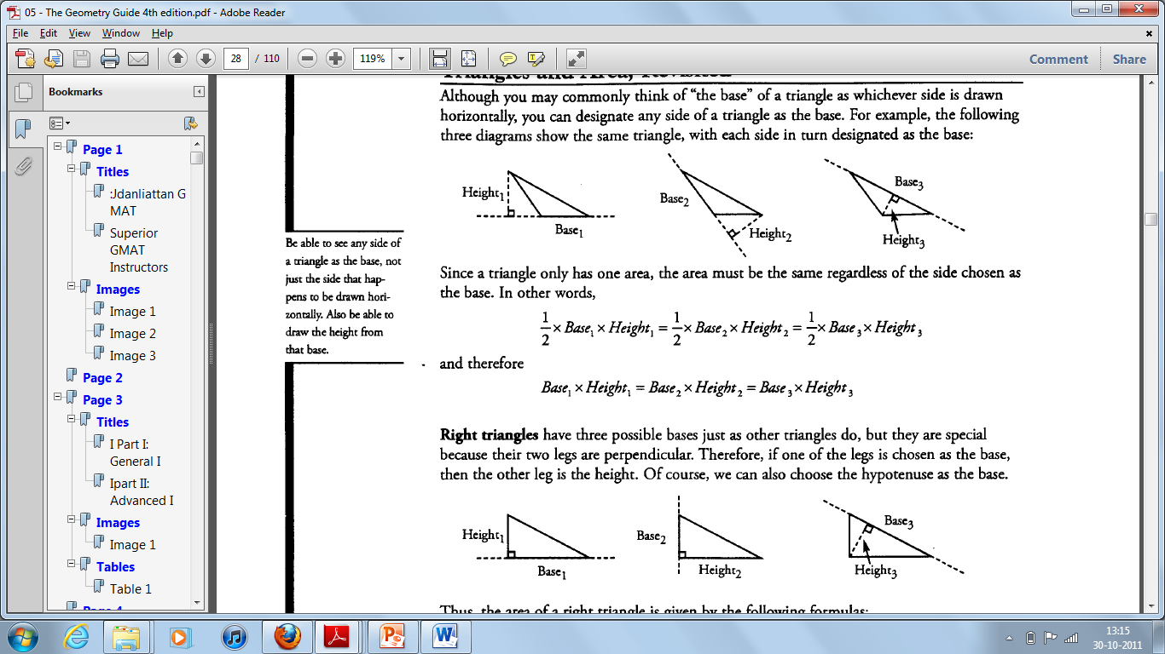
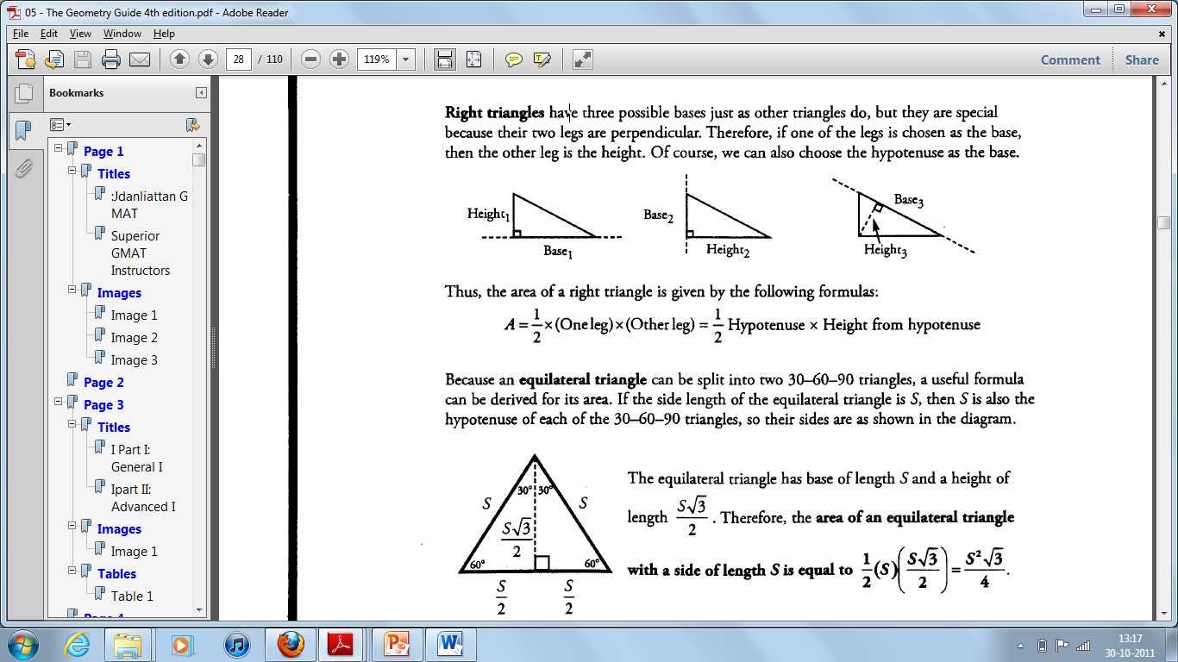
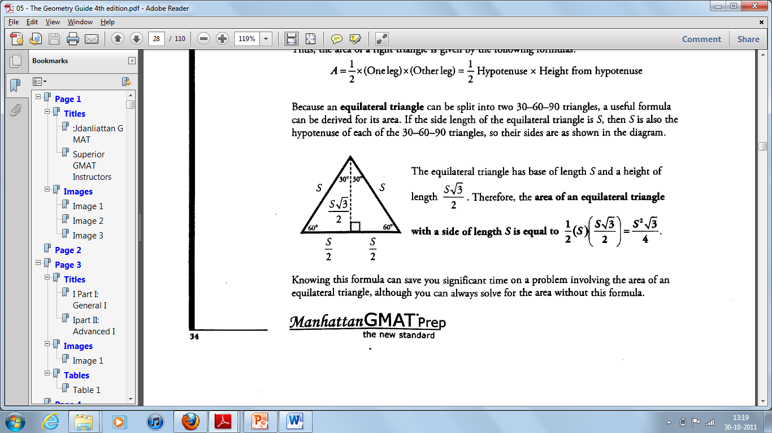
BASIC PROPERTIES OF TRIANGLES – C

Slide 95
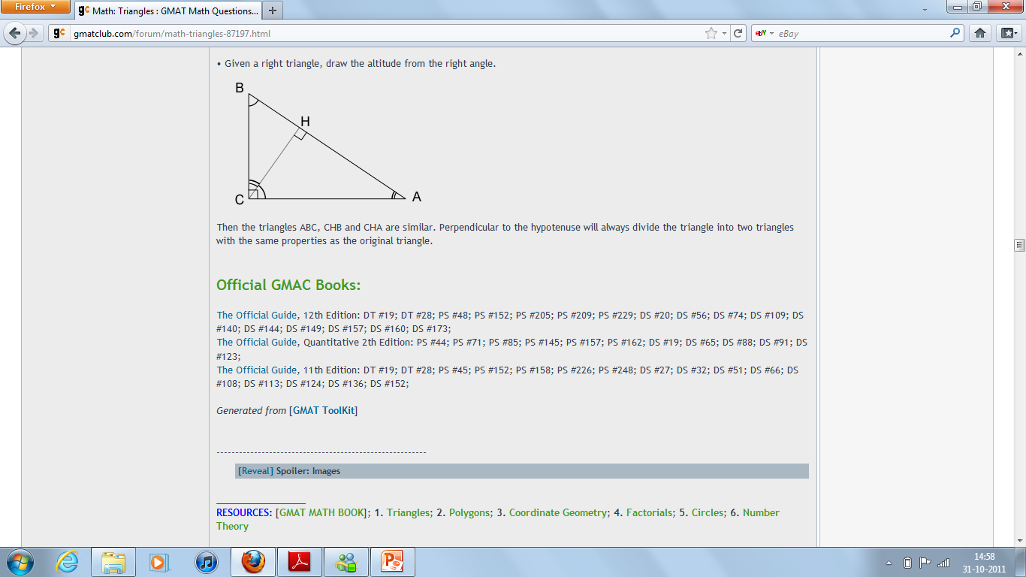
BASIC PROPERTIES OF TRIANGLES – B
ANGLES CORRESPOND TO THEIR OPPOSITE SIDE
This means that the largest angle is opposite the longest side, while the smallest angle is opposite the shortest side. Additionally, if two angles are equal, their sides are also equal
SUM OF THE ANGLES OF A TRIANGLE = 180 DEGREES
When one side is extended in any direction, an angle is formed with another side. This is called the exterior angle. There are six exterior angles in a triangle
SUM OF ANY TWO SIDES OF A TRIANGLE MUST BE GREATER THAN THE THIRD SIDE
DIFFERENCE BETWEEN ANY TWO SIDES IS LESS THAN THE THIRD SIDE
THE LENGTH OF THE THIRD SIDE MUST LIE BETWEEN THE SUM AND THE DIFFERENCE OF THE TWO GIVEN SIDES

Slide 96
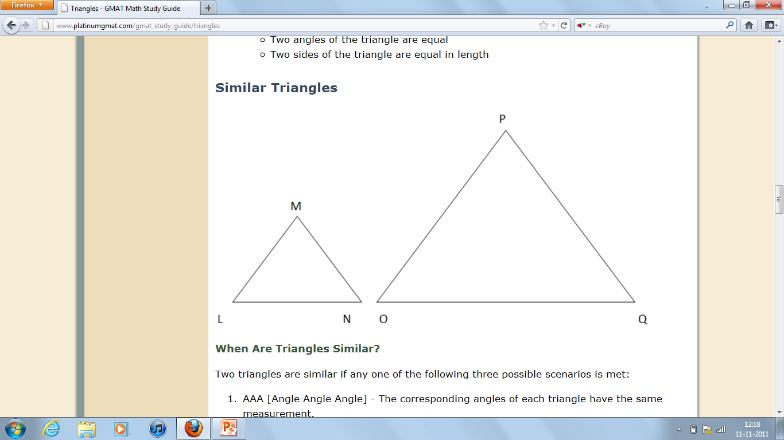
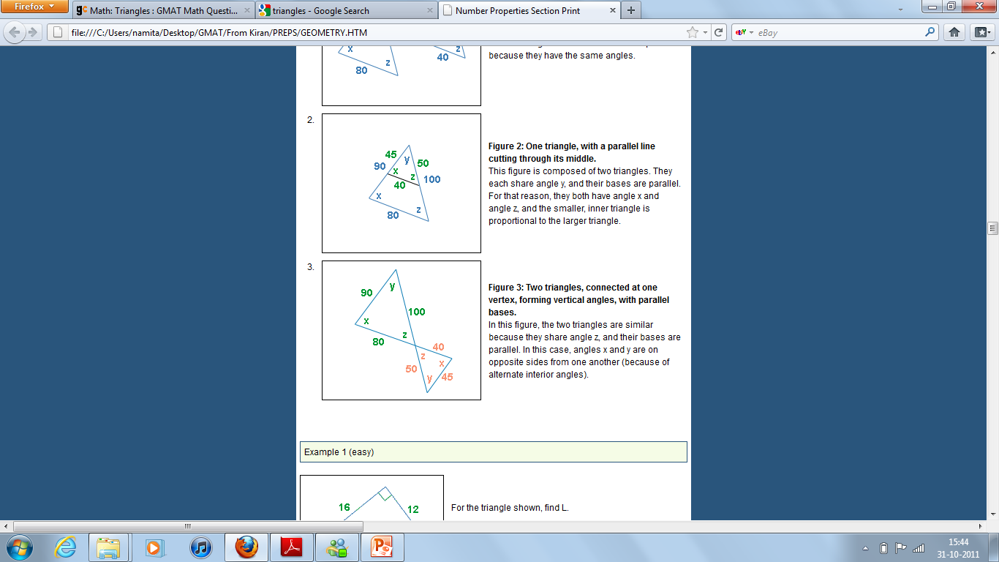
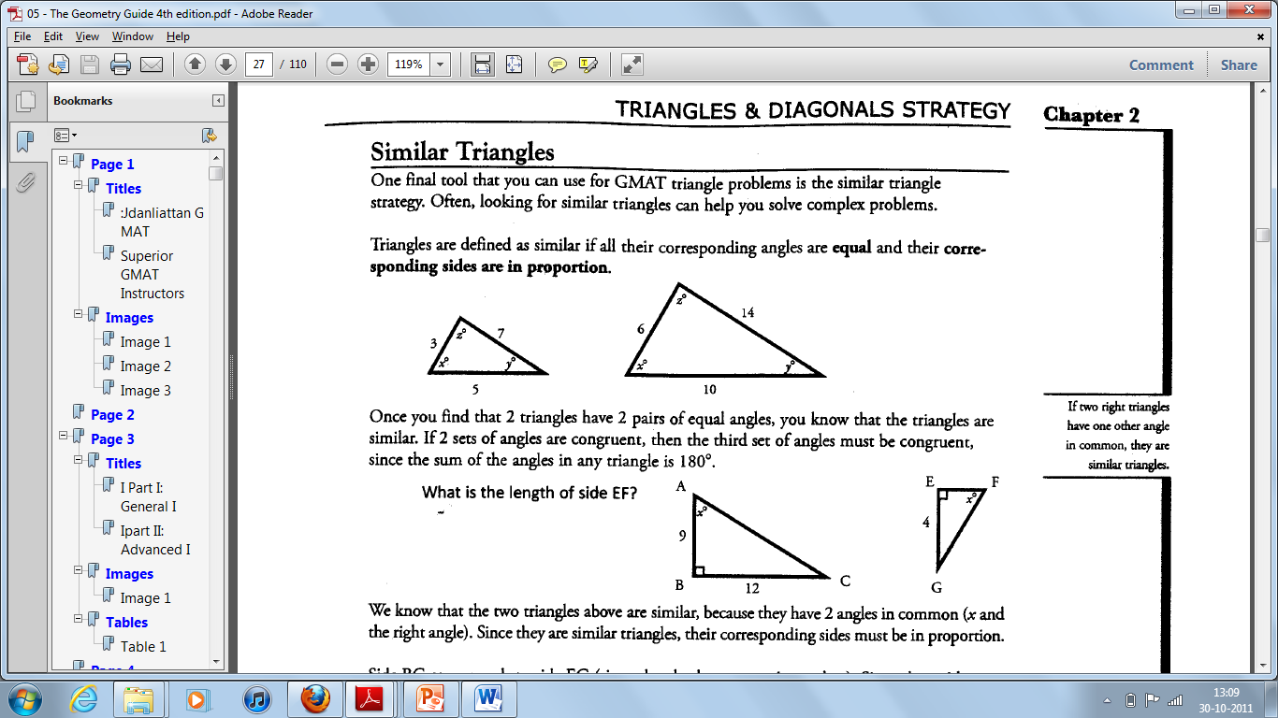
SIMILAR AND CONGRUENT TRIANGLES
Similarity – if any of the conditions are met –
Angle, angle, angle – if the corresponding angles of each triangle have the same measurement. In other words, the above triangles are similar if:
Angle L = Angle O; Angle N = Angle Q; Angle M = Angle P
Side, angle, side - An angle in one triangle is the same measurement as an angle in the other triangle and the two sides containing these angles have the same ratio. In other words, the above triangles are similar if:
Angle L = Angle O; ^{Side LM}/_{Side OP} = ^{Side LN}/_{Side OQ}
Side, side, side - Each pair of corresponding sides have the same ratio. In other words, the above triangles are similar if:
^{Side LM}/_{Side OP} = ^{Side LN}/_{Side OQ} = ^{Side MN}/_{Side PQ}

Slide 97
RIGHT- ANGLED TRIANGLE AND THE PYTHAGOREAN THEOREM
Pythagorean Theorem: c² = a² + b²
a and b are the legs, while c is the hypotenuse
Common combinations | Key multiples
3-4-5 3² + 4²= 5² * Watch out for impostor triangles! A random triangle with one side equal to 3 and another side equal to 4 does not necessarily have a third side of length 5 | 6-8-10 9-12-15 12-16-20
5-12-13 5² + 12² = 13² | 10-24-26
8-15-17 8² + 15² = 17²
a
c
b
THE 45-45-90 ISOSCELES TRIANGLE
The 45-45-90 triangle is a special triangle with 2 equal sides and a relation between each side. If you are given one dimension on a 45-45-90 triangle, you can find the others.
Relationship between sides
45° - 45° - 90°
Leg - leg - hypotenuse
: 1 : √2
x : x : x√2
  Therefore, in a 45-45-90 degree triangle, you only need to know the value of one side to determine the others
  A 45-45-90 is exactly half of a square. Two 45-45-90 triangles put together make up a square. So, if you are given the diagonal of a square, you can find the side by using the relation above. For example, if the diagonal of a square is 6√2, find the length of each of the two sides.
  (6√2)² = x² + x²
  36*2 = 2x²
  36 = x²
  → X = 6

Slide 98
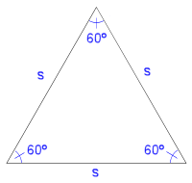
EQUILATERAL TRIANGLES AND THE 30-60-90 TRIANGLE
An equilateral triangle is one in which all three sides and all three angles are equal
Equilateral Triangles and the 30-60-90 Triangle:
HYPOTENUSE
30
30
HYPOTENUSE
L
ONG
L
ONG
60
60
SHORT
SHORT
RELATIONSHIP BETWEEN SIDES
30° | 60° | 90°
SHORT LEG | LONG LEG (HEIGHT) | HYPOTENUSE (SIDE)
1 | √3 | 2
x | x √3 | 2x

Slide 99
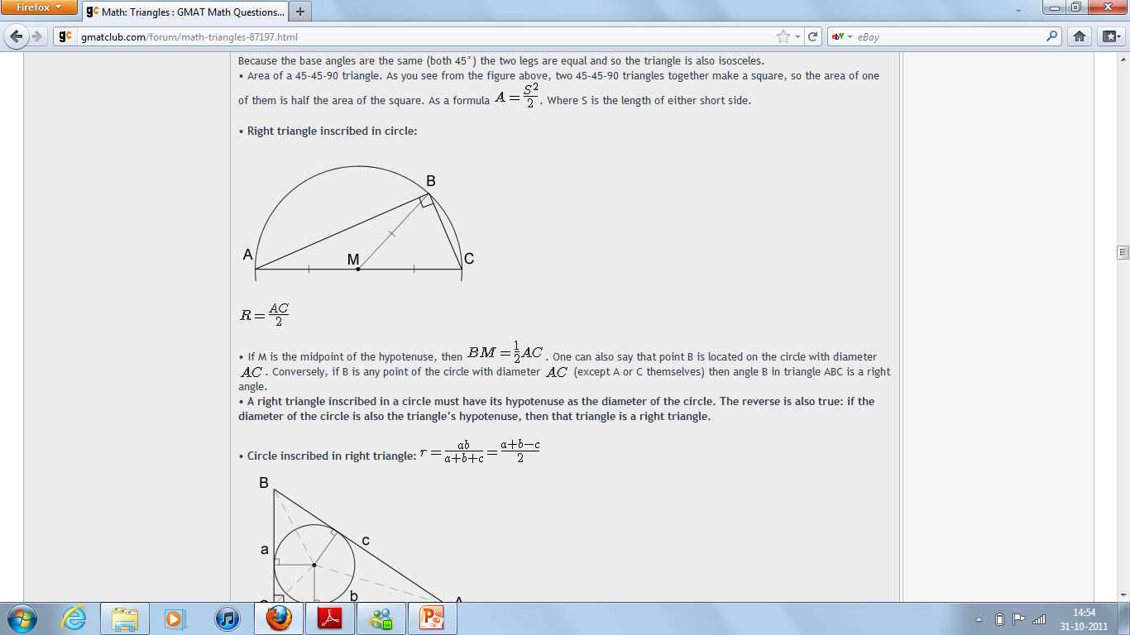
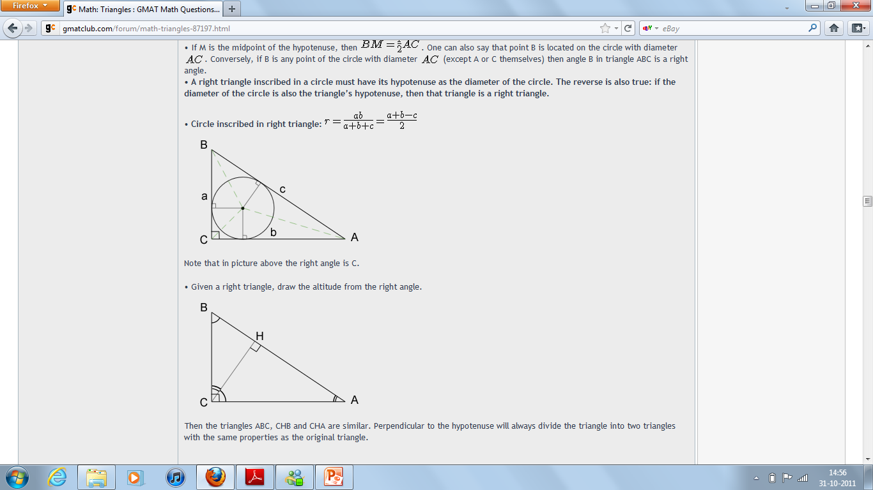
INSCRIBED AND CIRCUMSCRIBED TRIANGLES AND CIRCLES
A right triangle inscribed in a semi- circle must have its hypotenuse as the diameter of the circle. The reverse is also true: if the diameter of the circle is also the triangle’s hypotenuse, then that triangle is a right triangle

Slide 100
EXAMPLES
What is the perimeter of right triangle ABC? (1) AB = 5 (2) AC = 5√2 | Statement (1): We can't know the perimeter just by knowing one side of the right triangle. Not Sufficient Statement (2): We can't know the perimeter just by knowing one side of the right triangle. Not Sufficient Combining both – if AC is the hypotenuse, then the perimeter is 10 + 5√2. However, if BC is the hypotenuse, then the perimeter is 5 + 5√2 + 5√3 Insufficient – E

Slide 101
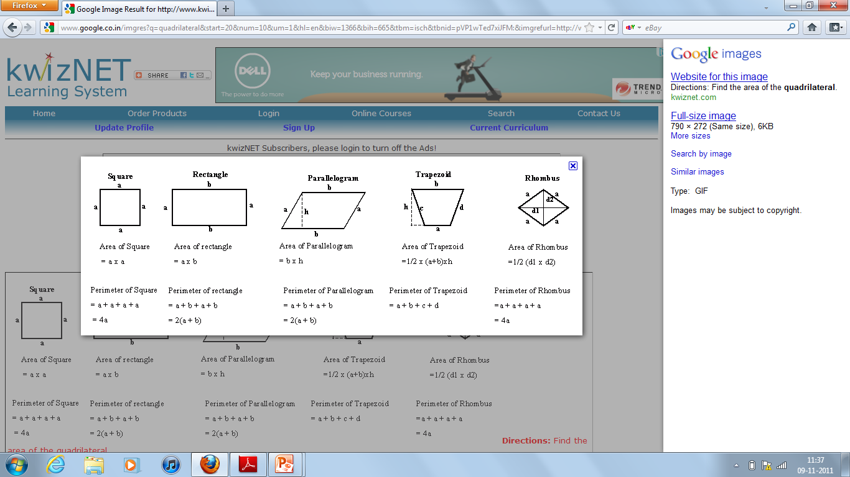
QUADRILATERALS
How to prove a quadrilateral is a parallelogram
If both pairs of opposite sides of a quadrilateral are equal
If both pairs of opposite angles of a quadrilateral are equal
If all pairs of consecutive angles of a quadrilateral are supplementary
If one pair of opposite sides of a quadrilateral is both equal and parallel
If the diagonals of a quadrilateral bisect each other
The area of a parallelogram is twice the area of a triangle created by one of its diagonals
Of all quadrilaterals with a given perimeter, the square has the largest area. Conversely, of all the quadrilaterals with a given area, the square is the one with the smaller perimeter
The diagonal formed by joining vertices of two smaller angles will be greater than the diagonal formed by joining vertices of two greater angles in a rhombus
The diagonals of a kite are perpendicular bisectors of each other. The kite also has two pairs of adjacent, congruent sides (i.e., all sides are not equal)– THE KITE IS NOT A PARALLELOGRAM

Slide 102
QUADRILATERALS
Shape | Area | Perimeter | Diagonal | Are Diagonals Equal? | Will diagonals bisect each other? | Property of sides and angles
Irregular Quadrilateral | 1/2 * diagonal * sum of both heights | Sum of its 4 sides |  | No | No | All sides and all angles are unequal
Parallelogram | Base * height | 2 (a + b), where a and b are the sides |  | No | Yes | Opposite angles and opposite sides are equal Consecutive (adjacent) angles are supplementary (180º)
Rectangle | Length * Breadth | 2 (Length + Breadth) | To find the diagonal of a rectangle, you must know either both sides or the length of one side and the proportion from this to the other side When a rectangle is inscribed in a circle, the diameter of the circle is equal to the diagonal of the rectangle The diagonal cuts the rectangle into two right angled isosceles triangles. Therefore, D = √L² + B² | Yes | Yes, but not at 90 degrees | All angles are 90º Opposite sides are equal
Rhombus | Product of the diagonals / 2 | 4a, where a is the side | The diagonals of a rhombus bisect opposite angles | No | Yes, at 90 degrees (i.e., the diagonals are perpendicular bisectors of each other) | All sides are equal Opposite angles are equal
Square | Side² diagonal²/2 | 4a, where a is the side | s √2, where s is the side of the square | Yes | Yes | All sides are equal and every angle is 90 degrees All squares are rhombuses, but all rhombuses are not squares All squares are rectangles
Trapezium | 1/2 * Sum of the bases * h | Sum of its 4 sides |  | No | No | One pair of sides is parallel but not equal All angles are not equal

Slide 103
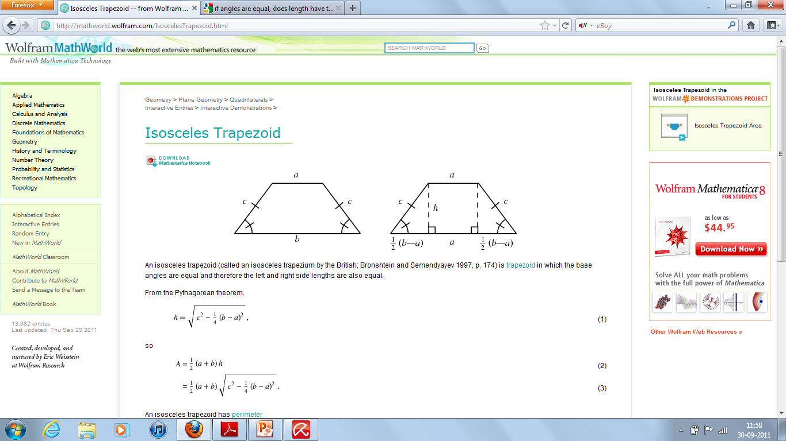
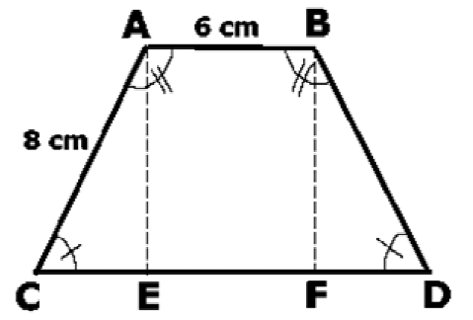
QUADRILATERALS
TRAPEZIOD
One pair of opposite sides is parallel, but not equal
Area = 1/2 * (a+b)*h
Isosceles Trapezoid
What is the area of the trapezoid as show?
Angle A = 120 degrees
The perimeter of the trapezoid ABCD = 36
The area of a trapezoid is equal to the average of the bases multiplied by the height. In this problem, you are given the top base (AB = 6), but not the bottom base (CD) or the height. (Note: 8 is NOT the height!) In order to find the area, you will need a way to figure out this missing data. Drop 2 perpendicular lines from points A and B to the horizontal base CD, and label the points at which the lines meet the base E and F.
EF = AB = 6 cm. The congruent symbols in the drawing tell you that Angle A and Angle B are congruent, and that Angle C and Angle D are congruent. This tells you that AC = BD and CE = FD.
Statement (1) tells us that Angle A = 120. Therefore, since the sum of all 4 angles must yield 360 (which is the total number of degrees in any four-sided polygon), we know that Angle B = 120, Angle C = 60, and Angle D = 60. This means that triangle ACE and triangle BDF are both 30-60-90 triangles. The relationship among the sides of a 30-60-90 triangle is in the ratio of x: x √3: 2x , where x is the shortest side. For triangle ACE, since the longest side AC = 8 , CE = 4 and AE = 4 √3 . The same measurements hold for triangle BFD. Thus we have the length of the bottom base (4 + 6 + 4) and the height and we can calculate the area of the trapezoid
Statement (2) tells us that the perimeter of trapezoid ABCD is 36. We already know that the lengths of sides AB (6), AC (8), and BD (8) sum to 22. We can deduce that CD = 14. Further, since EF = 6, we can determine that CE = FD = 4. From this information, we can work with either Triangle ACE or Triangle BDF, and use the Pythagorean theorem to figure out the height of the trapezoid. Now, knowing the lengths of both bases, and the height, we can calculate the area of the trapezoid
EACH STATEMENT ALONE IS SUFFICIENT

Slide 104
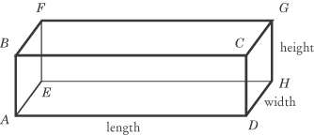

POLYGONS – 3 DIMENSIONAL
SHAPE | LATERAL SURFACE AREA Sum of the surface areas of all faces excluding the base of the solid | SURFACE AREA Sum of THE AREAS OF ALL FACES | VOLUME Volume is the quantity of “stuff” a container can hold
Rectangular solid |  | 2 (Base x Height) + 2 (Width x Height) + 2 (Base x Width) | Length * width * height
Cube | 4 x (Side)² | 6 x (Side)² Perimeter of the edges of a cube = 12*side | Length * width * height (i.e., Side³)
Circular Cylinder | 2πrh | 2πrh + 2πr² | πr²h It is important to note that although two cylinders have the same volume, they may not necessarily have the same shape, and therefore, each fits differently into a larger object
Circular Cone | πrl * Use for “covering a conical tent” | πrl + πr² | (1/3) πr²h
Sphere | In a sphere only one surface area exists and that is the total surface area | 4πr² *Use for “painting” | (4/3) πr³
Hemi-Sphere | 2πr² | 3πr² | (2/3) πr³

Slide 105
POLYGONS – 3 DIMENSIONAL
SHAPE | FORMULA – DIAGONALS | EXAMPLE
CUBE | S√3, where s is the edge of the cube | What is the measure of an edge of a cube with a main diagonal of length √60 d = s √3 √60 = s √3 √20 = s
RECTANGULAR SOLID | x² + y² + z² = d² Where x, y and z are sides of the rectangular solid, and d is the main diagonal
The number of diagonals in an n-sided polygon is n(n-3)/2

Slide 106
CIRCLES
    Circumference of a circle= 2πr
  Circumference of a semi-circle= πr
  Perimeter of a semi-circle = πr + D (Diameter of the circle)
    Area of a circle = πr²
    Area of a semi-circle = πr² / 2
    Length of the arc = (θ/360) × (2 π r)
    Area of the sector = (θ/360) × πr²
    Distance travelled by a wheel in n revolutions = n x circumference
    Perimeter of a sector = (θ/360) × (2 π r) + 2r
    Circles, when graphed on the coordinate plane, have an equation of x² + y² = r² where r is the radius (standard form) when the center of the circle is the origin. When the center of the circle is (h, k) and the radius is of length r, the equation of a circle (standard form) is (x - h)² + (y - k)² = r²

Slide 107
CIRCLES, ARCS AND SECTORS
A circle is a set of points that are equidistant from a fixed point called the centre. It comprises 360 degrees.
RADIUS: distance from the centre of the circle to any point on the circle; can be shown as a line segment connecting the centre to a point on the circle – OC
DIAMETER: is a line segment that connects two points on the circle and goes through the centre of the circle - AE
  Diameter = 2r
CHORD: is any line segment whose endpoints are any two points on the circle – BD
The tangent line and the radius of the circle that has an endpoint at the point of tangency are perpendicular to each other – AO IS PERPENDICULAR TO XY
ARC – a portion/distance on the circle
A
X
Y
C
B
O
C
E
D
A
O
B

Slide 108
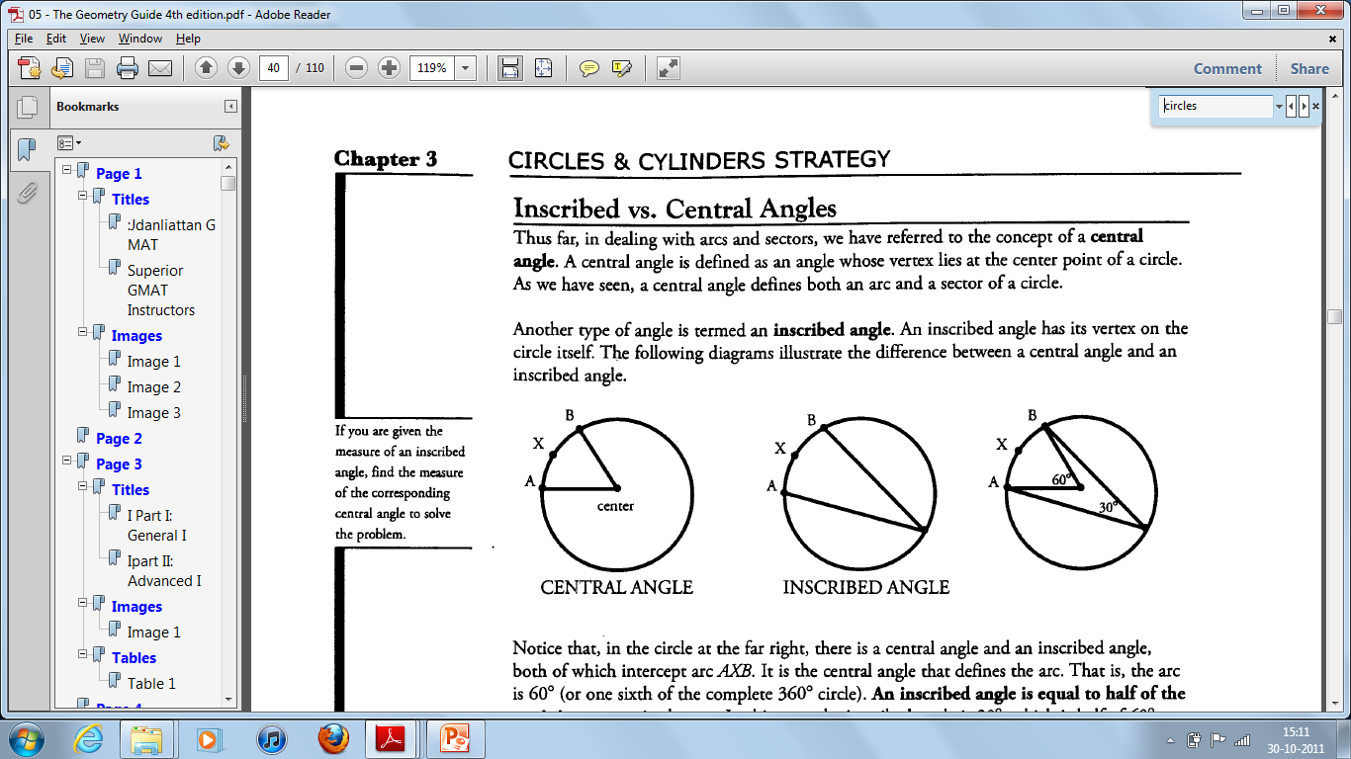
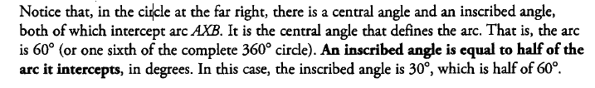
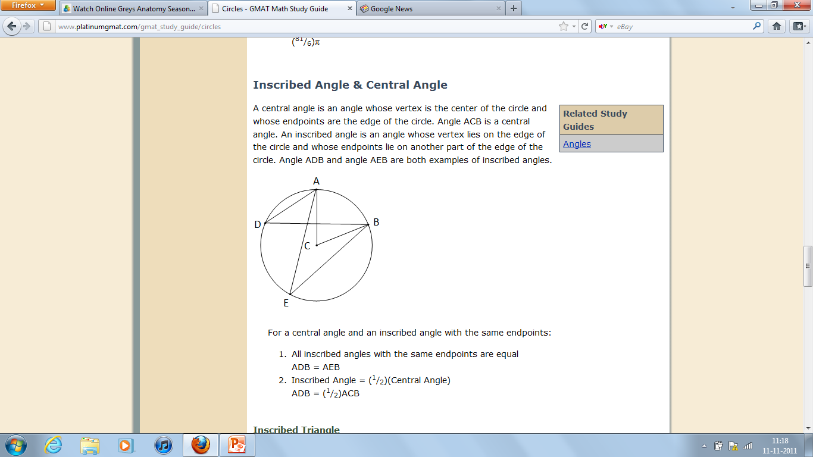
INSCRIBED CIRCLES
When a circle is inscribed inside a square, the side equals the diameter

Slide 109
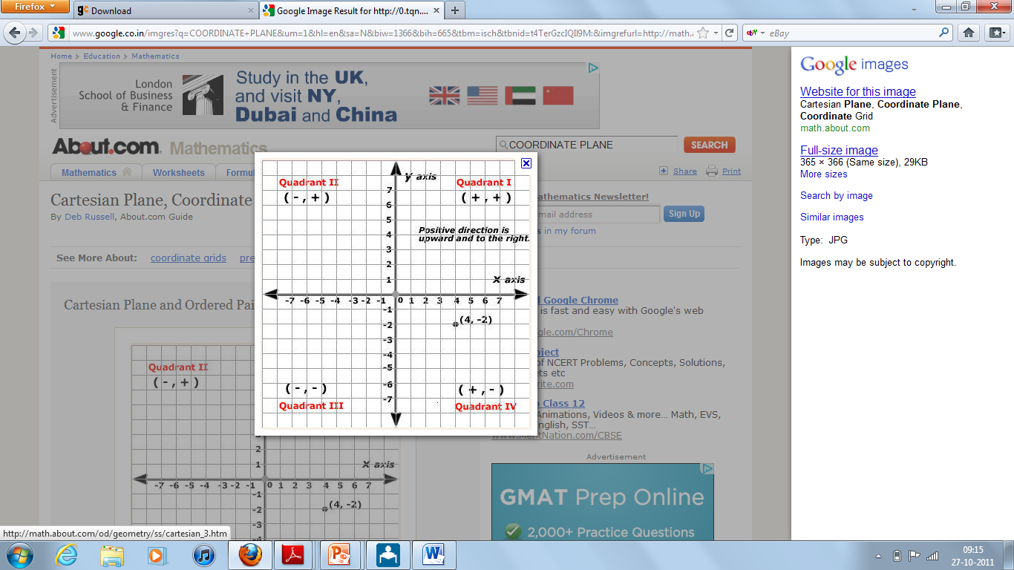
CO – ORDINATE GEOMETRY

Slide 110
CO-ORDINATE GEOMETRY – GENERAL CONCEPTS
CO-ORDINATE POINTS
Points in the plane are identified by using an ordered pair of numbers, (x , y), where x is the x co-ordinate and y is the y co-ordinate. For example, in (4, -2), the x co-ordinate is 4 and the y co-ordinate is -2
Any point on the X axis can be taken as (a,0)
Any point on the Y axis can be taken as (0,b)
The point (0, 0), where the axes cross, is called the origin
Along the X axis, the y co-ordinate is 0 and along the Y axis, the x co-ordinate is 0
  INTERCEPTS: The point where a line intersects a co-ordinate axis is called an intercept
X intercept: the point at which the line intersects the x axis
The x-intercept is expressed using the ordered pair (x, 0), where x is the point where the line intersects the x-axis. The x-intercept is the point on the line at which y = O
Y intercept: the point at which the line intersects the y axis
The y-intercept is expressed using the ordered pair (0, y), where y is the point where the line intersects the y-axis. The y-intercept is the point on the line at which x = O
LINE
A line can be formed in any of the three ways
By knowing the co-ordinates of any two points on the line
By knowing the co-ordinates of one point on the line and the slope of the line
By knowing the equation of the line
SLOPE OF A LINE: Y2 – Y1 / X2 – X1
A line in the plane is formed by the connection of two or more points. Therefore, the slope is defined as the “rise” over the “run” – that is, how much the line rises vertically divided by how much the line runs horizontally
  For example, what is the slope of the line for the following co-ordinates: (2,-3) and (6, 5)
  Slope = 5 – (-3) / (6 – 2) = 8/4, which is equal to 2
The slope is always the co-efficient of x in the equation (point-intercept) form y = mx + b. Therefore, in the equation y = 4x + 8; the slope is 8
If the equation of the line is given in the general form ax + by + c = 0; then the slope is –a/b and the intercept is –c/b
  The slope of all points/ co-ordinates on a line will ALWAYS be the same. However, just because two points have the same slope, doesn’t necessarily mean that the lie on the same line and vice versa. For instance, parallel lines have the same slope; conversely, if two lines have the same slope they could either be parallel or lie on each other
  If the slope is 1, the angle formed by the slope is 45 degrees
  Parallel lines have equal slopes
  Perpendicular lines have negative reciprocal slopes
  SLOPE DIRECTION - There are four types of slope an equation can have
  Positive – rises upward from left to right
  Negative – falls downward from left to right
  Zero – parallel to the x axis
  Undefined – parallel to the y axis
  Every line (but the one that crosses the origin OR the one that is parallel to X or Y axis OR the X and Y axis themselves) crosses three quadrants

Slide 111
CO-ORDINATE GEOMETRY – EQUATION OF A LINE/ SLOPE-INTERCEPT LINE
Y
y co-ordinate
M
Slope
X
x co-ordinate
B
y-intercept
What is the slope-intercept form for a line with the equation 6x + 3y = 18?
Rewrite the equation by solving for y as follows:
6x + 3y = 18
2x + y = 6
y = – 2x + 6
Thus, the slope is -2 and the y-intercept (b) is 6
Horizontal and vertical lines are not expressed in the y = mx +b form. Instead, they are expressed as simple, one-variable equations. Horizontal lines are expressed in the form: y = some number, such as y = 3 or y = 5 (i.e., equation of the line parallel to the x axis is 3 or 5). Vertical lines are expressed in the form: x = some number, such as x = 4 or x = 7 (i.e., equation of the line parallel to the y axis is 4 or 7)
Equation of the X axis is Y= 0
Equation of the Y axis is X= 0
Information Given | Method | Example
Determining the equation of a line given two points | Find the slope Plug in the slope in the equation y = mx + b Solve for b by plugging the coordinates of one point Write the equation in the form y = mx + b ** Note: Sometimes the GMAT will only give you one point on the line, along with the y-intercept. This is the same thing as giving you two points on the line, because the y-intercept is a point! A y-intercept of 4 is the same as the ordered pair (0, 4) | Point 1 = (5, -2); Point 2 = (3,4) Rise over run: (-2 - 4) / (5 – 3) = -3 y = -3x + b 4 = -3.3 + b b = 13 y = -3x + 13
Determining the equation of a line given one point and the slope | Y – Y1 = m(X- X1) | Find the equation of a line passing through the point A (14,23) and the slope 2 Y – 23 = 2(X – 23) Y = 2x – 5
Determining the equation of a line given the intercepts | If the X intercept of the line is a and Y intercept is b, the equation is : X/a + Y/b = 1 | Find the equation of a line whose x intercept is 5 and y intercept is 2 Substituting the values in the equation x/a + y/b =1, we get x/5 + y/2 = 1 2x + 5y = 10 -5y = 2x – 10 y = -2x/5 + 2

Slide 112
CO-ORDINATE GEOMETRY – 3
DISTANCE BETWEEN TWO POINTS
The distance between any two points in the coordinate plane can be calculated by using the Pythagorean Theorem
Example: what is the distance between the points (1, 3) and (7, -5)?
  Draw a right triangle connecting the points
  Find the lengths of the two legs of the triangle by calculating the rise and the run
    The y-coordinate changes from 3 to -5, a difference of 8 (the vertical leg)
    The x-coordinate changes from 1 to 7, a difference of 6 (the horizontal leg)
  Use the Pythagorean Theorem to calculate the length of the diagonal, which is the distance between the points
    6² + 8² = c²
    36 + 64 = c²
    100 = c²
    c = 10
    POSITIVE AND NEGATIVE QUADRANTS
    Quadrant I: x and y are both positive
    Quadrant II: x is negative, y is positive
    Quadrant III: x is negative, y is negative
    Quadrant IV: x is positive, y is negative
The GMAT sometimes asks you to determine which quadrants a given line passes through. For example: Which quadrants does the line 2x + Y = 5 pass through?
2x + y = 5
y = 5 – 2x
Since b = 5, the y-intercept is the point (0, 5). The slope is -2, so the line slopes downward steeply to the right from the y-intercept. Although we do not know exactly where the line intersects the x-axis, we can now see that the line passes through quadrants I, II, and IV
PARALLEL LINES
Two lines are said to be parallel when their slopes are equal and the y – intercept is different
For example: If Point A is (5,20) and Point B is (30,7), define a line through point C (12,10) that is parallel to the line that passes through both A and B
  Slope of AB = (7-20)/(30-5) → -13/25 → -0.52
  Substituting in equation y-y1 = m(x-x1) → y = -0.52(x – 12) + 10
  y = -0.52x + 16.24
  Distance between two parallel lines y = mx + b and y= mx + c can be found by the formula D = | b – c |/ √m² + 1

Slide 113
CO-ORDINATE GEOMETRY – 4
PERPENDICULAR BISECTORS
The perpendicular bisector of a line segment forms a 90° angle with the segment and divides the segment exactly in HALF. The key to solving perpendicular bisector problems is remembering this property: the perpendicular bisector has the negative reciprocal slope of the line segment it bisects. That is, the product of the two slopes is -1 (the only exception occurs when one line is horizontal and the other line is vertical, since vertical lines have undefined slopes)
Example: If the coordinates of point A are (2, 2) and the coordinates of point B are (0, -2), what is the equation of the perpendicular bisector of line segment AB?
Slope of AB is 2
Slope of the perpendicular bisector is – (1/2)
Now we know that the equation of the perpendicular bisector has the following form: y = (-1/2)x + b. However, we still need to find the value of b To do this, we will need to find one point on the perpendicular bisector
The perpendicular bisector passes through the midpoint of AB. Thus, if we find the midpoint of AB, we will have found a point on the perpendicular bisector. The x co-ordinate of the perpendicular bisector will be the average of the x co-ordinates of A and B. Similarly, the y co-ordinate of the perpendicular bisector of AB will be the average of the y co-ordinates of A and B.
Plug in the values of x (1) and y (0) to get b = 1/2
INTERSECTION OF TWO LINES
Recall that a line in the coordinate plane is defined by a linear equation relating x and y. That is, if a point (x, y) lies on the line, then those values of x and y satisfy the equation. For instance, the point (3, 2) lies on the line defined by the equation y = 4x - 10, since the equation is true when we plug in x = 3 and y = 2. On the other hand, the point (7, 5) does not lie on that line, because the equation is false when we plug in x = 7 and y = 5
So, what does it mean when two lines intersect in the coordinate plane? It means that at the point of intersection, BOTH equations representing the lines are true. That is, the pair of numbers (x, y) that represents the point of intersection solves BOTH equations. Finding this point of intersection is equivalent to solving a system of two linear equations
Example: At what point does the line represented by y = 4x - 10 intersect the line represented by 2x + 3y = 26?
Solving the equations simultaneously, we get x=4 and y=6
Therefore, the point of intersection is (4,6)
If two lines in a plane do not intersect, then the lines are parallel. If this is the case, there is NO pair of numbers (x, y) that satisfies both equations at the same time
The two equations/lines in a plane may also represent the same line. In this case, infinitely many points (x, y) along the line satisfy the two equations (which must actually be the same equation in two disguises)
The coordinates of the point P(x, y) which divides the line segment joining the points A(x1, y1) and B(x2, y2), internally, in the ratio m:n are (nx1 + mx2)/m+n and (ny1 + my2)/m+n

Slide 114
ADVANCED CONCEPTS
EQUATION OF A CIRCLE
The equation of a circle with centre (h, k) and radius r is (x – h)² + (y – k)² = r²
The equation of a circle with centre (0, 0) and radius r is x² + y² = r²
In the coordinate plane, a circle has center (2, -3) and passes through the point (5, 0). What is the area of the circle?
(5 – 2)² + (0 – (-3))² = r²
(3)² + (3)² = r²
18 = r²
Therefore, area = 18 π
Find the equation of a circle whose center is at (4, 2) and is tangent to y-axis
Since the circle is tangent to y-axis, the radius of the circle is perpendicular to y-axis. It also means that the length of the radius is also the length of the perpendicular segment from the center of the circle to y –axis. The point of tangency is at (0, 2). To find the length of the radius, use the distance formula:
(0 – 4)² + (2 – 2)² = r²
r = 4
Write the equation of the circle with the given condition: (10, 8) and (4, -2) are the endpoints of the diameter
In a circle, the radius is one-half of the diameter. Since the given are the endpoints of the diameter, the center of the circle is the midpoint of the diameter
(h,k) = [(10+4)/2, (8-2)/2)] → (7,3)
The next step is to get the length of the radius. Since radius is one-half of the circle, it will equal the distance from the center to any one end point of the diameter: (10 – 7)² + (8 – 3)² = r² → r = root 34
Equation = (x – 7)² + (y – 3)² = 34
What is the radius for the following – Circle tangent to the line 3x – 4y = 24 with center at (1, 0)
The radius of the circle is equal to the distance of the center (1, 0) from the line 3x – 4y = 24
To find the distance/radius from a point to a line, we use the formula: d = Ax + By + C / - √(A² + B² ), where A and B are the coefficients of x and y, and C is the constant in the equation of line. X and y are co-ordinates of the point
Therefore, A = 3, B = -4 and C = -24, x = 1, y = 0
Radius = 21/5

Slide 115
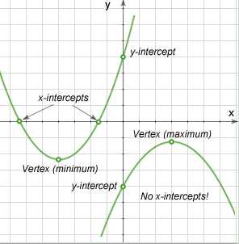
ADVANCED CONCEPTS
PARABOLAS
The equation y = Ax² + Bx + C is the equation of the quadratic graph which is a parabola with axis parallel to y axis
C is the y intercept (i.e., the value of y when x is 0)
If A > 0, the parabola opens upwards. If A < 0, the parabola opens downwards
If B² > 4AC, the parabola cuts the x-axis at 2 different points
If B² = 4AC, the parabola touches the x-axis at one point (the two points become co-incident)
If B² < 4AC, the parabola does not cut the x-axis at all
The vertex of a parabola represents the maximum or minimum value of the function. The vertex is located at point (-b/2a, c – (b²/4a))

Slide 116
Examples
In the xy-plane, does the line with equation y = 3x+2 contain the point (r,s) ? 1) (3r+2-s)(4r+9-s) = 0 2) (4r-6-s)(3r+2-s)=0 | Line with equation y = 3x + 2 contains the point ( r, s ) means that when substituting r and s in line equation: s = 3r + 2 (or 3r +2 - s = 0) holds true Insufficient. Either (3r+2-s) = 0 OR (4r+9-s) = 0 or BOTH Insufficient. Either (3r+2-s) = 0 OR (4r-6-s) = 0 or BOTH (1)+ (2) Both 4r+9-s = 0 and 4r-6-s = 0 cannot be true, hence (3r+2-s) = 0 must be true. Sufficient
Does Line S intersect line segment QR → Q (1,3) and R (2,2) The equation of the line S is y = -x + 4 The slope of line S is -1 | Lines are said to intersect if they share one or more points. The slope of a line is the change in y divided by the change in x, or rise/run. The slope of line segment QR is (3 – 2)/(1 – 2) = 1/-1 = -1 (1) SUFFICIENT: The equation of line S is given in y = mx + b format, where m is the slope and b is the y-intercept. The slope of line S is therefore -1, the same as the slope of line segment QR. Line S and line segment QR are parallel, so they will not intersect unless line S passes through both Q and R, and thus the entire segment. To determine whether line S passes through QR, plug the coordinates of Q and R into the equation of line S. If they satisfy the equation, then QR lies on line S. Point Q is (1, 3): y = -x + 4 = -1 + 4 = 3 Point Q is on line S. Point R is (2, 2): y = -x + 4 = -2 + 4 = 2 Point R is on line S. Line segment QR lies on line S, so they share many points. Therefore, the answer is "yes," Line S intersects line segment QR. (2) INSUFFICIENT: Line S has the same slope as line segment QR, so they are parallel. They might intersect; for example, if Line S passes through points Q and R. But they might never intersect; for example, if Line S passes above or below line segment QR.
Does the equation y = (x – p)(x-q) intercept the x-axis at the point (2,0)? pq = -8 - 2 – p = 8 | At the point where a curve intercepts the x-axis (i.e. the x intercept), the y value is equal to 0. If we plug y = 0 in the equation of the curve, we get 0 = (x – p)(x – q). This product would only be zero when x is equal to p or q. The question is asking us if (2, 0) is an x-intercept, so it is really asking us if either p or q is equal to 2. (1) INSUFFICIENT: We can’t find the value of p or q from this equation. (2) INSUFFICIENT: We can’t find the value of p or q from this equation. (1) AND (2) SUFFICIENT: Together we have enough information to see if either p or q is equal to 2. To solve the two simultaneous equations, we can plug the p-value from the first equation, p = -8/q, into the second equation, to come up with -2 + 8/q = q. This simplifies to q² + 2q – 8 = 0, which can be factored (q + 4)(q – 2) = 0, so q = 2, -4. If q = 2, p = -4 and if q = -4, p =2. Either way either p or q is equal to 2.

Slide 117
MINOR PROBLEM TYPES

Slide 118
MINOR PROBLEM TYPES
OPTIMIZATION
SCHEDULING
GROUPING
In general optimization problems, the objective is to maximize or minimize some quantity, given constraints on other quantities. These quantities are all related through some equation
Example
The guests at a football banquet consumed a total of 401 pounds of food. If no individual guest consumed more than 2.5 pounds of food, what is the minimum number of guests that could have attended the banquet?
Begin by considering the extreme case in which each guest eats as much food as possible, or 2.5 pounds apiece. The corresponding number of guests at the banquet works out to 401/2.5 = 160.4 people
You obviously cannot have a fractional number of guests at the banquet. Thus the answer must be rounded. To determine whether to round up or down, consider the explicit constraint: the amount of food per guest is a maximum of 2.5 pounds per guest. Therefore, the minimum number of guests is 160.4 (if guests could be fractional), and we must round up to make the number of guests an integer: 161
Note the careful reasoning required! Although the phrase "minimum number of guests" may tempt you to round down, you will get an incorrect answer if you do so. In general, as you solve this sort of problem, put the extreme case into the underlying equation, and solve. Then round appropriately
Scheduling problems, which require you to determine possible schedules satisfying a variety of constraints, can usually be tackled by careful consideration of extreme possibilities, usually the earliest and latest possible time slots for the events to be scheduled
Example
How many days after the purchase of Product X does its standard warranty expire? (1997 is not a leap year
When Mark purchased Product X in January 1997, the warranty did not expire until March 1997
When Santos purchased Product X in May 1997, the warranty expired in May 1997
Rephrase the two statements in terms of extreme possibilities:
Statement 1
Shortest possible warranty period: Jan. 31 to Mar. 1 (29 days later)
Longest possible warranty period: Jan. 1 to Mar. 31 (89 days later)
Statement 2
Shortest possible warranty period: May 1 to May 2, or similar (1 day later)
Longest possible warranty period: May 1 to May 31 (30 days later)
Even taking both statements together, there are still two possibilities-29 days and 30 days -so both statements together are still insufficient
Note that, had the given year been a leap year, the two statements together would have become sufficient!
In grouping problems, you make complete groups of items, drawing these items out of a larger pool. The goal is to maximize or minimize some quantity, such as the number of complete groups or the number of leftover items that do not fit into complete groups. As such, these problems are really a special case of optimization. One approach is to determine the limiting factor on the number of complete groups
Example
Orange Computers is breaking up its conference attendees into groups. Each group must have exactly one person from Division A, two people from Division B, and three people from Division C. There are 20 people from Division A, 30 people from Division B, and 40 people from Division C at the conference. What is the smallest number of people who will not be able to be assigned to a group?
The first step is to find out how many groups you can make with the people from each division separately, ignoring the other divisions. There are enough Division A people for 20 groups, but only enough Division B people for 15 groups and only enough Division C people for 13 groups. So the limiting factor is Division C. Therefore the total number of people left over will be 7 from A + 4 from B + 1 from C = 12
COMPUTATION
Very occasionally, the GMAT features problems centered on computation problems that contain no variables at all.
Example
Five identical pieces of wire are soldered together to form a longer wire, with the pieces overlapping by 4 cm at each join. If the wire thus made is exactly 1 meter long, how long is each of the identical pieces? (1 meter = 100 cm)
It is easy to assume that, because there are 5 pieces, there must be 5 joins. Instead, there are only 4 joins. Each join includes 4 cm of both wires joined, but is only counted once in the total length of 100 cm. Therefore, the total length of all the original wires is 100 + 4(4) = 116 cm. Because there are 5 wires, each wire is (116/5) = 23.2 cms long

Slide 119
MENTAL MATH / SHORT CUTS
Multiplying two digit numbers | Break each number down into two components, representing each digit. For instance, 21 = 20 + 1, or 97 = 90 + 7 Let's apply the FOIL method to help us find the square of 21, a calculation that comes up occasionally on GMAT questions. 21^2 = (20 + 1)(20 + 1) = 400 + 20 + 20 + 1 = 441
Divide and Multiply by Five ... Fast | For both division and multiplication, the key concept here is that 5 is simply 10 divided by 2. So, anywhere you see a 5 in an equation, you can substitute (10/2). For example 77 * 5 would be (77*10)/2 → 770/2
Percentages | Break down every number that’s asked into questions of 100 For example 8% of 300 would be (8% of 100) + (8% of 100) + (8% of 100) 8% of 25 would be 8% of 100 / 4

