Slide 1
Disclaimer ☺
While every effort has been taken to ensure that this material is free of errors, there is a possibility that some errors might have unintentionally crept in. I take no responsibility for any loss occurring to anyone due to relying on this material. If you come across any error, kindly write to me so that I can update this PPT.
This material is compiled based on lots of research and interactions with students and alumni of the target schools. This material can’t and shouldn’t be distributed for any monetary value. I only wish to give back to GMAT Club and it’s users for all the benefits I’ve derived. So please don’t sue me! ☺
Earnestly hope this compilation helps you! ☺
Have you seen my “Ultimately Comprehensive
GMAT Sentence Correction Flashcard”? Here is a link to the material: Latest Version Link You might want to pass it on!
GOOD LUCK!
Here is the link to the current version of the Recommenders Prep PPT!

Slide 2
Recommenders Prep
Agenda
1. Why recommendations & What you must do?
2. Illustrative Overview of what you will have to do
3. What’s a great recommendation/Who is a great recommender?
4. Tips for Recommenders
5. Example of a Recommendation letter
6. Gearing you for writing a Great Recommendation
7. My career and education plans
8. Timelines & Participation Confirmation
9. Additional Material for your reference

Slide 3
Why recommendations & What you must do?
Why recommendations?
  B Schools use recommendations to get an independent assessment to see if what the applicant states in different parts of the application process are legitimate and correct
  An individual typically in the US, recommends a candidate only if he/she is a “fan” of the applicant and has a very strong view that the individual would be a good business leader. (Schools judge the level of admiration of the recommender by seeing how the recommendation has been drafted)
  There is no specified weightage given by schools for the quality of recommendations. Rumor says ~20%. Considering that my GMAT score is low (which also has a ~20% weightage), I will need the best of recommendations to maximize my B school admission chances.
What you must do?
  You will get a link on your office mail id (corporate mail ids are preferred over personal)
  Key in text wrt basic details about you (sample in slide 3)
  Provide your rating for different qualities (like leadership, communication) in me (sample in slide 4)
  Answer a few questions - provide recommendation letters for specific questions. Such questions could have a word limit of up to 500 words per questions. Generally the word limit is 100 words per question. (sample in slide 5)
  Points (a) to (c) are basic and similar across all schools. We will very briefly discuss these points and will go through (d) in great depth in this PPT.
  I should not write or help you draft the letters since schools can easily identify the same tone, style, errors in my essays & recommendations and they would view it as a fraudulent an unethical practice. Further the school will not get a different view of the applicant.

Slide 4
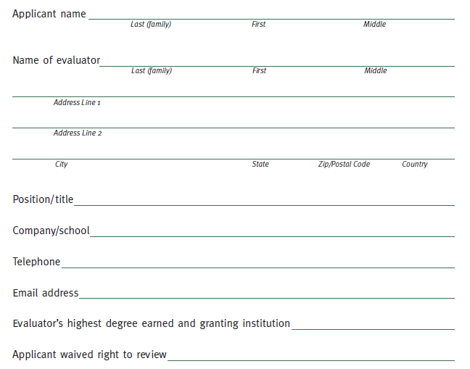
Illustrative Overview of what you will have to do | About you
Key in text wrt basic details about you.
For some schools, I will have to update this information. I will send you an e-mail tonight if I have any particular questions

Slide 5
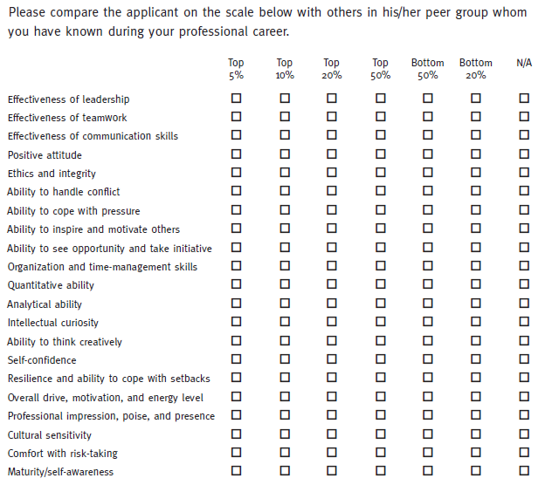
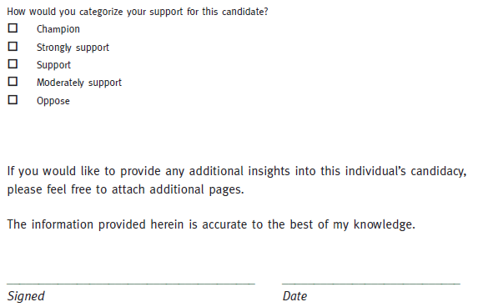
Illustrative Overview of what you will have to do | Your rating of my skills
Provide your rating for different qualities (like leadership, communication) in me

Slide 6
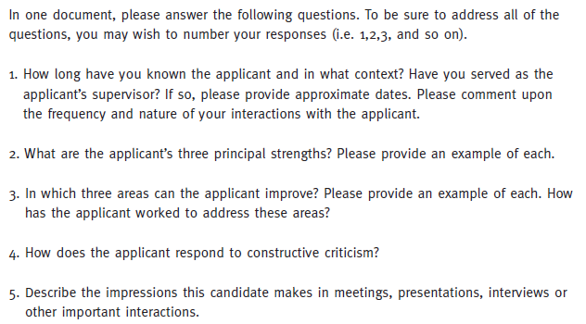
Illustrative Overview of what you will have to do | Recommendation letters
Recommendation questions:
Answer a few questions - provide recommendation letters for specific questions. Such questions could have a word limit of up to 500 words per questions. General word limit observed is 100 per question.
Illustrative response to these questions is available in slide 9

Slide 7
What’s a great recommendation/Who is a great recommender?
A great recommendation is written by someone who knows the applicant’s work very well, someone who can
  go beyond simple assertions to give examples of impressive contributions that provide evidence of the applicant’s leadership skills, teamwork ability and business acumen
  provide references with specific stories that illustrate strengths OR provide factual, concrete anecdotes that demonstrate that the applicant has the skills that the recommender says he or she does
US recommenders typically exaggerate, so a great recommender joins the American party of recommenders. Consider excellent = good, good = fair and fair = poor. (Illustrations are highlighted in the next two slides in this format)
Recommenders are fully aware of the applicants career and education plans and drafts recommendations accordingly.
A great recommender does not:
  simply write a single letter and force it to “fit” the school’s questions, such recommenders hurt applicants
  Divulge from the question asked in the essay
  Write anything significantly negative – the recommender is honest but not brutally honest!

Slide 8
Tips for Recommenders
Discuss how well you know the applicant.
  Ms. Smith reported directly to me for two years prior to her well-deserved promotion to the position of Senior in our Big Six Accounting Firm.
Avoid generalities and platitudes. Highlights positive aspects of the candidates groups conceived stereotype/clichéd weakness as a strength
Describe your qualifications for comparing the applicant to other applicants. (Highlight the applicant’s strengths and weaknesses in the light of a peer group)
  I have personally supervised ten interns every summer for the last five years plus worked with over two hundred college graduates in my capacity as trainer for Big Bank Corp.
Include some mild criticism, typically the flip-side of a strength.
  The only fault I have encountered in him is his retiring nature. His modesty sometimes hides a young man of remarkable strength and broad interests.
  Occasionally, her fortitude and persistence can turn into stubbornness, but usually her good nature and level-headedness prevail.
Choose two to three qualities that you observed in the applicant. (Highlight different applicant’s strengths as per the schools requirements)
  Jane has a rare blend of top writing and interpersonal skills.
  The combination of tenacity, analytical abilities, and good communications skills found in Mr. Doe is truly unique.

Slide 9
Tips for Recommenders
In discussing those qualities, support your statements with specific instances in which he or she demonstrated those attributes. Be as concrete and detailed as possible.
  He is the only student I ever had who came to all my office hours as part of a relentless, and ultimately successful, drive to master financial theory. He was one of just ten percent in the class to receive an A.
  Because of Jane's writing skills, I didn't hesitate to ask her to write a report which was used by our PAC as the basis for a major policy statement. Congressman X eventually used the statement, based on Jane's sophisticated 20-page analysis of Middle East politics, in lobbying for increased funding.
Discuss the applicant's potential in his or her chosen field.
I enthusiastically recommend Mr. Doe to your business school. This well-rounded student will be a fine businessperson.
With her exceptional leadership, writing, and quantitative skills, Ms. Smith will be an outstanding strategic consultant and a credit to the business school she attends.

Slide 10
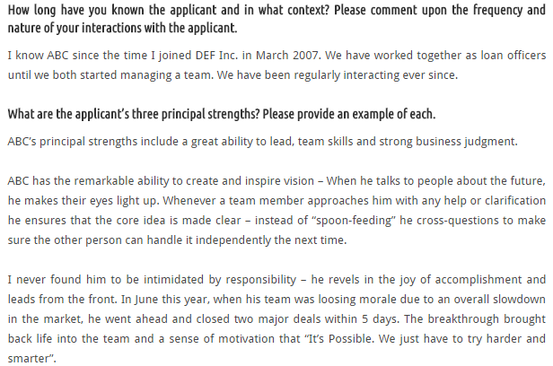
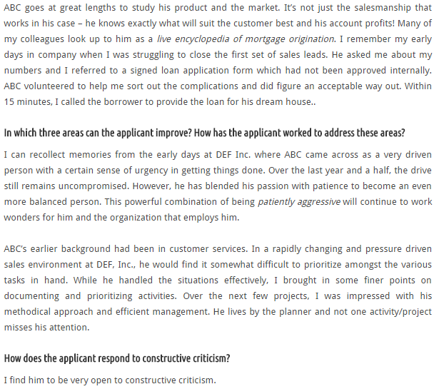
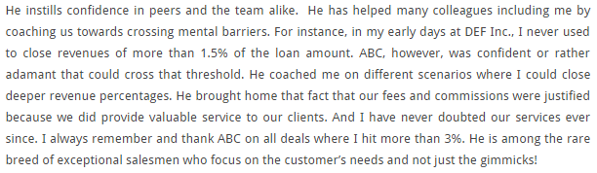
Example of a Recommendation letter
KEY:
Exaggeration
Illustration/example
Flip side of a strength
How a negative was eliminated

Slide 11
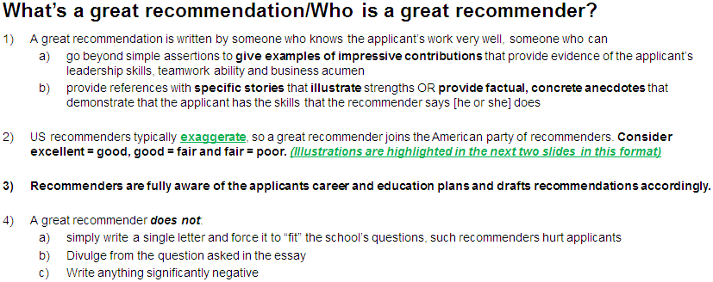
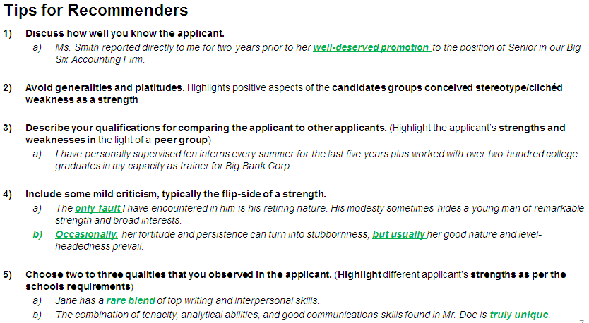


Gearing you for writing a Great Recommendation
KEY:
For all blue stars, kindly write statements based on your interactions with me. Where required kindly seek inputs from individuals who have interacted/ worked with me.
For all black rectangles, kindly use your judgment and wisdom.
For all the green circles, kindly use the data in the subsequent slides.

Slide 12
My career and education plans
B com @ Loyola → taste of social entrepreneurship
  Secured business plan funding of over €67,000 for my Students In Free Enterprise (SIFE, now known as ENACTUS), social entrepreneurship projects (64K from a German foundation, rest from HSBC, KPMG and miscellaneous donors)
  Winners and runners up at the 2010 and 2009 SIFE India National Competitions
  Awarded the “Excellence in Leadership Award” in College for leading social entrepreneurship projects, being the President, Joint Secretary and Treasurer of Loyola SIFE, Managerial Committee Member of the Entrepreneurship Development Cell
  Started feeling strongly that SIFE work is almost equal to what a private equity (PE) firm does. Decided career in PE to be my medium term goal and social entrepreneurship to be my long term goal.
PE @ Tata Capital (TCL)
  Got in through B com campus placement. Told the HR very categorically that I would only be a CA intern and not an employee
  Underwent 3 months training at S P Jain school of management (while on CA articleship) & got placed in PE operations
  Temporarily quit articleship and awaited CA inter results to join as an industrial trainee. But I failed in CA
  Immediately left TCL, but got a great reassurance that PE is where I want to be
  Boss gives feedback to ace due diligence/financial modeling skills to re-enter PE a year before MBA

Slide 13
My career and education plans
ASA & Associates – attempt to ace audit skills and join Due Diligence
  Aced statutory audit and audit program management skills in 9 months (was almost a dummy earlier)
  Started feeling that the workaholic in me would stop me from passing CA final. Quit ASA
CA, CISA, Financial Modeling, Industry research reports, Investment Bank (IB) interviews, free lance audits
  Took up CISA so that I could be competitive for a Due Diligence role and can have an integrated audit skill set
  Learned and practiced financial modeling and prepared industry research reports to join an IB
  Got offered by very small IBs. Didn’t take them up as it would hurt my B school plans
  Got a feedback from IBs to gain sector expertise
  TCL boss approves and appreciates points (c) and (d) above
Wipro – Phase 1
  Joined Wipro in campus thinking IT sector is a good sector as lots of PE funds focus on IT
  Pursued BTS to ensure I get placed in audit, so that I understand how an IT co. works
  Continued being interviewed by some small IBs, but didn’t take the one offer I got
  Met TCL boss in Dec’14. He warns me to quit IA to not get branded as an IA for life.
  Decide to quit Wipro in a few months post GMAT

Slide 14
My career and education plans
The accident at Wipro
  During my 1 month leave, I introspected why and how I still was working with Wipro
  Felt that I had hardly regretted anything and rather enjoyed my 1 year
  Realized that what interested me in SIFE and PE was not identifying great opportunities for investment (something a PE entrant does for almost 5 to 10 years till he becomes the fund partner/director) but on how PE firms make changes in the companies they invest in. Changes wrt
    Capital and organization structure
    Business processes improvement/re-engineering
    Various strategy enhancements
Career plans as of now
  Short term: Gain a general management MBA and join a top 4 consulting company. Get involved in social entrepreneurship part time.
  Medium term: Work for 5 to 10 years in the above mentioned consulting practices. Get involved in social entrepreneurship part time.
  Long term: Join PE firms as a part time consultant and teach strategy at a top B School. Get involved in social entrepreneurship full time.

Slide 15
School Selection & USPs, Attributes preferred by each school
Main criterion for school selection → schools where the highest percentage of students join consulting
I am but very poor/take time in acing tests. So how to ace in b school was a fear? Joining a school which hardly gives weightage to individual tests while are great general management programs appears to be the best solution. And the schools I chose are
  Darden (stretch school),
  IESE, Spain (reach school) and
  Harvard (stretch school).
  Joining one of these 3 schools would be a dream come true!
Other schools chosen are:
  Kellogg (stretch school)
  Tuck (stretch school)
  UCLA (reach school)
  Columbia (stretch school)
  Tepper (reach school)
Each school is unique and wants to admit students who have a character similar to that of the school. They make their decisions on the basis of attributes highlighted across the application. Caution: There is a very thin line of difference between ‘packaging’ a candidate as a fit for each school (disaster) vis-à-vis demonstrating in a genuine manner how the candidate has the strengths required for the program and how the program would help the candidate achieve his/her career goals.

Slide 16
Timelines & Participation confirmation
Particulars | Darden | IESE | Harvard | Kellogg | Tuck | UCLA | Columbia | Tepper
Recommenders | Both | Both | Both | Both | Both | Both | Both | Both
My Jan round deadline | 3rd | 4th | 1st | 2nd | 2nd | 3rd | 4th | 1st
Finalize changes | Dec 19th to 22nd (Friday to Monday)
Upload or copy-paste final recommendation letter within timeline | Dec 23rd to 24th (Tuesday to Wednesday)
Key:
Recommender’s Actionable
Applicant’s Actionable
XX & YY, I have only approached the two of you so far as I see you as my perfect recommenders. I understand that preparing these recommendation letters would require a lot of time and effort and re-effort! I’d be much happy to get recommended by you. But in case, you opine that you wouldn’t be able to spend the required time, I understand and there is nothing to worry about. But please confirm your withdrawal, if required, in a weeks time.

Slide 17
Additional Material for your reference
My CV
A blog write up on me as an inspiring person
Recommendation letter from the then principal of Loyola College, Chennai

