Slide 1


Slide 2
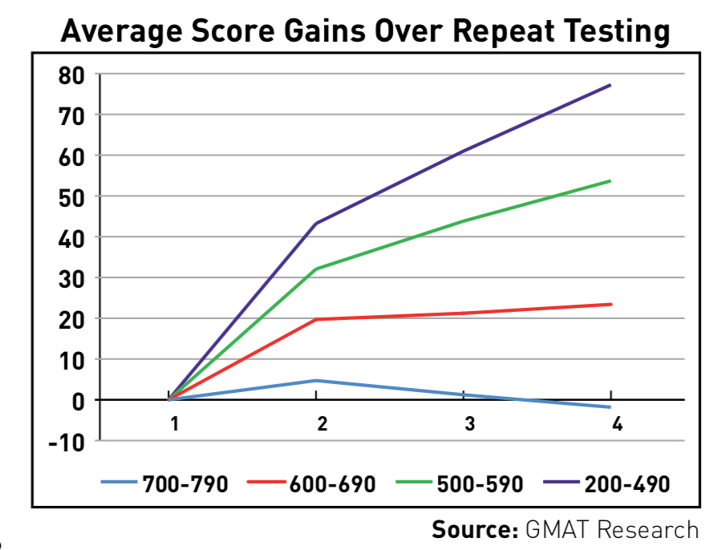
GMAT says you probably won’t improve your score much
Average gain = 33 points on a 2nd testing

Slide 3
The most exciting hour of your GMAT life
Part I: four-phase GMAT self-study “plan”
Part II: 7 key principles for self-study
Part III: Q&A… time permitting

Slide 4
Part I: Four-Phase Study “Plan”

Slide 5
Phase 1: goals & baseline
Score goals: find averages for target schools
  Be honest about your profile!
  HBS with a 650? Probably not.
Familiarize yourself with question types (OG?)
Take ONE free GMATPrep exam
  If you’re 100+ points away, be prepared for a LOT of studying
  Save remaining 5 GMATPrep exams for later

Slide 6
Phase 2: long-term foundations
Verbal: CR & RC
  RC Beginner’s Guide: http://bit.ly/2G8NXK8
  CR Beginner’s Guide: http://bit.ly/2BpSwkl
  LSAT for RC & CR: http://bit.ly/2GaG8E2
  Improve your reading…?
Quant
  “All you need!” (@Bunuel): http://bit.ly/2F1whRx
  Emphasis on algebra, arithmetic, & execution
Need 100+ pts? Save best materials for later!

Slide 7
Phase 3: OGs + SC + timing practice
CR/RC: transition from LSATs to GMAT OG
  For V40: ~80% on LSATs in under an hour
SC: grammar is good, but meaning is king
  SC Beginner’s Guide: http://bit.ly/2Hcg3FX
  Only a few hundred questions available
Quant
  Focus more on less-common question types
  Non-official practice tests for timing practice

Slide 8
“Graduating” from phase 3
All homework: no careless errors
Quant practice tests: nothing over 3 minutes
  Non-official quant tests aren’t 100% accurate, but they’re good practice
  Avoid non-official verbal tests
Strong overall results
  Difficulty levels vary throughout OGs
  Good time to use OG diagnostic

Slide 9
Phase 4: GMATPrep & final polishing
Final 5 (or 6) GMATPrep Exams
  Buy the Exam Packs! http://bit.ly/2En3mGl
GMATPrep “fake tests” using Question Pack 1
  $30 buys enough questions for 4-6 tests
  “Fake test” instructions: http://bit.ly/2o5hf4Y
Work on weaknesses between exams
Be honest about your scores
  Luck might buy +/- 30 points, but not much more

Slide 10
Part 2: Self-study principles

Slide 11
1. Official questions are king! But…
Manage materials carefully!
OGs (including quant/verbal guides):
  Just over 700 quant, 700 verbal questions
  3 hours/day? You’ll be done in two weeks!
  OG: 2018 ed. + 12th ed. = 60% “bonus”
GMATPrep = 6 tests only
GMATPrep Question Pack
  225 verbal, 230 quant
  Best used as “fake tests”: http://bit.ly/2o5hf4Y
Choose non-official resources carefully

Slide 12
2. ZERO TOLERANCE for dumb errors
Adaptive test
  Score is based primarily on WHICH questions you miss, not how many you miss
  Score = level of question at which you get (very roughly) 40% correct
If you miss a few easy questions, you’ll see more easy questions… and then you’re totally, fully, comprehensively, epically, unbelievably screwed.

Slide 13
2. ZERO TOLERANCE for dumb errors
Be systematic
  Quant: read every question twice, check your work as you go, reread again at the end
  Verbal: find your optimal intensity
Manage your time wisely
  Quant: skip the hard stuff – nothing over 3 mins.
  Verbal: no gimmicks; guess at the end if necessary
  “Catching up” never works

Slide 14
3. Redo, don’t review… yet
OG explanations are crappy
  NOT written by actual question-writers
Explanations can’t say where YOU went wrong
Redo your mistakes a day or two later…
  …after “washing your brain”
Pay special attention to the ones you get RIGHT the 2nd time -- how did you goof up?

Slide 15
4. Track everything
Error logs
  http://bit.ly/2Hfi6bY
  count “careless” errors?
Include times & dates
  Flag questions that took a long time, even if you got them right

Slide 16
5. No bingeing
2 hours per workday, 4 hours per weekend day => ~ 15-18 hours/week
Exceeding this might make you crazy and worse at GMAT
Maintain exercise, sleep, diet, social life
  Anxiety will eat you alive if your life is unbalanced
Prioritize your weaknesses… but don’t binge on question types/topics

Slide 17
6. Stay real, stay inspired
Favorite REAL debriefs
  @abhishek.pitti, 420 to HBS: http://bit.ly/2Ery3y2
  @jkolachi, 350 to 700: http://bit.ly/2F2T0MX
  @abhimahna, V21 to V40: http://bit.ly/2ECNl2m
  @souvik, 4 yrs. to 760: http://bit.ly/2CkLA4x
Be honest about your progress
Stay positive, but don’t let scores fool you
  7 reasons why scores fall: http://bit.ly/2nYNrYJ

Slide 18
7. GMAT Club resources: forum
Tips from @abhimahna: http://bit.ly/2Eowkps
Follow experts & top members
Write explanations
  “One teach, two learn.”
Question of the Day series
  RSS: http://bit.ly/2F5N6uE
  All previous QOTDs: http://bit.ly/2HbyBG5

Slide 19
7. GMAT Club resources: more plans
@bb
  “Regular” plan: http://bit.ly/2ED99en
  Advanced plan: http://bit.ly/2BYKGiB
@souvik101990
  http://bit.ly/2EIXgTY
@Bunuel
  http://bit.ly/2F1whRx

Slide 20
7. GMAT Club resources: videos
2017 verbal videos: http://bit.ly/2GbuRDo
Current video series: http://bit.ly/2GaxF3B
Next week’s video (Feb. 21, 9:30 a.m. PST):
  How cutting corners kills your GMAT score
Subscribe! www.youtube.com/gmatclub

