Slide 1
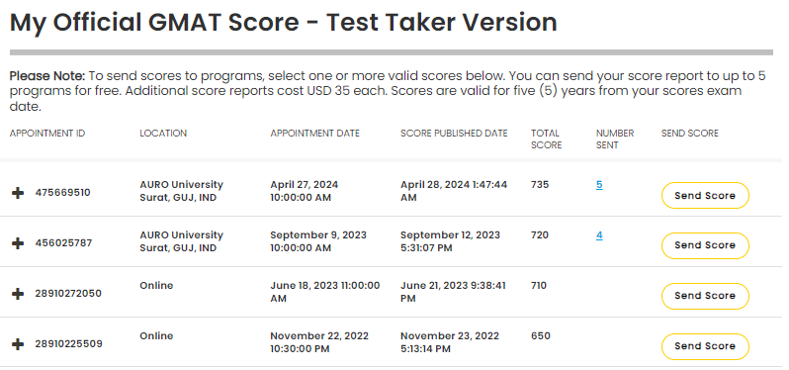
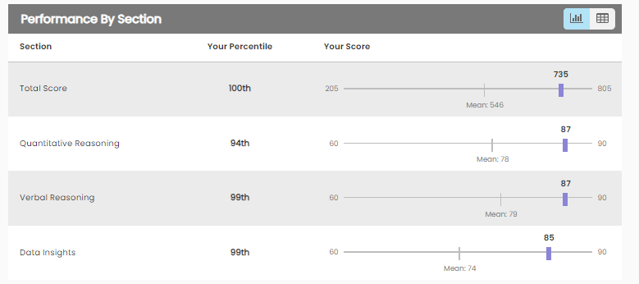
GMAT FE 735 | 100 PERCENTILE | All attempts & Final Attempt
About Me
  Graduated in 2019 from IIT (ISM), Dhanbad
  Working as a Drilling Engineer for the Past 5 years!!
  You can Connect me with Here
    https://www.linkedin.com/in/piyush14ry/
    https://www.instagram.com/piyush14ry/
    piyush14ry@gmail.com
For Me, it was a 2 year and 4 attempts long journey.
Obviously, it was not a continuous journey but into bits and pieces.
I enrolled myself into various coaching and personal tutors.
  Save yourself from doing the same.
  Take your time picking the right one – see their free videos/ read their material
  Once selected, complete the course with them!!
My Biggest Learning
  Go all in! Don’t be scared/ nervous when you are not able to grasp something. The learning lies beyond that point.
  For example, there is turbulence when you try to reach higher altitude.
  Without turbulence you can’t reach greater heights.

Slide 2
GMAT FE 735 | 100 PERCENTILE | MOCKS
Think about your prep in 2 stages
  Stage 1: Learning concepts.
    How would you know you have completed stage 1?
    If you can answer 8 of 10 questions randomly thrown at you from GMAT club correctly without TIME CONSTRAINT
  Stage 2: Mocks
    Here you develop your temperament for solving those questions in TIMED manner.
    Reach out at:
    https://www.linkedin.com/in/piyush14ry/
    https://www.instagram.com/piyush14ry/
    piyush14ry@gmail.com

Slide 3
GMAT FE 735 | 100 PERCENTILE | Pattern to attempt the exam
Q & DI | Break | Verbal
Verbal | Break | Q & DI
    Reach out at:
    https://www.linkedin.com/in/piyush14ry/
    https://www.instagram.com/piyush14ry/
    piyush14ry@gmail.com

Slide 4
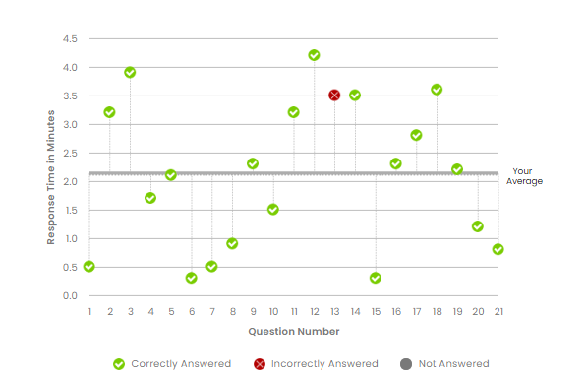
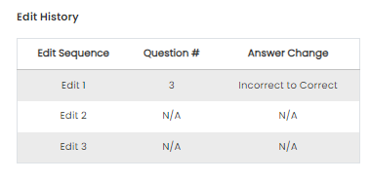
GMAT FE 735 | 100 PERCENTILE | Quant
There are 2 parts in Quant
  Concept
  Reading Questions carefully in exam
Concepts
  Being an Engineer/ IITian, concepts were never difficult for me.
  Few concepts where I lacked confidence were – PnC and Probability.
Reading Questions carefully in exam
  This is the KEY in my opinion
  The only way GMAT can get you to mark a wrong answer is that you calculate something that is not actually asked in the question finally.
Regarding time management
  My only criteria was to maintain 7 questions (one-third questions) per 15 minutes
Review/ change answers
  From Mocks, I knew I don’t have time to review for DI or Verbal.
  Only in Quant, if I knew that if by giving some more time, I can do it correctly – I’ll mark for review.
Also, most importantly, Pay utmost attention to the first 8 to 9 questions and get them right!
    Reach out at:
    https://www.linkedin.com/in/piyush14ry/
    https://www.instagram.com/piyush14ry/
    piyush14ry@gmail.com

Slide 5
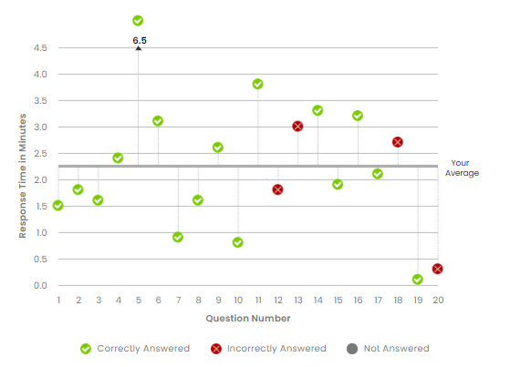
GMAT FE 735 | 100 PERCENTILE | DI
DI in my opinion is a very challenging area.
I will suggest you to do DI right after Quant so that you are in a flow of calculations.
Make full use of CALCULATOR present.
Target only to make 18 questions
  6 questions per 15 minutes
For me there were 3 areas
  Data Sufficiency
  Multi Source Reasoning & others
For Data Sufficiency
  You need to really be very clear with your basics
  Need a lot of “concentration”
  Of the 4 questions I got wrong – 3 were of Data Sufficiency
For Multisource reasoning
  Watch Payal Tandon’s video on GMATCLUB YouTube channel
  Her motto was “OWN THE DATASET”
  This is was single handedly the most useful Mantra for me
Again it’s very important to get the first 8 to 9 questions right!!
Also, I knew from Mocks that it was not possible for me to come back and re-solve questions. So, I did not leave any for review.
    Reach out at:
    https://www.linkedin.com/in/piyush14ry/
    https://www.instagram.com/piyush14ry/
    piyush14ry@gmail.com

Slide 6
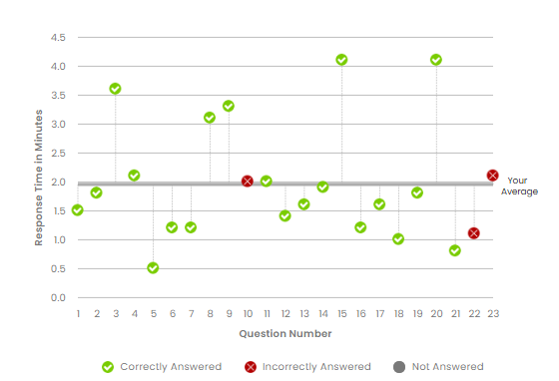
GMAT FE 735 | 100 PERCENTILE | Verbal
For CR, I studied from various coaching –
  E-gmat
  GMATWhiz (took personal coaching too)
  TopOnePercent. The RC course of TopOnePercent is a magic in itself. It will transform you completely.
  TargetTestPrep (free trial for CR)
  Vibhu Anurag (Personal Tutor for last leg of my prep).
One mistake that I did was not to go that second and third layer of thinking.
  I was in search of some magic way of solving CR. Only, to find the ultimate truth that there aren’t any!!
  In fact, on the final day I got just one question wrong on CR.
So, the key learning is to
  Find a teacher whose way of teaching resonates with you.
  Stick with them until the end.
  Or else, you would be wasting a lot of money as well as time like me.
Also, when solving a question
  READ EVERY WORD!!
    Reach out at:
    https://www.linkedin.com/in/piyush14ry/
    https://www.instagram.com/piyush14ry/
    piyush14ry@gmail.com

Slide 7
GMAT FE 735 | 100 PERCENTILE | Verbal Start Over
So for Verbal If I had to start over.
This is what I would do
  Pick any coaching (for me, TargetTestPrep resonated the most for CR and TopOnePercent for RC)
  Complete it end to end. Revise. Ask all your doubts.
  Now, once you have reached a accuracy of 60% in hard questions you need to fine tune your learning.
  At this step, a big shout out to Vibhu Anurag!!
Also, for all the Indian Coaching
  Can you please make CR tutorials in HINGLISH.
  Like, my point is we think in HINDI/ HINGLISH
  So, if someone could make such videos and post online it will be a great learning
  Also, post videos of you taking the MOCK.
  A lot can be learned about your temperament and strategy!
    Reach out at:
    https://www.linkedin.com/in/piyush14ry/
    https://www.instagram.com/piyush14ry/
    piyush14ry@gmail.com

