Slide 1
Strategies for Perfect Quant Score (Q90)
- GMAT Club

Slide 2
What is your current Quant Score range?
Below Q80
Q80-Q83
Q84-Q86
Q87-Q89
Q90

Slide 3
A florist normally sells roses at a 40% discount to their list price. On Valentine's Day, in addition to the usual discount, the florist runs a promotion where customers receive 1 additional rose free for every bouquet of 5 roses purchased. Despite this promotion, the florist still earns a 50% profit on the cost price. If the list price of a rose is p, what is the cost price of a rose to the florist?
A. 2p/3
B. p/6
C. p/4
D. 2p/5
E. p/3

Slide 4
LP = p
SP = LP*(60/100)*(5/6) = p/2
Profit = CP/2
SP – CP = Profit
p/2 – CP = CP/2
p/2 = 3CP/2
CP = p/3

Slide 5
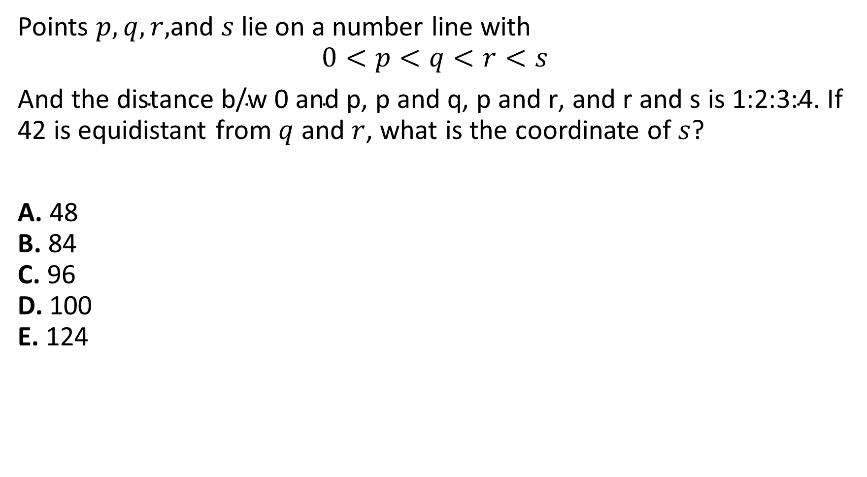
Points $p,q,r,$and $s$lie on a number line with
$$0<p<q<r<s$$
And t$\text{he} \text{distance} \text{b}\text{/}\text{w}\text{ 0 }\text{and} \text{p}\text{, }\text{p} \text{and} \text{q}\text{, }\text{p} \text{and} \text{r}\text{, }\text{and} \text{r} \text{and} \text{s} \text{is}\text{ 1:2:3:4.}$ If 42 is equidistant from $q$ and $r$, what is the coordinate of $s$?
A. 48
B. 84
C. 96
D. 100
E. 124

Slide 6
Distance – 0p:pq:qr:rs = x:2x:x:4x
S is at a distance of x + 2x + x + 4x = 8x
Also 42 is equidistant from q and r, and hence needs to lie in the middle of both the points, which gives us 2 equations
3x + y = 42 – (1)
3x + 2y = 4x – (2)
On solving you get, x = 2y => y = 6 and x = 12
We need to answer 8x => 8*12 = 96
PS: Smart approach is to look for options divisible by 8, only sensible option is 96

Slide 7
Elliot agreed to complete a project for an initial payment of $180. Working alone, he expected to finish the project exactly by the deadline. After Elliot had completed half of the project, his manager informed him that the project would need to be completed 2 hours earlier than originally planned. To meet the revised deadline, Elliot enlisted his brother, who works at half of Elliot's speed. Together, they completed the remaining work on time. If Elliot and his brother are paid the same hourly wage, how much was Elliot's brother paid?
A. $30
B. $45
C. $60
D. $75
E. $90

Slide 8
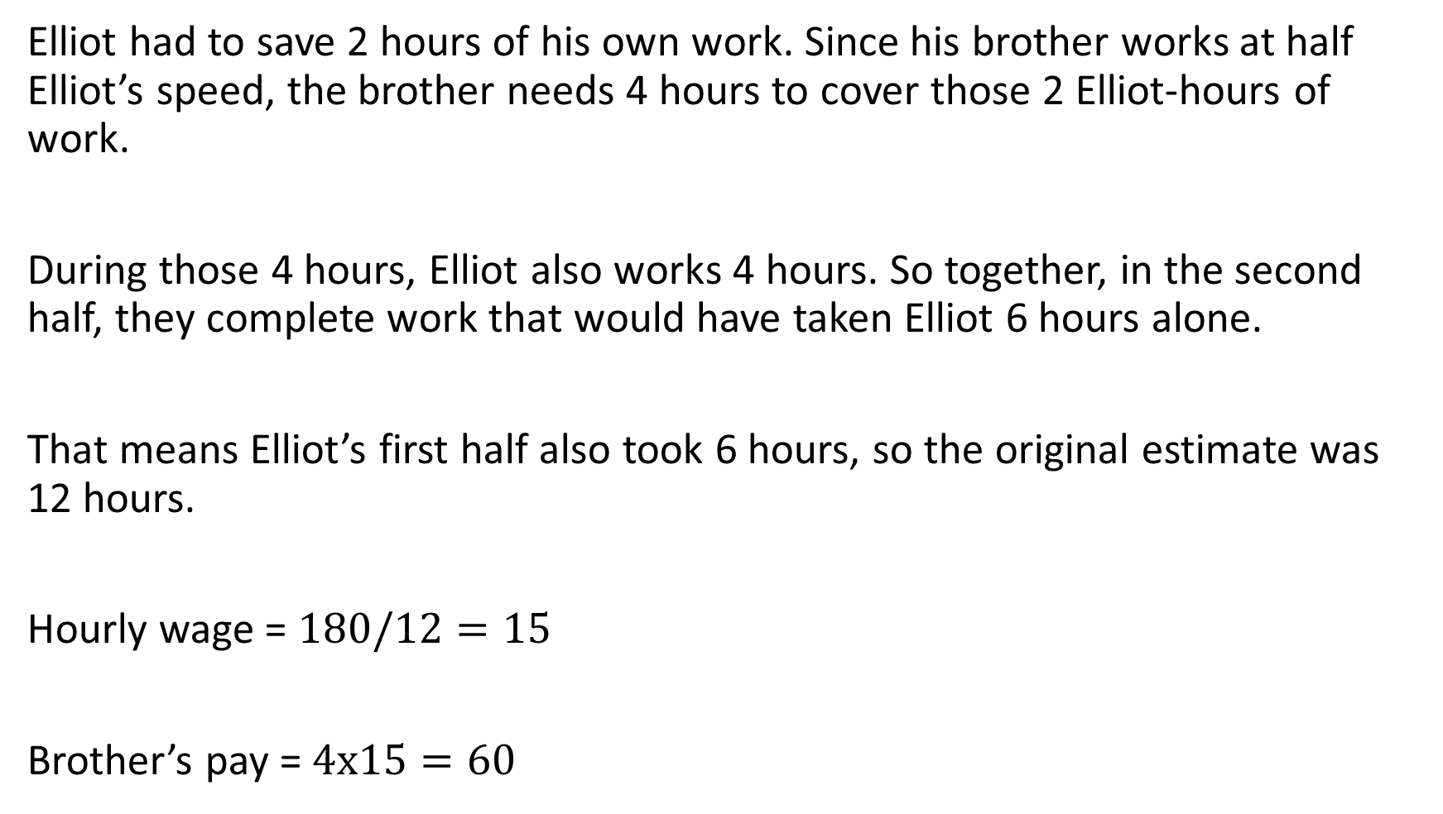
Elliot had to save 2 hours of his own work. Since his brother works at half Elliot’s speed, the brother needs 4 hours to cover those 2 Elliot-hours of work.
During those 4 hours, Elliot also works 4 hours. So together, in the second half, they complete work that would have taken Elliot 6 hours alone.
That means Elliot’s first half also took 6 hours, so the original estimate was 12 hours.
Hourly wage = $180/12=15$
Brother’s pay = $4x15=60$

Slide 9
Tips
Build strong fundamentals
Do topic-wise practice until you are comfortable across all difficulty levels (at least up to the 705 range on GMAT Club)
Analyze mistakes, not just the correct answer. Ask yourself: "What should have been my first thought when I saw this question?"
You don't get step marking. A beautiful setup with the wrong answer is still wrong.
Identify patterns and build muscle memory. An error log can be your best friend.
Every number tells a story. So observe them before setting up equations.
Have multiple approaches. The first method is not always the fastest one.
Know when to stop solving and start making decisions.
Leave enough time for review. Many points are lost on questions you already knew how to solve.

