Slide 1
Last Month GMAT Prep
- GMAT Club

Slide 2
1. When Should You Book Your GMAT?
Book your test when...
  • Last 3-4 mocks are within ~20 points of your target
  • No major section score fluctuations
  • Comfortable with concepts across all topics
  • You know WHY you miss questions
Don't book yet if...
  • Scores swing wildly
  • Still learning new concepts
  • Easy questions are inconsistent
  • You're hoping test day will magically boost your score

Slide 3
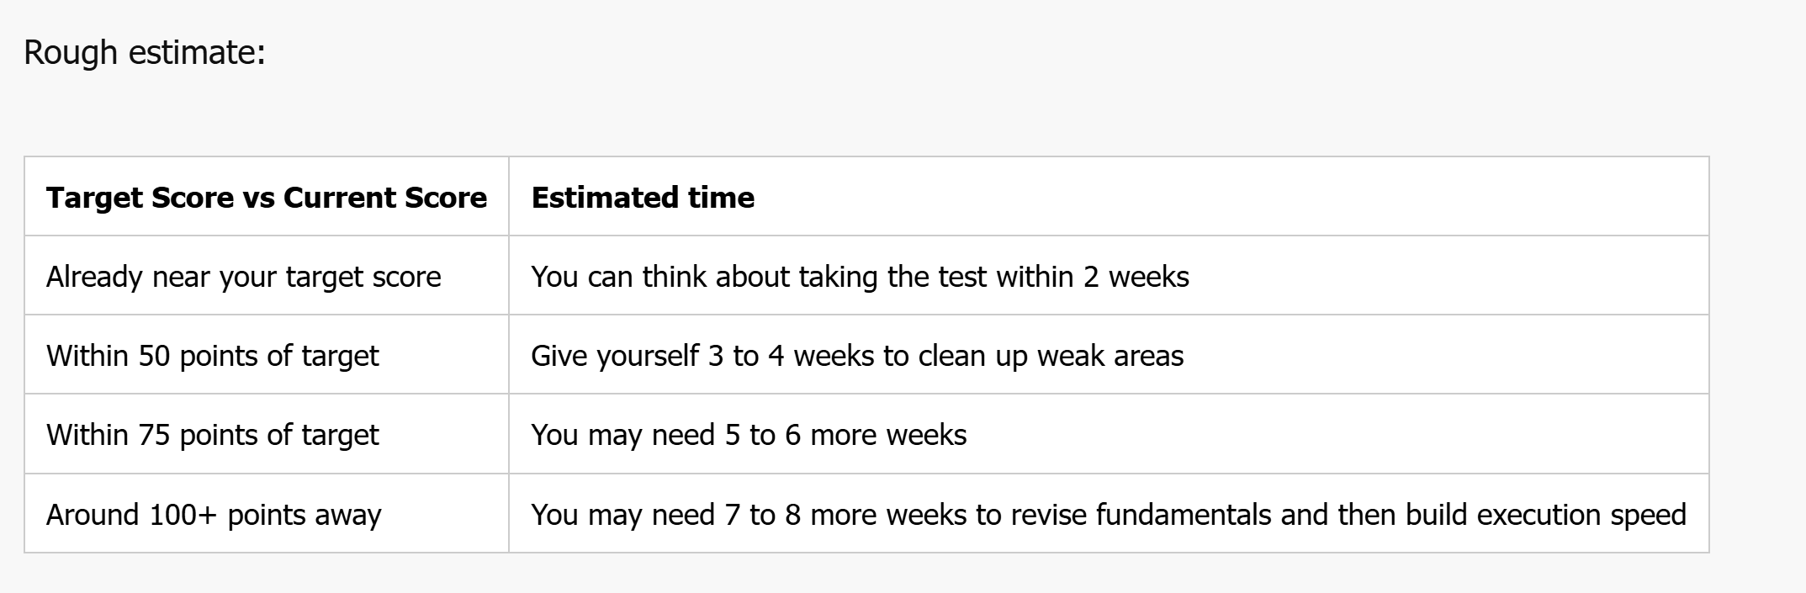

Slide 4
2. Last Month Strategy
Practice
  • Prioritize Official Guide
  • Revisit your error log
  • 30% weak area, 70% mixed practice
Mocks
  • 2 full mocks/week
  • Review your mocks properly
  • Track silly, concept, timing & decision mistakes
Refine
  • Finalize section order after 2 weeks
  • Double down on strengths
  • Protect easy/medium questions in weaker areas
  • 10-15 min meditation if anxiety affects performance

Slide 5
3. Last Week
Focus on Execution
  • Review every official mock taken till date
  • Keep an error log specifically for official mocks
  • Practice in exact exam conditions
  • No new concepts
  • Surround yourself with official material
  • Relax the day before the exam
Goal: Build confidence, not learn something new.

Slide 6
4. Test Day
Before the Test
  • Sleep well & eat light
  • Practice a few easy questions
  • Reach 30 mins early
  • Test your markers
During the Test
  • Think only about the current question
  • Don't overinvest on one question
  • Use breaks wisely (water + light snack)
  • Forget the previous question immediately
  • Enjoy the experience as you can always retake if needed

Slide 7
Choosing Your Section Order
• What section gives you the highest confidence?
• Where do you mentally fatigue?
• Does your mock data support your current order?
Strongest -> Weakest -> Average
Weakest -> Strongest -> Average

Slide 8
Helpful Links
https://www.beatthegmat.com/rocked-the-gmat-scored-800-q51-v51-via-meditation-t282365.html
https://gmatclub.com/forum/what-to-do-30-14-7-3-1-days-before-the-test-152506.html
https://gmatclub.com/forum/timing-strategies-on-the-gmat-206035.html
https://www.gmatninja.com/articles/gmat/basics/how-to-tackle-gmat-anxiety/
https://www.gmatninja.com/articles/test-anxiety/mindfulness-and-mental-performance/how-mindfulness-meditation-can-improve-your-score/
https://gmatwithcj.com/emotional-aspect-gmat/

