Slide 1
GMAT Inequalities
- GMAT Club

Slide 2
((x - 2) * (x - 3)) / (x - 5) <= 0
x < 2
2 < x < 3
(0.5 * -0.5)/-2.5 = +ve
-1 / 0 / 1 / 2.5 / 5 (Substitute)
…-… 2 …+.. 3 ……-…. 5 ………+……
Ans => x <= 2 & 3 <= x < 5
(-infi, 2] & [3, 5)
+ ve * + ve => + ve
- ve * + ve => - ve
- ve * - ve => + ve
(x - 1) * (x - 4) > 0
x < 1 & x > 4

Slide 3
1
QUESTION 1
Rational Inequality
What is the range of x such that
((x − 2)(x + 5)) / (x − 1) < x
A
1 < x < 2.5
B
−5 < x < 1
C
−2 < x < 5
D
x < −5 or x > 1
E
−5 < x < 5

Slide 4
((x – 2)* (x + 5))/(x - 1) < x
(((x – 2)* (x + 5))/(x - 1)) – x < 0
((x^2 + 3x - 10)/(x - 1)) – x < 0
((X^2 + 3x – 10) – (x^2 - x))/(x - 1) < 0
(4x - 10)/(x - 1) < 0
4*(x – 2.5)/(x – 1) < 0
(x – 2.5)/(x - 1) < 0
…+. 1 ….-…. 2.5 …+…

Slide 5
2
QUESTION 2
Reciprocals & Inequalities
If t denotes a negative number such that 1/81 < t² < 1/9, then 1/t must be
A
Less than −9
B
Between −9 and −3
C
Between −3 and 0
D
Between 0 and 3
E
Greater than 9

Slide 6
1/81 < t^2 < 1/9
1/9 < |t| < 1/3
1/9 < t < 1/3 && -1/3 < t < -1/9
-1/3 < t < -1/9
-3 > 1/t > -9
Food for thought -> 1/4 < x < ½ -> 4 > y > 2
-2 < x < 2
-2 < x < -0.1
0.1 < x < 2

Slide 7
3
QUESTION 3
Lattice Point Counting
The number of ordered pairs of integers (x, y) satisfying
x² + y² < 100 and |x| > |y| is
A
120
B
126
C
132
D
138
E
144

Slide 8
-9 < x < 9 && -9 < y < 9
|x| > |y| && x^2 + y^2 < 100
y x
0 +-(1/2/3/4/5/6/7/8/9)
+-1 +-(2/3/4/5/6/7/8/9)
+-2 +-(3/4/5/6/7/8/9)
+-3 +-(4/5/6/7/8/9)
+-4 +-(5/6/7/8/9)
+-5 +-(6/7/8)
+-6 +-(7)
18 + 32 + 28 + 24 + 20 + 12 + 4 = 138

Slide 9
4
QUESTION 4
Absolute Values
If |8x − 1| < |3x + 9|, which of the following CANNOT be the product
of two possible values of x?
A
−3/2
B
−1
C
1/4
D
1
E
3

Slide 10
(8x - 1)^2 < (3x + 9)^2
(8x - 1)^2 - (3x + 9)^2 < 0
(8x – 1 – 3x - 9)(8x – 1 + 3x + 9) <0
(5x - 10)(11x + 8)< 0
(x-2)(x+8/11)<0
-8/11 < x < 2
Smallest product value = -8/11 * 2 = -16/11 = -1.45
Hence, -1.5 is not possible

Slide 11
5
QUESTION 5
Linear Inequalities
If 2x + 3y < 15 and 3x − y ≥ −5, which of the following is true?
A
x > 0
B
y < 5
C
y ≤ 5
D
A and B
E
A and C

Slide 12
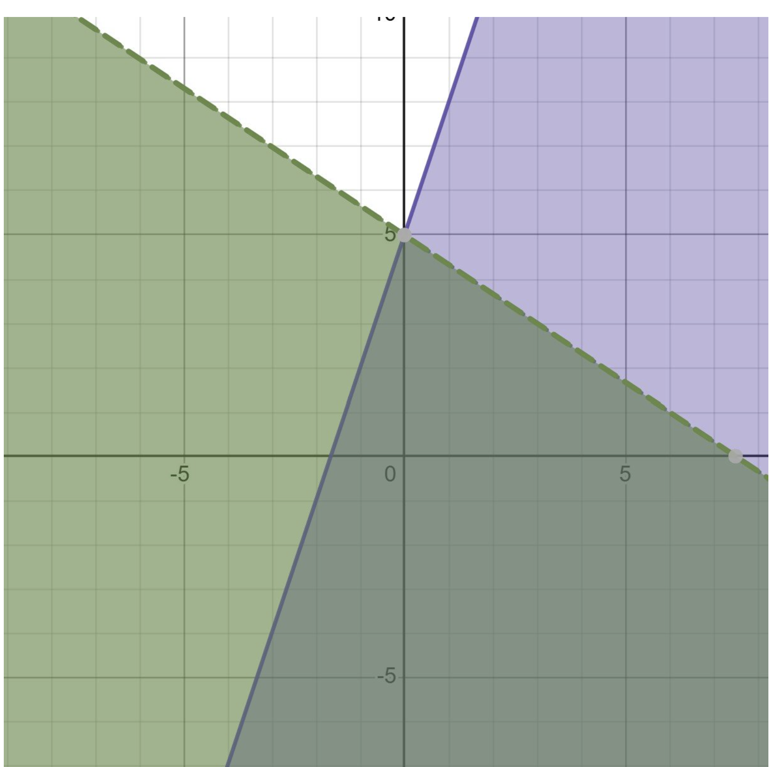
From the graph, B seems to be the right choice

